Slide 1
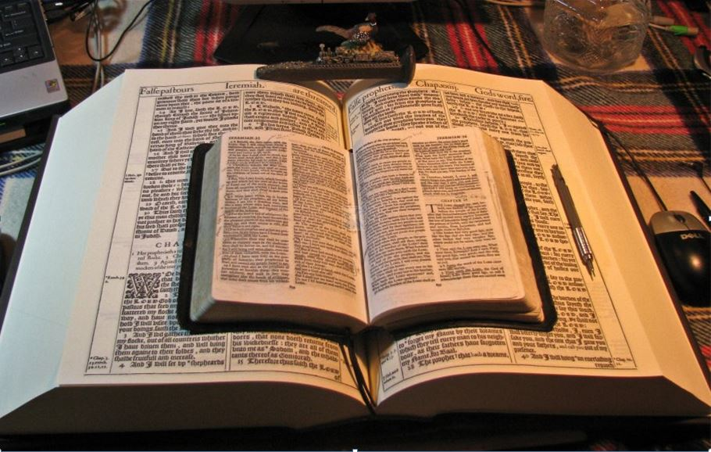
October 2021
…Praise thy name for… thy truth:
for Thou Hast Magnified Thy Word Above All Thy Name
October 2021
Pastors
Titus 1:16
Teachers
Holding fast the faithful word as he hath been taught, that he may be able by sound doctrine both to exhort
and to convince the gainsayers. Titus 1:9
Missionaries
Questions for
Today’s Gainsayers
Professors
Bible Students
Religious
GAINSAYER - One who contradicts or denies what is alleged; an opposer.
Teachings of the Risen Christ as Our Saviour
Doubters
They profess that they know God; but in works they deny him, being abominable, and disobedient, and unto every good work reprobate.
Ignorant
Found only in the
Word of Truth – the
King James 1611 Bible
Parents
Very hateful; detestable; lothesome. applicable to whatever is odious to the mind or offensive to the senses.
Mikel Paulson
2 Gretchen Ln., Bella Vista, AR 72715
sousaman1611@cox.net
www.scatteredchristians.org
www.paulson1611rd.org
YouTube – “Retired Music Educator”
Abandoned in sin; lost to virtue or grace.
Young People
Paul as the ONLY Apostle to the Gentiles
Social
Media
Couch
Scholars
Rightly Dividing
the Word of Truth
by the Apostle Paul Only
Bible Studies from the Risen Saviour Jesus Christ
from a King James 1611 Bible
Teaching the ‘Greater Commission’ According to the Apostle Paul!
Emphasizing the ‘Goodness of God’ During Today’s “Dispensation of the Grace of God.”

Slide 2
Titus 1:7-16
Paul appointed Titus to set in order the things that are wanting, and ordained elders in every city…
Titus 1:7-16
For a bishop must be blameless, as the steward of God;
not selfwilled,
not soon angry, not given to wine,
no striker,
not given to filthy lucre; But a lover of hospitality,
a lover of good men, sober, just, holy, temperate;
Holding fast the faithful word as he hath been taught, that he may be able by sound doctrine both to exhort and to convince the gainsayers.
For there are many unruly and vain talkers and deceivers, specially they of the circumcision: Whose mouths must be stopped, who subvert whole houses, teaching things which they ought not, for filthy lucre's sake. One of themselves, even a prophet of their own, said, The Cretians are alway liars, evil beasts, slow bellies.
This witness is true.
Wherefore rebuke them sharply, that they may be sound in the faith; Not giving heed to Jewish fables, and commandments of men,
that turn from the truth.
Unto the pure all things are pure: but unto them that are defiled and unbelieving is nothing pure; but even their mind and conscience is defiled.
They profess that they know God;
but in works they deny him, being abominable, and disobedient, and unto every good work reprobate.
Titus 1:7-16
Titus 1:7-16

Slide 3
Here are a 'few' questions & comments that show the strict need for rightly dividing the word of truth:
Because the Gospels are still considered Old Testament doctrine, why don’t we try to follow the Levitical law today?
What is the faith OF Jesus Christ and how important is it when compared to OUR faith IN Christ?
Does Acts 8:37 tell us that all we need to believe today is that Jesus is the Son of God?
If we confess our sins according to I John 1:9, are we then forgiven? (to whom? And what if…?
If we believe ourselves to be completely forgiven after we confess our sins according to I John 1:9,
does that make us ‘saved?’ And if so, do we lose our salvation the next time we sin…
at least until our next confession?
And if we believe in baptism ‘before,’ ‘for,’ or ‘after,’ being saved,
do we need to be re-baptized every time we ‘need’ to confess our sins to get ‘saved’ again?
Do we have any sins that we need to have forgiven ‘after’ we are saved in order to maintain our salvation?
If we must still confess our sins, what if we forget one sin?
Can we lose our salvation according to Hebrews 6:1-6?

Slide 4
Here are a 'few' questions & comments that show the strict need for rightly dividing the word of truth:
Hebrews 9:16,17 tells us a ‘forever fact’ that a New Testament doesn't begin until the death of the testator,
so wouldn’t that mean the New Testament does NOT include the Gospels doctrinally!
The utter loss of the soul or of final happiness in a future state; future misery or eternal death.
Hebrews 10:38 tells us that if we ‘draw back’ then we are drawing back into perdition.
Is that possible for us today to ‘draw back’ so far that we can lose our salvation?
Whose faith did the people in Hebrews 11 ’fall back’ on?
The faith OF Jesus Christ or their own faith as they try to follow those Old Testament examples?
If The Book of Hebrews is called Hebrews because it is written TO the Hebrews...
…and then the same with James because it says it is written TO the twelve tribes in verse 1…
then why do ya’ll preach and teach it as TO us Gentiles today?
Peter is called the apostle to the circumcision (Jews) and Paul the apostle to the uncircumcision (Gentiles).
So, tell me again why we should follow Peter?
Should we try to follow Jesus and Paul, etc. by imitating Jesus and Paul and even God like all the modern bibles say?
Are we to ‘follow’ Jesus by trying to walk in his footsteps?
How does baptizing a baby make it a ‘child of God’ when that baby has no conscious ability to believe?...
…and along with that, how can a ‘child’ be a ‘child of God but not have the Holy Spirit until ‘confirmation’ / communion time?

Slide 5
Here are a 'few' questions & comments that show the strict need for rightly dividing the word of truth:
Do we have to endure to the end to maintain our present salvation unto the ‘end’? Matthew 22:14
If after we are saved, a) the Lord does not impute our sins to us, but instead imputes HIS righteousness to us; b) or as it says in Romans 7, it isn’t us sinning but sin that dwells within us, then what sins do we need to worry about/confess?
Can you please explain the participants along with the purposes, description and definition of the
‘judgment seat of Christ’ vs the ‘white throne judgment?’
Is our own forgiveness from God based on whether or not we have forgiven others, as it says in Matthew 6:14,15?
Is Satan walking the earth at this time now, seeking whom he may devour, as it says in I Peter 5:8?
What specific commandments are we to keep if we ‘want to know him,’ according to I John 2:3.
If you say you are anointed, then by the scriptural definition of being anointed (“you need not that any man teach you..”) do you already ‘know everything there is to know’ and if so, do you believe that you cannot be taught anything by anyone else.
If so, would it also be true then, that you don’t need to know any Scripture for your final authority
because Christ ‘tells you everything’ – you ‘know all truth,’ ‘in your heart,’ etc. today? I John 2:27; John 14:26
… and if that is true to you, doesn’t that make you ‘your own final authority’ and so people should go to you for truth and God’s guidance instead of them having to know and study any Scripture?
Does God require us to tithe 10% today?

Slide 6
Here are a 'few' questions & comments that show the strict need for rightly dividing the word of truth:
Can we lose our salvation because we have a ‘brother’ that we hate? I John 3:15.
If we are ‘born of God' and then sin, are we no longer ‘born of God? I John 3:9
Is I John 4:15 our salvation verse for us all today? “Whosoever shall confess that Jesus is the Son of God, God dwelleth in him and he in God.”
I John 5:1 also tells us the same thing – salvation seems to be all based on Whosoever believeth that Jesus is the Christ is born of God... are these our salvation verses for today?
If by believing that Jesus is the Son of God, you overcome the world,
what does it mean to overcome the world? I John 5:5
Which ‘church design’ do you follow? Acts 2:38-47 with the Jews where you try to find favor with all the people, etc. or Ephesians 4:12-16 through Paul for the Gentile local church to feed and help grow spiritually today?
Do you become partakers of the evil deeds of the Mormons, etc.
if you allow them into your house and wish them God’s speed?
II John 10,11
Does/Has God spue the church out of his mouth today because of the lukewarmness of the people?
Revelation 3:16

Slide 7
Here are a 'few' questions & comments that show the strict need for rightly dividing the word of truth:
During the time of great tribulation, why do men try to wrestle what Paul preaches?
Could it be that what Paul preaches is NOT to be preached during the tribulation?
II Peter 3:15,16
Does a sincere Christian today have to ‘worry’ about the law when Romans 10:4 says
'Christ is the end of the law for righteousness to every one that believeth’?
Can you explain how sin is not imputed when there is no law?
Romans 5:13 - (For until the law sin was in the world: but sin is not imputed when there is no law.
We are dead to sin, according to Romans 6:11, so explain that verse, and compare it to the gospels...
Likewise reckon ye also yourselves to be dead indeed unto sin,
but alive unto God through Jesus Christ our Lord.
As a former Gentile now ‘Church of God’ (I Corinthians 10:32), is God my ‘heavenly Father’ as stated in the Gospels but to the Jews only but never used from Paul, the apostle to the Gentiles?
When Matthew 5:9 says to be a child of God, you must be a peacekeeper,
but Galatians says to be a child of God, one must have faith in Christ Jesus.
Which is it?
In order to help people overcome contradictions and confusion in NT doctrine, can you explain the differences in “Jesus’ teachings to the Jews and apostles” before He was crucified and glorified …
when compared to the “teachings of the Risen Jesus Christ” after He rose and went to the Gentiles through Paul?

Slide 8
BONUS
PAGE
Contradictions? Confusion? or Simply not knowing how to rightly divide the word of truth?)
Can you define these terms and understand which ones pertain to us today?(you can’t follow both!)
‘Born again’ or ‘Quicken
Spirit led through your own thoughts, authority, feelings, etc. or Scriptures rightly divided, read and studied with Paul as your only and final authority in all manner of faith and practice.
The Twelve Apostles or the Apostle Paul
The ‘Severity of God’ or the ‘Goodness of God’
Water Baptism or Spirit Baptism
Giving 10% in Tithes and offerings or giving what you can as you esteem your pastor, preacher, teacher.
Local church or ‘Universal’ church
and the body of Christ
Dead IN sins or Dead TO sin
Bondage and/or going back to bondage or true liberty
Kingdom of Heaven or Kingdom of God
Operation made with hands or operation made without hands
Jesus’ teachings to the Jews or the teachings of the risen Christ to the Gentiles
Physical circumcision or Spiritual circumcision
Modern bibles or King James 1611 Bible
In the flesh or separated from the flesh
Original Greek or King James 1611 Bible
New Testament doctrine to us from the pre-glorified Jesus or New Testament after Christ died and rose again.
Modern updated King James Bible and editions
or the King James 1611 Bible
Are the teachings of the apostle Peter TO us today
or
are the teachings from the apostle Paul TO us today

Slide 9
For the Conclusion, picture this:
Let’s say you live in an apartment complex,
and you are asked to go out and get the mail for everyone.
You bring back everyone’s mail, but you first sit down, open and read all the mail.
Naturally, you start getting upset at all the bills. WHY?
That mail was 'for' you to pick up and deliver and you learned a lot about everyone,
but not all of that mail was ‘TO’ you!
Simple, eh!
Study to shew thyself approved unto God, a workman that needeth not to be ashamed,
rightly dividing the word of truth.
But shun profane and vain babblings: for they will increase unto more ungodliness.
II Timothy 2:15,16
Genesis to Revelation is all there FOR us to be comforted as we learn the past, present and future…
For whatsoever things were written aforetime were written for our learning,
that we through patience and comfort of the scriptures might have hope. Romans 15:4
…but only Romans to Philemon is TO us today as Gentiles and Church of God for all matters of faith and practice!
Titus 2:11-15 - For the grace of God that bringeth salvation hath appeared to all men, Teaching us that, denying ungodliness and worldly lusts, we should live soberly, righteously, and godly, in this present world; Looking for that blessed hope,
and the glorious appearing of the great God and our Saviour Jesus Christ; Who gave himself for us,
that he might redeem us from all iniquity, and purify unto himself a peculiar people, zealous of good works.
These things speak, and exhort, and rebuke with all authority. Let no man despise thee.

Slide 10
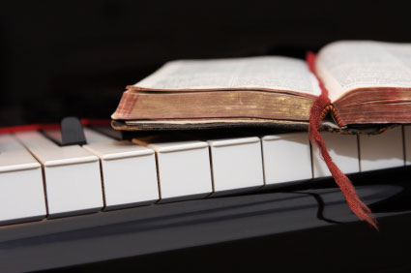
Because of the “goodness of God” that is taught only by Paul and found only in a King James 1611 Bible, I do sincerely hope this video presentation Bible study has brought you to a new level of Biblical Scriptural understanding.
Prepared and presented by:
Mikel Paulson
2 Gretchen Ln, Bella Vista, AR 72715
509-876-1611
www.scatteredchristians.org
www.paulson1611rd.org
sousaman1611@cox.net
Or… maybe you need to experience a ‘new beginning’ in your life based on what you have just learned from the Risen Christ, through Paul, and found only in the King James 1611 Bible.
Remember, it is NOT the ‘severity of God’ that will lead anyone to repentance today.
However, during the time of the coming great tribulation, the severity of God returns and the goodness of God ends… and it does appear to be coming sooner than later!
It is the ‘Goodness of God’ that leadeth ‘thee’ to repentance today, and it is a joyful repentance with the riches of the full assurance of understanding and the peace of God that passeth all understanding!
The goodness of God is ‘still in place’ ‘for’ and ‘to’ us during today’s Dispensation of the Grace of God

Slide 11
Peace be to the brethren,
and love with faith,
from God the Father
and the Lord Jesus Christ.

Slide 12
Grace be with all them
that love our Lord Jesus Christ in sincerity.

Slide 13
Amen
Ephesians 6:23,24

