Slide 1
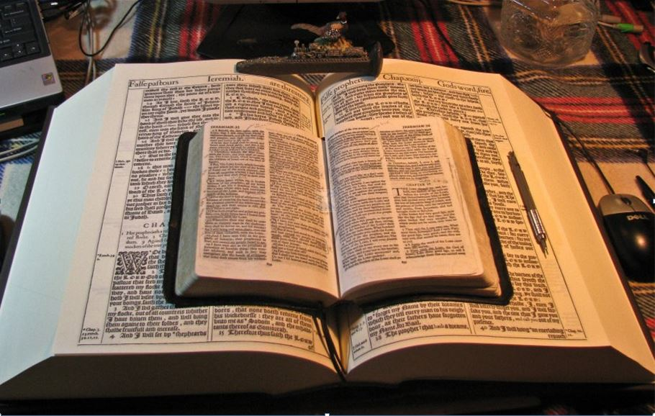
2021
…Praise thy name … for thy truth:
for Thou Hast Magnified Thy Word Above All Thy Name
Today’s
“Dispensation of the Grace of God”
GOODNESS of GOD
The Greatest of All Dispensations!
Mikel Paulson
2 Gretchen Ln., Bella Vista, AR 72715
sousaman1611@cox.net
www.scatteredchristians.org
www.paulson1611rd.org
YouTube – “Retired Music Educator”
Rightly Dividing
the Word of Truth
by the Apostle Paul Only
Bible Studies from the Risen Saviour Jesus Christ
from a King James 1611 Bible
Teaching the ‘Greater Commission’ According to the Apostle Paul!
Emphasizing the ‘Goodness of God’ During Today’s “Dispensation of the Grace of God.”

Slide 2
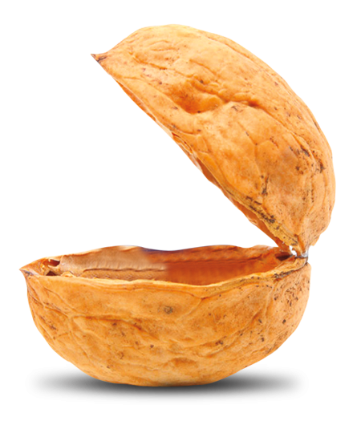
Bonus In a Nutshell
Be not thou therefore ashamed of the testimony of our Lord, nor of me his prisoner: but be thou partaker of the afflictions of the gospel according to the power of God; Who hath saved us, and called us with an holy calling, not according to our works, but according to his own purpose and grace, which was given us in Christ Jesus before the world began,
Paul, a servant of God, and an apostle of Jesus Christ, according to the faith of God's elect, and the acknowledging of the truth which is after godliness; In hope of eternal life, which God, that cannot lie, promised before the world began; Titus 1:1,2
Today is ‘by far’ the greatest of all dispensations
…for now, anyway!
That in the dispensation of the fulness of times he might gather together in one all things in Christ, both which are in heaven, and which are on earth; even in him: Eph 1:10
But we speak the wisdom of God in a mystery, even the hidden wisdom, which God ordained before the world unto our glory:
I Corinthians 2:7
But is now made manifest by the appearing of our Saviour Jesus Christ, who hath abolished death, and hath brought life and immortality to light through the gospel: Whereunto I am appointed a preacher, and an apostle, and a teacher of the Gentiles. II Tim 1:8-11
GOODNESS of GOD
For I would not, brethren, that ye should be ignorant of this mystery, lest ye should be wise in your own conceits; that blindness in part is happened to Israel, until the fulness of the Gentiles be come in. Romans 11:25
Garden
Old Testament and the Law
According as he hath chosen us in him
before the foundation of the world,
that we should be holy and without blame before him in love:
Having predestinated us unto the adoption of children
by Jesus Christ to himself,
according to the good pleasure of his will, Ephesians 1:4,5
Having made known unto us the mystery of his will,
according to his good pleasure which he hath purposed in himself:
That in the dispensation of the fulness of times
he might gather together in one all things in Christ,
both which are in heaven, and which are on earth; even in him:
Gospels was law and belief that He was the Son of God
Tribulation: law and no mark
In whom also we have obtained an inheritance,
being predestinated according to the purpose of him who worketh all things after the counsel of his own will:
That we should be to the praise of his glory,
who first trusted in Christ.
In whom ye also trusted,
after that ye heard the word of truth,
the gospel of your salvation:
in whom also after that ye believed,
ye were sealed with that holy Spirit of promise,
Ephesians 1:9-13
But we are bound to give thanks alway
to God for you,
brethren beloved of the Lord,
because God hath from the beginning
chosen you to salvation
through sanctification of the Spirit
and belief of the truth:
II Thessalonians 2:13
He MAKES us holy and without blame!
Dispensation of the grace of God
Holy and Without Blame

Slide 3
For though I made you sorry with a letter, I do not repent, though I did repent: for I perceive that the same epistle hath made you sorry, though it were but for a season. Now I rejoice, not that ye were made sorry, but that ye sorrowed to repentance: for ye were made sorry after a godly manner, that ye might receive damage by us in nothing. For godly sorrow worketh repentance to salvation not to be repented of: but the sorrow of the world worketh death. II Corinthians 7:8-10
Bonus In a Nutshell
Christ hath redeemed us from the curse of the law, being made a curse for us: for it is written, Cursed is every one that hangeth on a tree: Galatians 3:13
Today is ‘by far’ the greatest of all dispensations
We are QUICKENED – We are ‘made’ alive…
Made able ministers for us who we can trust to ‘say’ it right
and ‘do’ it right!
Stand fast therefore in the liberty wherewith Christ hath made us free, and be not entangled again with the yoke of bondage. Galatians 5:1
Not that we are sufficient of ourselves to think any thing as of ourselves; but our sufficiency is of God; Who also hath made us able ministers of the new testament; not of the letter, but of the spirit: for the letter killeth, but the spirit giveth life. II Cor 3:5,6
In whom we have redemption through his blood, the forgiveness of sins, according to the riches of his grace; Ephesians 1:7
For he hath made him to be sin for us, who knew no sin; that we might be made the righteousness of God in him.
2Co 5:21,
GOODNESS of GOD
To the praise of the glory of his grace, wherein he hath made us accepted in the beloved. Ephesians 1:6
Wherefore, my brethren, ye also are become dead to the law by the body of Christ; Rom 7:4
… that the goodness of God leadeth thee to repentance? Rom 2:4
Made us dead to the law!
Having made known unto us the mystery of his will, according to his good pleasure which he hath purposed in himself: That in the dispensation of the fulness of times he might gather together in one all things in Christ, both which are in heaven, and which are on earth; even in him: Eph 1:9,10
Blessed is the man
to whom the Lord will
not impute sin.
Romans 4:8
Made us redeemed
from the curse of the law!
Made us the righteousness of God!
For he hath made him
to be sin for us,
who knew no sin;
that we might be made…
Made us sorrow to repentance!
And hath raised us up together, and made us sit together in heavenly places in Christ Jesus: Eph 2:6
Made us free from bondage!
Wherefore remember, that ye being in time past Gentiles in the flesh, who are called Uncircumcision by that which is called the Circumcision in the flesh made by hands; That at that time ye were without Christ, being aliens from the commonwealth of Israel, and strangers from the covenants of promise, having no hope, and without God in the world: But now in Christ Jesus ye who sometimes were far off are made nigh by the blood of Christ. For he is our peace, who hath made both one, and hath broken down the middle wall of partition between us; Having abolished in his flesh the enmity, even the law of commandments contained in ordinances; for to make in himself of twain one new man, so making peace;
II Corinthians 5:21
Made us accepted in the beloved!
Made known to us
the mystery of his will!
All of Our Guilt is Gone and Should Stay Gone!
Made us able to sit together in
heavenly places in Christ Jesus!
Unless you can’t forgive yourself and want to still feel guilty
Unless your pastor wants you to feel guilty by you not changing yourself to the Gospels pattern, Beatitudes, etc.
Made us Gentiles and Jews both one!
Unless you choose to ‘follow’ or ‘imitate’ gospel
Jesus, etc. and the apostle’s doctrine.
Made us meet to be partakers of the inheritance of the saints in light!
Giving thanks unto the Father, which hath made us meet to be partakers of the inheritance of the saints in light: Colossians 1:12-14

Slide 4
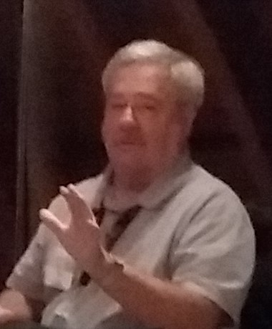
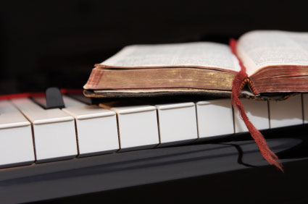
That’s it in a nutshell! Today is by far the greatest dispensation of all dispensations. Because of the “goodness of God” that is taught only by Paul and found only in a King James 1611 Bible during this Dispensation of the Grace of God, I hope this video presentation Bible study will bring to you a new level of understanding.
Or maybe you will experience a ‘new beginning’ in your life based on what you have just learned from the Risen Christ through Paul in the KJB.
Prepared and presented by:
Mikel Paulson
2 Gretchen Ln, Bella Vista, AR 72715
509-876-1611
www.scatteredchristians.org
www.paulson1611rd.org
sousaman1611@cox.net
Or… And thinkest thou this, O man, that judgest them which do such things, and doest the same, that thou shalt escape the judgment of God?
Or despisest thou the riches of his goodness and forbearance and longsuffering; not knowing that the goodness of God leadeth thee to repentance?
But after thy hardness and impenitent heart treasurest up unto thyself wrath against the day of wrath and revelation of the righteous judgment of God;
Romans 2:3-5
Remember, it is NOT the severity of God that will lead anyone to repentance today.
That is for ‘tomorrow,’ during the time of the coming tribulation.
It is the ‘Goodness of God’ that leadeth ‘thee’ to repentance today, and it is a joyful repentance, too… …full of spiritual understanding!
The goodness of God is still in place ‘for’ and ‘to’ us during today’s “Dispensation of the Grace of God,” the greatest of all dispensations!
(for now, anyway)

Slide 5
He which testifieth these things saith,
Surely I come quickly.
Amen.
Even so, come, Lord Jesus.
The grace of our Lord Jesus Christ
be with you all. Amen.

Slide 6
It is Finished

