Slide 1
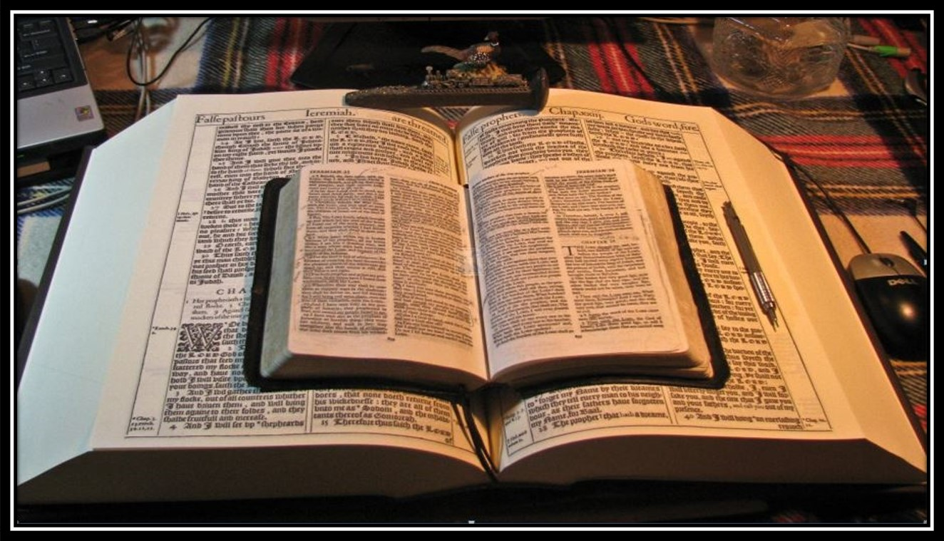
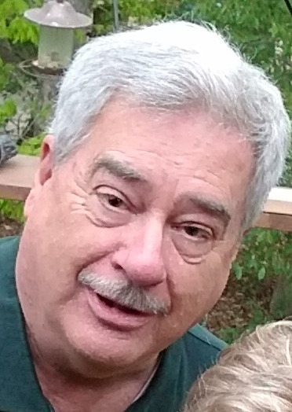
Pause and Study
2022 For Thou Hast Magnified Thy Word Above All Thy Name 2022
Pause and Study
The King James 1611 Bible
We began part I by Scripturally identifying the people that are religiously confused or believe they can deny, ignore, reject, mock, scoff or in some way or another, think they can escape the judgment of God in their own way or belief. Romans 1:17-2:10
Romans 2:1-16
In part II, we learn specifics about the Judgment of God. We will fully understand how those same people will not escape the judgment of God. As a bonus, you will learn how to truly ‘escape’ the judgment of God! Romans 2:5-11
The Righteous Judgment of God
According to the Truth of Apostle Paul’s Gospel!
In the day when God shall judge the secrets of men
by Jesus Christ according to my gospel. Romans 2:16
2:1,2
Therefore thou art inexcusable, O man, whosoever thou art that judgest:
for wherein thou judgest another,
thou condemnest thyself;
for thou that judgest doest the same things.
But we are sure that the judgment of God
is according to truth
against them which commit such things.
Part II
“Judgment from a Just and Holy God”
3,4
And thinkest thou this, O man,
that judgest them which do such things,
and doest the same,
that thou shalt escape the judgment of God?
Or despisest thou the riches of his goodness and forbearance and longsuffering;
not knowing that the
goodness of God leadeth thee to repentance?
Teaching Paul’s ‘Greater Commission’
emphasizing the ‘Goodness of God’
during today’s ‘Latter Times’ in the
“Dispensation of the Grace of God”
as we draw nearer to the ‘Last Days’!
Rightly Dividing the Word of Truth in the King James 1611 Bible according to the apostle Paul
Bible Sermon Presentations of
the Risen Saviour Jesus Christ
from a King James 1611 Bible
Mikel Paulson 2 Gretchen Ln Bella Vista, AR 72715
email: sousaman1611@cox.net cell: 509-876-1611
websites: www.paulson1611.org / www.scatteredchristians.org

Slide 2
Now, let’s move on and look at the main chunk of this study/commentary
Part II verses 5-11
The Righteous Judgment of God
There is No Respect of Persons with God
He is the Rock, his work is perfect: for all his ways are judgment: a God of truth and without iniquity, just and right is he. Deuteronomy 32:4
(At your first reading here, you would think that in order for anyone to ‘go to heaven after they die,’ they must have been doing a bunch of good godly works,
have a general belief in God, be a church-goin’ person, been water baptized, partaken in communion somewhere, confirmed with a love to worship with all kinds of music, ignoring doctrinal differences, being led by the Spirit of God by your own feelings and conclusions, etc. and of course, have plenty of confession time.)
2:6-11
Who will render to every man according to his deeds:
To them who by patient continuance in well doing
seek for glory and honour and immortality, eternal life:
…also of the Gentiles / Heathen / Us
…of the Jews / Israel first
If any man teach otherwise,
and consent not to wholesome words,
even the words of our Lord Jesus Christ, and to the doctrine which is
according to godliness;…
Therefore I said, Surely these are poor; they are foolish: for they know not the way of the LORD, nor the judgment of their God. Jer 5:4
But unto them that are contentious, and do not obey the truth,
but obey unrighteousness, indignation and wrath,
Tribulation and anguish, upon every soul of man that doeth evil,
of the Jew first, and also of the Gentile;
(Said by Jeremiah directly to the Jews during the OT as they had rejected the words of the LORD! (p.s. - exactly like the Gentile nation is doing today, and as warned by Paul to us today only in a KJB!)
…He is proud, knowing nothing,
but doting about questions and
strifes of words, whereof cometh envy, strife, railings, evil surmisings, Perverse disputings of men of corrupt minds, and destitute of the truth, supposing that gain is godliness: from such withdraw thyself. I Timothy 6:3-5
But glory, honour, and peace, to every man that worketh good,
to the Jew first, and also to the Gentile:
But neither he, nor his servants, nor the people of the land, did hearken unto the words of the LORD, which he spake by the prophet Jeremiah. Jeremiah 37:2
For there is no respect of persons with God.
However, by us looking to the teachings of the RISEN Christ, through the apostle Paul, in a rightly divided King James 1611 Bible, we can joyfully learn that God’s judgment is not applicable to us today!
For they that are such serve not our Lord Jesus Christ, but their own belly; and by good words and fair speeches deceive the hearts of the simple. Romans 16:18
Now to him that is of power to stablish you according to my gospel, and the preaching of Jesus Christ, according to the revelation of the mystery, which was kept secret since the world began… Romans 16:25

Slide 3
Remember: The judgment of God has always remained the same
since the beginning of time, it still is the same today and always will be!
According as he hath chosen us in him before the foundation of the world,
that we should be holy and without blame before him in love: Ephesians 1:4
As we learned from Paul, we see that the risen Christ MAKES and KEEPS us holy and without blame on the inside - NOW!
Who shall also confirm you unto the end,
that ye may be blameless in the day of our Lord Jesus Christ. I Corinthians 1:8
Our judgment seat of Christ will take care of the ‘outside’ works later.
And the very God of peace sanctify you wholly;
and I pray God your whole spirit and soul and body be preserved blameless
unto the coming of our Lord Jesus Christ. I Thessalonians 5:23
The Final Eternal Product
However, the difference during today's dispensation of the grace of God, and following Christ’s death and resurrection,
Christ Himself actually pays for our (heathen/Gentile) ‘sin and sins’ and takes God’s judgment upon Himself… ‘for’ us!
In other words, “The Risen Christ MAKES us free!” “The Risen Christ MAKES us holy and without blame!”
For where a testament is, there must also of necessity be the death of the testator.
For a testament is of force after men are dead: otherwise it is of no strength at all while the testator liveth. Hebrews 9:16,17
One final reminder - this can be all true for you, but ‘ONLY IF’ you have put your faith and trust in and on the risen Saviour! Truth – we are able to escape Satan’s deceitfully subtle physical and spiritually seductive snares and darts that are found in false man-made religions of ‘good works’ and self-righteousness, rituals, confessions, baptisms, communion rituals, wafers, inner false ‘anointed’ feelings, signs, wonders and miracles as taught by fancy evil seducing preachers with their good words and fair speeches from the many denominations who are all following over 400+ various modern bible versions.
Above all, taking the shield of faith, wherewith ye shall be able to quench all the fiery darts of the wicked.
And take the helmet of salvation, and the sword of the Spirit, which is the word of God: Ephesians 6:16,17.
That if thou shalt confess with thy mouth the Lord Jesus, and shalt believe in thine heart that God hath raised him from the dead, thou shalt be saved.
For with the heart man believeth unto righteousness; and with the mouth confession is made unto salvation. Romans 10:9,10
…who first trusted in Christ. In whom ye also trusted, after that ye heard the word of truth, the gospel of your salvation:
in whom also after that ye believed, ye were sealed with that holy Spirit of promise… Ephesians 1:12b,13

Slide 4
Remember: The judgment of God has always remained the same
since the beginning of time, it still is the same today and always will be!
According as he hath chosen us in him before the foundation of the world,
that we should be holy and without blame before him in love: Ephesians 1:4
As we learned from Paul, we see that the risen Christ MAKES and KEEPS us holy and without blame on the inside - NOW!
Who shall also confirm you unto the end,
that ye may be blameless in the day of our Lord Jesus Christ. I Corinthians 1:8
Our judgment seat of Christ will take care of the ‘outside’ works later.
And the very God of peace sanctify you wholly;
and I pray God your whole spirit and soul and body be preserved blameless
unto the coming of our Lord Jesus Christ. I Thessalonians 5:23
The Final Eternal Product
However, the difference during today's dispensation of the grace of God, and following Christ’s death and resurrection,
Christ Himself actually pays for our (heathen/Gentile) ‘sin and sins’ and takes God’s judgment upon Himself… ‘for’ us!
In other words, “The Risen Christ MAKES us free!” “The Risen Christ MAKES us holy and without blame!”
For where a testament is, there must also of necessity be the death of the testator.
For a testament is of force after men are dead: otherwise it is of no strength at all while the testator liveth. Hebrews 9:16,17
However, if you think you are able to escape Satan’s deceitfully subtle physical and spiritually seductive snares and darts by…
1) following your false man-made religions of ‘good works’ and self-righteousness, rituals, confessions, baptisms, communion rituals, wafers, inner false ‘anointed’ feelings, signs, wonders and miracles as taught by fancy evil seducing preachers with their good words and fair speeches from the many denominations who are all following over 400+ various modern bible versions, or… 2) ignoring it all and living life and the ways of the world to the fullest, or…3) rejecting God totally…
…you will be without excuse (Rom 1:20-32), having become vain in your imaginations; with a darkened foolish heart; professing yourself to be wise, but becoming fools; serving the creature more than the Creator; living unto vile affections, receiving in yourselves that recompence of your own error with a God-given reprobate mind, now being a person who at one time knew the judgment of the very living God through the risen Jesus Christ you are rejecting, you are worthy of death and dead in your sins. Eph 2:1,4; Col 2:13
But after thy hardness and impenitent heart treasurest up unto thyself wrath against the day of wrath and revelation of the righteous judgment of God; Who will render to every man according to his deeds: To them who by patient continuance in well doing seek for glory and honour and immortality, eternal life: But unto them that are contentious, and do not obey the truth, but obey unrighteousness, indignation and wrath, Tribulation and anguish, upon every soul of man that doeth evil, of the Jew first, and also of the Gentile; Rom 2:5-9

Slide 5
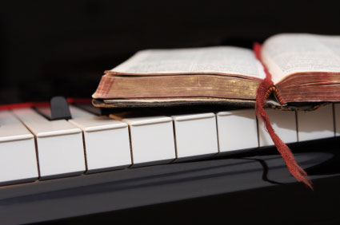
Because of the “goodness of God” that is taught only by Paul and found only in a King James 1611 Bible, I sincerely hope this Bible study/commentary presentation has brought you to a new level of Biblical / Scriptural awareness and understanding…
This presentation was created and presented by
Mikel Paulson
2 Gretchen Ln, Bella Vista, AR 72715 509-876-1611 www.scatteredchristians.org www.paulson1611rd.org
Email: sousaman1611@cox.net
…or maybe you just need to receive that ‘new beginning’ with a soul saving ‘quickening’ in your life based on what you have just learned from the Risen Christ, through Paul, and as found only in the King James 1611 Bible.
It is the ‘goodness of God’ that leadeth thee to repentance today, and it is a peaceful and excitingly joyful repentance with
the riches of the full assurance of understanding
and the peace of God that passeth all understanding.
Romans 2:4; Colossians 2:2; Philippians 4:7
Remember, it is NOT the ‘severity of God’ that will lead you or anyone else to repentance today.
However, during the coming ‘time of great tribulation,’ this marvelous ‘goodness of God’ ends and the ‘severity of God’ returns! (and I personally do believe that this ‘time of great tribulation’ appears to be coming soon than we ever realized before!)
For then shall be great tribulation, such as was not
since the beginning of the world to this time, no,
nor ever shall be. Matthew 24:21
Alas, be comforted today: The goodness of God is still in place ‘for’ us and ‘to’ us during this Dispensation of the Grace of God.

Slide 6
Charity never faileth:
but whether there be prophecies, they shall fail;
whether there be tongues, they shall cease;
whether there be knowledge, it shall vanish away.
For we know in part, and we prophesy in part.
But when that which is perfect is come,
then that which is in part shall be done away.
I Corinthians 13:8-10
“That which is perfect” came in 1611.
It was, still is and always will be the King James 1611 Bible
Behold, the days come, saith the Lord GOD,
that I will send a famine in the land,
not a famine of bread,
nor a thirst for water,
but of hearing the words of the LORD:
And they shall wander from sea to sea,
and from the north even to the east,
they shall run to and fro to seek the word of the LORD,
and shall not find it.
In that day shall the fair virgins and young men
faint for thirst.

Slide 7
One more time and I will tell you it won’t be my last… but it is so incredibly important in order to simply understand the Scriptures:
That while we realize that Genesis to Revelation was all written ‘FOR’ all of us according to Romans 15:4,
For whatsoever things were written aforetime were written for our learning,
that we through patience and comfort of the scriptures might have hope…
…we must also realize and remember that God is directing Paul’s books ‘TO’ the Gentiles/Heathen - US…
Romans 11:13 - For I speak to you Gentiles, inasmuch as I am the apostle of the Gentiles, I magnify mine office:
I Timothy 2:7 - Whereunto I am ordained a preacher, and an apostle, (I speak the truth in Christ, and lie not;)
a teacher of the Gentiles in faith and verity.
II Timothy 1:11 - Whereunto I am appointed a preacher, and an apostle, and a teacher of the Gentiles.
…and that also includes those who think the judgment of God is ‘not fair’ or even ‘not true’, etc.
We see that the Judgment of God IS fair and includes everyone, believe it or not!
The simple and obvious truth is that during today’s dispensation of the grace of God,
God provided Himself and gave us the option to stand before Him on your terms
or put your faith and trust on Him to take your judgment Himself!
Don’t wait until it is too late because then you will have no choice.
You will stand before God ‘dead in your trespasses and sins’
…despisest thou the riches of his goodness and forbearance and longsuffering;
not knowing that the goodness of God leadeth thee to repentance? Romans1` 2:4
Even when we were dead in sins, hath quickened us together with Christ, (by grace ye are saved;) Ephesians 2:5

Slide 8
“That which is perfect” came in 1611.
It was, still is, and always will be
the King James 1611 Bible
Believe it or not!

