Slide 1
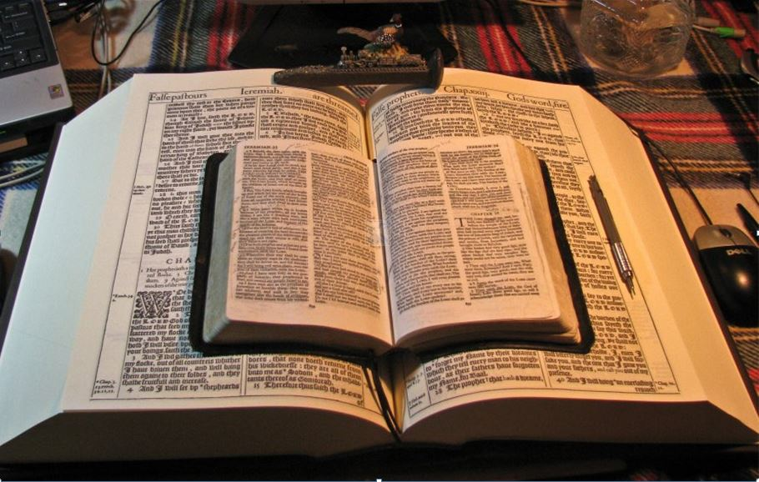
…Praise thy name for thy lovingkindness and for thy truth:
for Thou Hast Magnified Thy Word Above All Thy Name
Acts 17:16-34
Our Ensample On Mars’ Hill
Learning from Paul on Today’s Modern Church-Going Christian!
Brethren, be followers together of me,
and mark them which walk so
as ye have us for an ensample.
Philippians 3:17
Mikel Paulson
2 Gretchen Ln., Bella Vista, AR 72715
sousaman1611@cox.net
www.scatteredchristians.org
www.paulson1611rd.org
YouTube – “Retired Music Educator”
Rightly Dividing
the Word of Truth
by the Apostle Paul Only
Bible Studies from the Risen Saviour Jesus Christ
from a King James 1611 Bible
Teaching the ‘Greater Commission’ According to the Apostle Paul!
Emphasizing the ‘Goodness of God’ During Today’s “Dispensation of the Grace of God.”

Slide 2
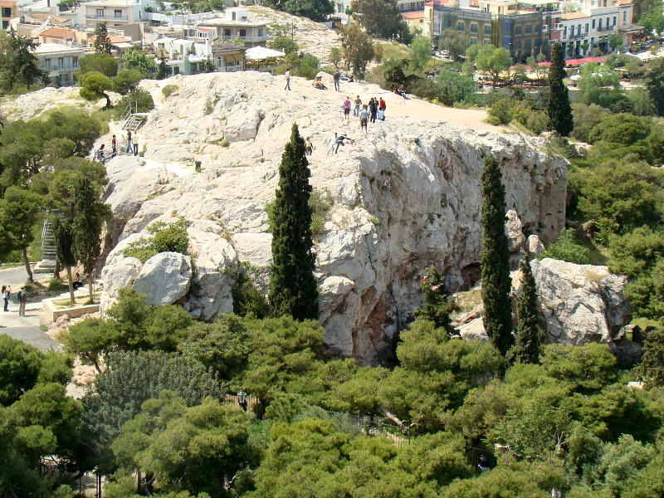
Our Ensample On Mars’ Hill

Slide 3
Before we get started: Example or Ensample?
It matters enough for the Scriptures to use both words – ‘example’ and ‘ensample’!
They are each used in different ways because they have different meanings.
Surely any ordinary person can see that ‘en’ on the front of a word means something to do with ‘in’.
For example, without getting all complicated and just keeping it basic, an entrance is the way in.
In the same way ‘ex’ on the front of a word means something to do with ‘out’
For example, an exit is the way out.
The word “ensamples” has to do with that which reflects within the group referred to; the Israelites – ‘do in the same manner.’
The word “examples” has to do with that which radiates to outside of the group where it took place, ‘learn from.’
Consider how the verses actually read:
Now these things were our examples, to the intent we should not lust after evil things, as they also lusted. (1 Cor 10:6)
These things that happened show us [Paul, the Corinthian assembly, any believers (1 Cor 1:2) and us] what we should not do.
Now all these things happened unto them for ensamples: and they are written for our admonition, upon whom the ends of the world are come. (1 Cor 10:11) These things that happened were to show them [the Israelites] what they should not do,
however, for us, they are written [Paul, the Corinthian assembly, any believers (1 Cor 1:2) and us today] to ‘learn from,’ not just ‘do in the same manner.’
Ok, one more thing… let’s set up the background to this story.
OK, now we can begin - Paul’s Ensample!
Acts 17:10-15 - And the brethren immediately sent away Paul and Silas by night unto Berea: who coming thither went into the synagogue of the Jews. These were more noble than those in Thessalonica, in that they received the word with all readiness of mind, and searched the scriptures daily, whether those things were so.
Therefore many of them believed;
also of honourable women which were Greeks, and of men, not a few.
But when the Jews of Thessalonica had knowledge that the word of God was preached of Paul at Berea, they came thither also, and stirred up the people. And then immediately the brethren sent away Paul to go as it were to the sea: but Silas and Timotheus abode there still. And they that conducted Paul brought him unto Athens: and receiving a commandment unto Silas and Timotheus for to come to him with all speed, they departed.
Acts 17:16-17
Now while Paul waited for them at Athens,
his spirit was stirred in him,
when he saw the city wholly given to idolatry.
Therefore disputed he in the synagogue with the Jews,
and with the devout persons,
and in the market daily with them that met with him.

Slide 4
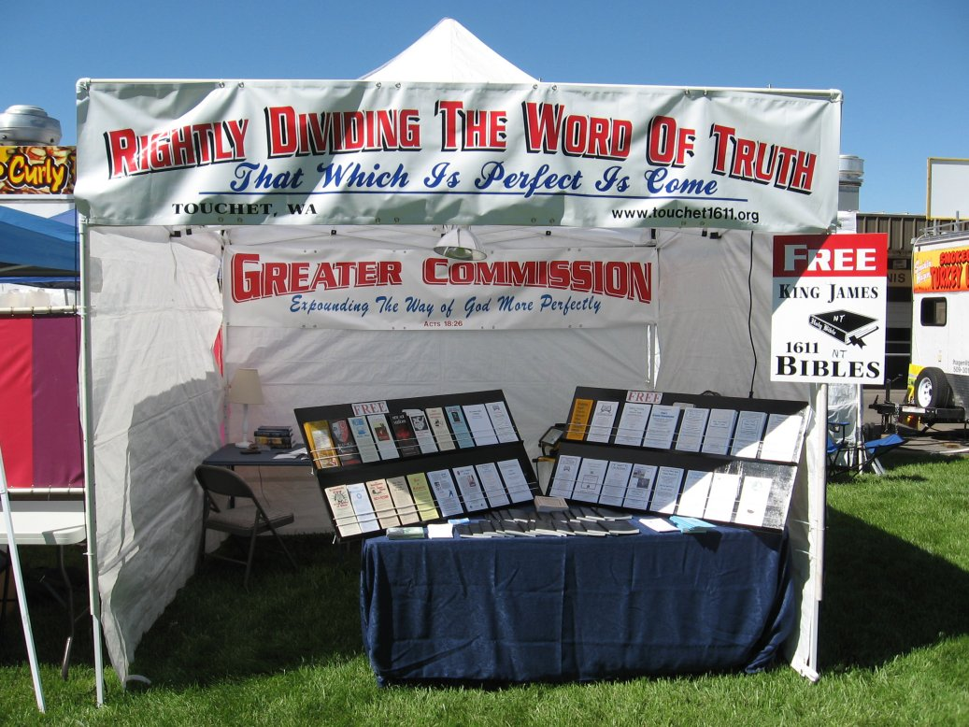
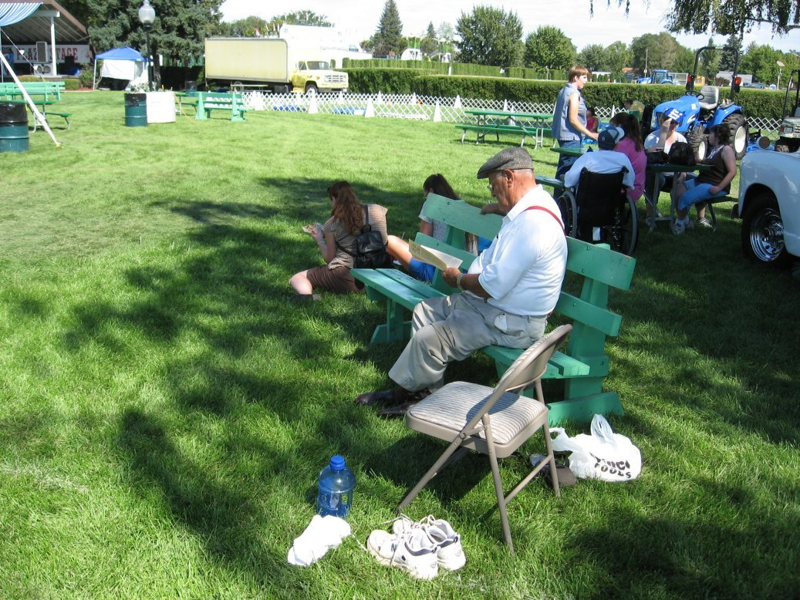
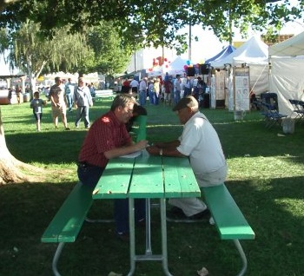
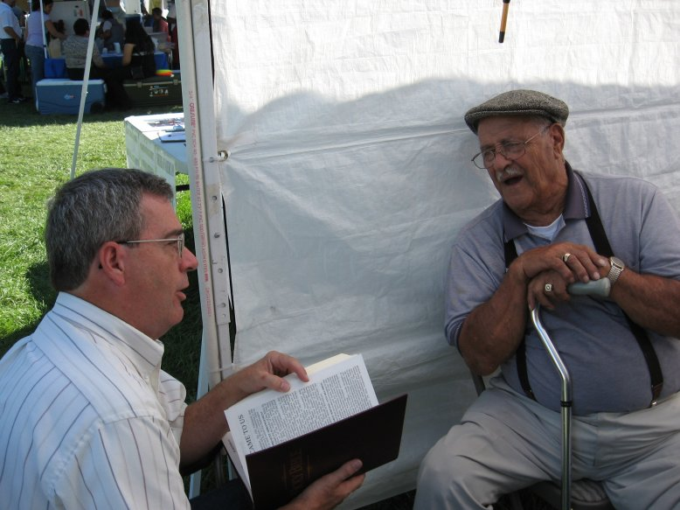
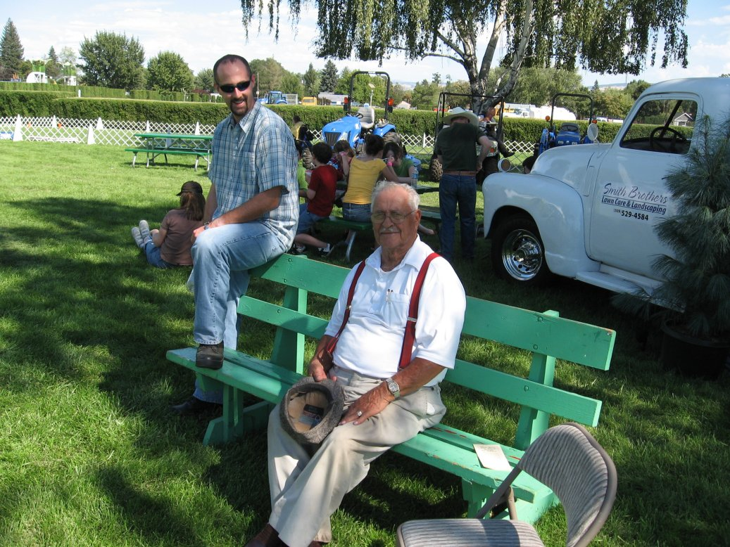
Now while we waited for them at our booth, our spirit was stirred in us,
when we saw the people wholly given to idolatry.
Therefore disputed we in the fairgrounds with the fairgoers, and with the lost as well as with the religious and devout persons, and in the booth daily with them that met with us.

Slide 5
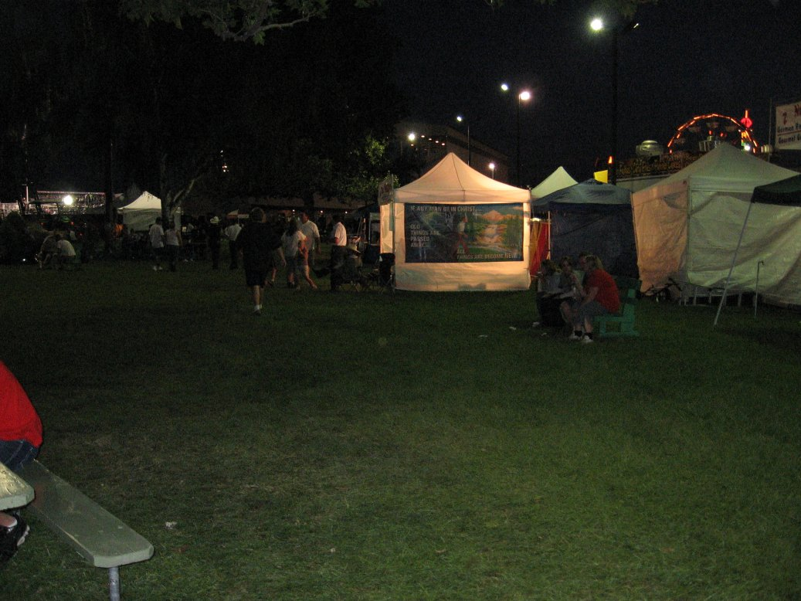
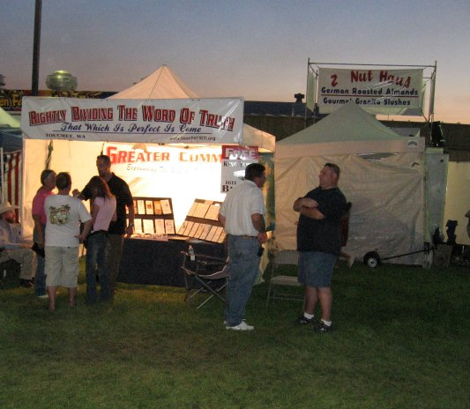
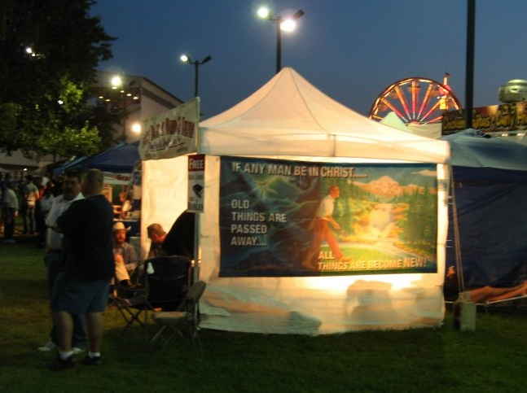
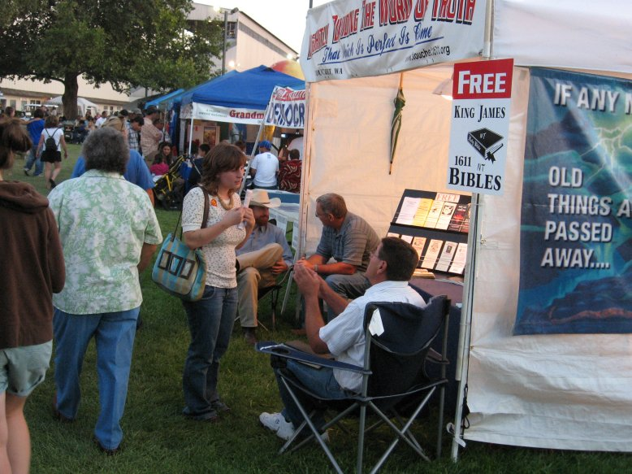
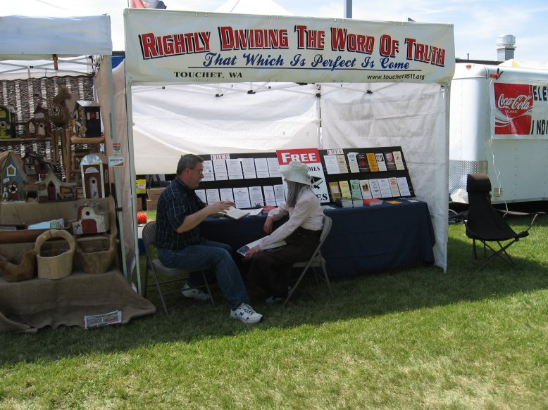
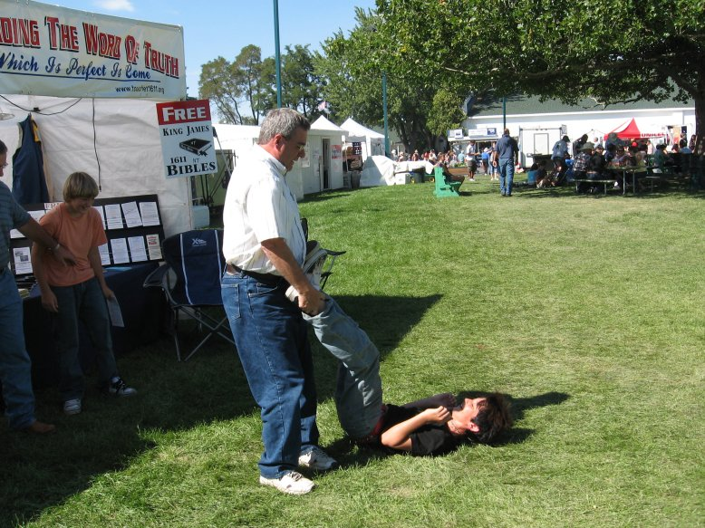
Now while we waited for them at our booth, our spirit was stirred in us,
when we saw the people wholly given to idolatry.
Therefore disputed we in the fairgrounds with the fairgoers, and with the lost as well as with the religious and devout persons, and in the booth daily with them that met with us.

Slide 6
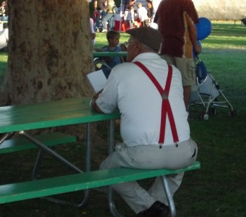
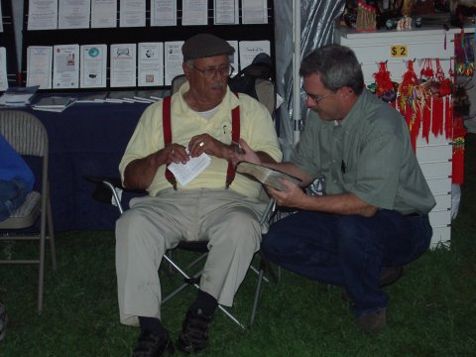
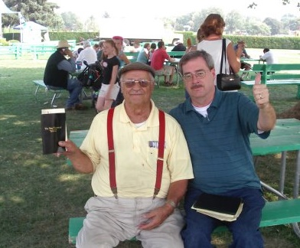
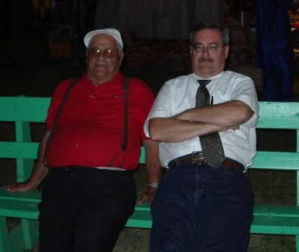
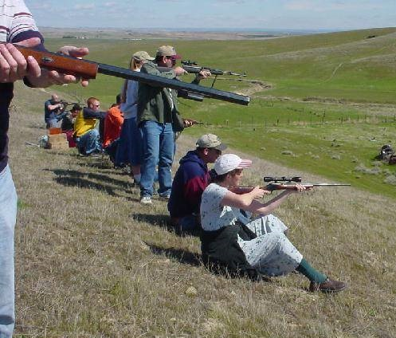
Now while we waited for them at our booth, our spirit was stirred in us,
when we saw the people wholly given to idolatry.
Therefore disputed we in the fairgrounds with the fairgoers, and with the lost as well as with the religious and devout persons, and in the booth daily with them that met with us.

Slide 7
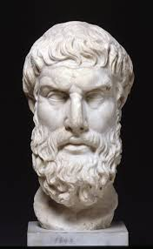
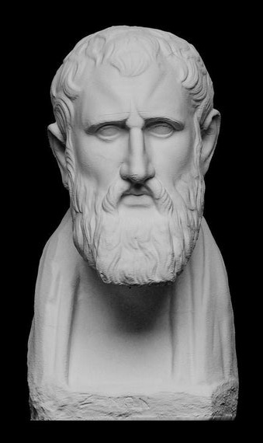
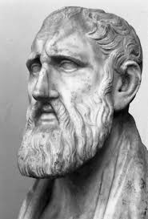
Acts 17:18a - Then certain philosophers of the Epicureans, and of the Stoicks, encountered him.
Epicureans
Stoicks
1. Luxurious; given to luxury; contributing to the luxuries of the table. a disciple or student of the Greek philosopher Epicurus.
2. a person devoted to sensual enjoyment, especially that derived from fine food and drink.
A member of a school of philosophy founded by Zeno of Citium about 300 B.C. holding that the wise man should be free from passion, unmoved by joy or grief, and submissive to natural law; one apparently or professedly indifferent to pleasure or pain.
The word "stoic" commonly refers to someone who is indifferent to pain, pleasure, grief, or joy. The modern usage as a "person who represses feelings or endures patiently" was first cited in 1579 as a noun and in 1596 as an adjective.
Following the Cyrenaic philosopher Aristippus, Epicurus believed that the greatest good was to seek modest, sustainable pleasure in the form of a state of ataraxia (tranquility and freedom from fear) and aponia (the absence of bodily pain) through knowledge of the workings of the world and limiting desires.
When you're stoic, you don't show what you're feeling and you also accept whatever is happening. The noun stoic is a person who's not very emotional.
Stoic Principles
Nature: Nature is rational.
Law of Reason: The universe is governed by the law of reason. ...
Virtue: A life led according to rational nature is virtuous.
Wisdom: Wisdom is the root virtue. ...
Apathea: Since passion is irrational, life should be waged as a battle against it.
For Epicurus, pleasure is tied closely to satisfying one's desires.
He distinguishes between two different types of pleasure:
1) 'moving' pleasures and 2) 'static' pleasures
Epicurus thinks the greatest destroyer of happiness is:
1) anxiety about the future,
2) fear of the gods and fear of death.
The Stoics lived a lifestyle of virtue, dividing virtue into four main types:
Wisdom, justice, courage, and moderation
with wisdom being subdivided into good sense, good calculation,
quick-wittedness, discretion, and resourcefulness.
The Difference between the Stoics and the Epicureans:
The Stoics cared about virtuous behavior and living according to nature…
The Epicureans were all about avoiding pain and seeking natural and necessary pleasure.

Slide 8
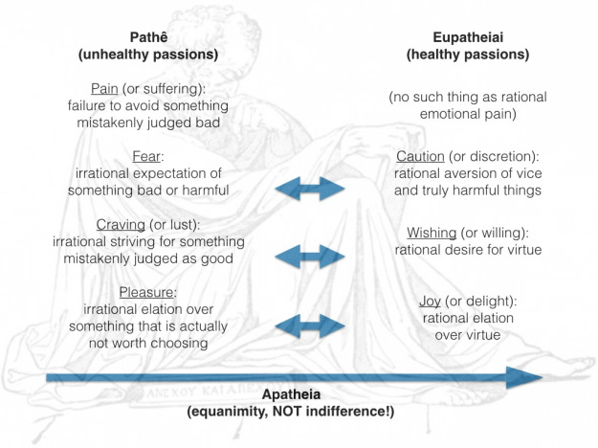
For it is written, I will destroy the wisdom of the wise, and will bring to nothing the understanding of the prudent. Where is the wise? where is the scribe? where is the disputer of this world? hath not God made foolish the wisdom of this world? For after that in the wisdom of God the world by wisdom knew not God, it pleased God by the foolishness of preaching to save them that believe. I Corinthians 1:19-21
Therefore, even when you read a familiar word like “fear,” don’t think of the fight-or-flight response that is indeed unavoidable when we are suddenly presented with a possible danger. What the Stoics meant by “fear” was what comes after that: your considered opinion about what caused said instinctive reaction.
Stoic psychology was subtle: they knew that we have automatic responses that are not under our control. That’s why they focused on what is under our control: the judgment rendered on the likely causes of our instinctive reactions, a judgment rendered by what Marcus called the ruling faculty (the executive function of the brain).
Again, take a look at the below diagram: pain is not the simple sensation of pain but the failure to avoid something that we mistakenly judge bad. Similarly, for the other pathê: fear is the irrational expectation of something bad or harmful; craving is the irrational striving for something mistakenly judged as good; and pleasure is the irrational elation over something that is actually not worth choosing.
Contrariwise, the eupatheiai are the result of a rational aversion of vice and harmful things (discretion), a rational desire for virtue (willing), and a rational elation over virtue (delight).
A major difference between the two schools is that the Stoics thought the pivotal thing in life is virtue and its cultivation, while the Epicureans thought that the point was to seek pleasure and especially avoid pain.
Nonetheless, both schools thought that a crucial component of eudaimonia (the flourishing life) was something very similar, to which the Stoics referred to as apatheia (literally “being without passions”) and the Epicureans as ataraxia (literally “tranquility”).
There are, however, some differences between the two concepts, especially in the way the two schools taught one could achieve, or at the least approximate, the respective states of mind.
The Internet Encyclopedia of Philosophy has a good entry on Epictetus, which comes with a useful glossary of Stoic terms. Here is what it says about the matter under examination:
apatheia: freedom from passion, a constituent of the eudaimôn life
ataraxia: imperturbability, literally “without trouble,” sometimes translated as “tranquillity”; a state of mind that is a constituent of the eudaimôn life.
So, both apatheia and ataraxia are components of the eudaimonic life, and indeed, while the second term is usually associated with the Epicureans, both schools used it.
As far as the Stoics are concerned, it is good to remember that “passion” didn’t mean what we now mean by that term, and indeed it didn’t even mean “emotion” in the modern sense of the term. That’s why it is grossly incorrect to say that the Stoics aimed at a passionless life, or at the suppression of emotion.
Indeed, they divided the “passions” into unhealthy and healthy ones. The first group included pain, fear, craving, and pleasure. The second one “discretion,” “willing,” and “delight.” The latter three where the opposite of the first group, except for pain, which does not have a positive counterpart.
So for the Stoics the “passions” are not automatic, instinctive reactions that we cannot avoid experiencing. Rather, they are the result of a judgment, giving “assent” to an “impression.”

Slide 9
BASIC PRINCIPLES FOR THE MODERN EPICUREAN
Epicureanism is a vital way of living which free you from a life
of unhappiness, fear and anxiety.
Epicureanism is a missionary philosophy, and while epicureans have written scholarly works, they have always been very interested in explaining this way of life in a manner simple enough for anyone to understand and remember.
The following eight counsels are a basic guide to Epicurean living.
1) Don’t fear God. 2) Don’t worry about death. 3) Don’t fear pain. 4) Live simply. 5) Pursue pleasure wisely. 6) Make friends and be a good friend. 7) Be honest in your business and private life. 8) Avoid fame and political ambition.
Stoicism is a way of living that focuses intensely on
Reality instead of Fantasy or Idealism.
Stoicism is very present-moment focused and
helps you deal with things such as:
the whims and wiles of human nature (aka social intelligence)
sickness and old age
falling in and out of “fortune”
living life to the fullest
The Stoics believe a variety of things,
but most of them center around creating a strong internal locus of control.
An internal locus of control is when you have the belief that
you are responsible for your success or failure in this world.
You can’t use your childhood, how you were brought up, or things that happened to you in the past as an excuse for passivity and being a victim.
Thoughts from a Stoic: For those of us who live our lives in the real world, there is one branch of philosophy created just for us: Stoicism. It’s a philosophy designed to make us more resilient, happier, more virtuous and more wise and as a result, make us a better people, better parents and better professionals.
Ten Basic Epicurean Values
Epicureanism is a deeply ethical and rational way of life which was immensely popular for almost five hundred years (approximately 300 B.C. to 200 A.D.). Based upon a thoroughly scientific understanding of the universe, it teaches that the way to happiness is simple and available to everyone. Here are some of its most cherished values.
Stoicism has been a common thread though some of history’s great leaders. It has been practiced by Kings, presidents, artists, writers and entrepreneurs. Marcus Aurelius. Frederick the Great, Montaigne, George Washington, Thomas Jefferson, Adam Smith, John Stuart Mill, Theodore Roosevelt, General James Mattis, - just to name a few - were all influenced by Stoic philosophy.
These have to do with ourselves
1) Prudence 2) Self-management 3) Self-sufficiency 4) Serenity 5) Simplicity
These have to do with our relationship with others
6) Friendliness 7) Honesty 8) Generosity 9) Cheerfulness 10) Gentleness
P.S. The Stoics often identified the universe and God with Zeus, as the ruler and upholder, and at the same time the law, of the universe. ... In one sense the Stoics believed that this is the best of all possible worlds. Only God as Nature is good, and Nature is perfectly rational.
Courage; Temperance; Justice; Wisdom. They are the most essential values in Stoic philosophy. Marcus Aurelius wrote, “If, at some point in your life, you should come across anything better than justice, truth, self-control, courage - it must be an extraordinary thing indeed.”
Yes, indeed! The King James Bible, published in 1611, rightly divided according to Paul, the very words of the risen Christ TO us and about
the ‘Goodness of God.’

Slide 10
18-20 - And some said, What will this babbler say? other some, He seemeth to be a setter forth of strange gods… May we know what this new doctrine, whereof thou speakest, is? …For thou bringest certain strange things to our ears: we would know therefore what these things mean.
21 - (For all the Athenians and strangers which were there spent their time in nothing else, but either to tell, or to hear some new thing.)
Ya, right!!! We have certainly heard that a ‘few’ times over the years, haven’t we! How many times have we…
P.S. And doesn’t it seem ‘particularly interesting’ that they use the same term Paul uses– babblings!
I Timothy 6:20 O Timothy, keep that which is committed to thy trust, avoiding profane and vain babblings, and oppositions of science falsely so called: II Timothy 2:16 But shun profane and vain babblings: for they will increase unto more ungodliness.
And notice about what it was that Paul was talking - …because he preached unto them Jesus, and the resurrection.
Today that includes: the KJB1611; words from the Risen Christ; the ‘goodness’ and NOT the ‘severity’ of God; ‘no OT church’; the dispensation of the grace of God, not the ‘church age;’ no fleshly Sunday/Sabbath worship; conceited and arrogant Christians; evil seducing deceived and deceiving pastors with their good words and fair speeches that deceive the simple; rightly dividing the word of truth meaning the Gospels, Acts 1-8 and Hebrews to Jude are TO Jews only while Paul’s books, Romans to Philemon, are TO Gentiles Only; the Devil not being on the earth, yet; Anti-Globalism, America falling but never was a solid Christian nation and has no place in prophecy, etc. No personal confession or confessions needed; no water baptism and no ‘Lord’s Supper’ needed; knowledge, prophecies and tongues were only ‘in part’ but are now gone ‘because of’ and now ‘through’ only the KJB1611.
Remember those two groups from Romans 2:3,4: 1) those that laugh at the judgment of God and 2) those that despise the goodness of God!
And thinkest thou this, O man, that judgest them which do such things, and doest the same, that thou shalt escape the judgment of God?
Or despisest thou the riches of his goodness and forbearance and longsuffering; not knowing that the goodness of God leadeth thee to repentance?
They have seen the hypocrisy of ‘religion’ and ‘religions!’
They have seen an increase in a perverted and nonsensical ‘Christianity!’
They have been brought up ‘against’ any existence of God!
The NEA has done their job! It has changed the truth of God into a lie!
They are trusting science more than ever today!
They now trust their government to provide for their happiness (not pursuit)!
They have had their minds ‘reprobated’ based on Romans 1:16-32!
They are more willing to live under communism, socialism, fascism because they have been duped by the ‘east.’ Therefore thou hast forsaken thy people the house of Jacob, because they be replenished from the east, and are soothsayers like the Philistines, and they please themselves in the children of strangers. Isaiah 2:6
They worship and serve the creature more than the Creator…
They say they believe that Jesus ‘died and rose again’ but they reject the words He spoke to Paul, who is called to be the only apostle to the Gentiles!
They have allowed their pastors to scratch their itchy, lustful, fleshy ears.
There are over 300+ modern bibles today; they all say it differently,and silly me, but I always thought that things that are different are not the same. How can all those different versions be the ‘word of God?’ They carry the modern ones and completely reject the King James 1611- because they are told to!
They have allowed their arrogant and conceited selves to be their own final authority in all matters of faith and practice!
They have been taught wrong division thus following the severity of God!
They have replaced “preach the word; be instant in season, out of season; reprove, rebuke, exhort with all longsuffering and doctrine” with a “Mars’ Hill” style of false ‘worship’ using all kinds of music!

Slide 11
Acts 17:22-31
Then Paul stood in the midst of Mars' hill, and said,
Ye men of Athens, I perceive that in all things ye are too superstitious.
For as I passed by, and beheld your devotions, I found an altar with this inscription, TO THE UNKNOWN GOD. Whom therefore ye ignorantly worship, him declare I unto you.
God that made the world and all things therein, seeing that he is Lord of heaven and earth, dwelleth not in temples made with hands;
Neither is worshipped with men's hands, as though he needed any thing,
seeing he giveth to all life, and breath, and all things;
And hath made of one blood all nations of men for to dwell on all the face of the earth,
and hath determined the times before appointed, and the bounds of their habitation;
That they should seek the Lord, if haply they might feel after him, and find him,
though he be not far from every one of us:
For in him we live, and move, and have our being;
as certain also of your own poets have said, For we are also his offspring.
Forasmuch then as we are the offspring of God,
we ought not to think that the Godhead is like unto gold, or silver, or stone,
graven by art and man's device.
And the times of this ignorance God winked at;
but now commandeth all men every where to repent:
Because he hath appointed a day, in the which he will judge the world in righteousness by that man whom he hath ordained;
whereof he hath given assurance unto all men, in that he hath raised him from the dead.

Slide 12
Revelation 6:2 - And I saw, and behold a white horse: and he that sat on him had a bow; and a crown was given unto him: and he went forth conquering, and to conquer.
17:32-34
For the mystery of iniquity doth already work: only he who now letteth will let, until he be taken out of the way. And then shall that Wicked be revealed, whom the Lord shall consume with the spirit of his mouth, and shall destroy with the brightness of his coming: II Thess 2:7,8
And the Response?
And when they heard of the resurrection of the dead, some mocked…
I Peter 5:8 - Be sober, be vigilant; because your adversary the devil, as a roaring lion, walketh about, seeking whom he may devour:
…and others said, We will hear thee again of this matter.
So Paul departed from among them.
Howbeit certain men clave unto him, and believed:
Revelation 19:11 - And I saw heaven opened, and behold a white horse; and he that sat upon him was called Faithful and True, and in righteousness he doth judge and make war…. 13 - and his name is called The Word of God.
…among the which was Dionysius the Areopagite,
and a woman named Damaris,
and others with them.
Behold therefore the goodness and severity of God: on them which fell, severity; but toward thee,
goodness, if thou continue in his goodness: otherwise thou also shalt be cut off.
For this cause I Paul, the prisoner of Jesus Christ for you Gentiles, If ye have heard of the dispensation of the grace of God which is given me to you-ward: How that by revelation he made known unto me the mystery; (as I wrote afore in few words, Whereby, when ye read, ye may understand my knowledge in the mystery of Christ) Which in other ages was not made known unto the sons of men, as it is now revealed unto his holy apostles and prophets by the Spirit; That the Gentiles should be fellowheirs, and of the same body, and partakers of his promise in Christ by the gospel: Whereof I was made a minister, according to the gift of the grace of God given unto me by the effectual working of his power.
Delivering thee from the people, and from the Gentiles, unto whom now I send thee, To open their eyes, and to turn them from darkness to light, and from the power of Satan unto God, that they may receive forgiveness of sins, and inheritance among them which are sanctified by faith that is in me. Whereupon, O king Agrippa, I was not disobedient unto the heavenly vision: But shewed first unto them of Damascus, and at Jerusalem, and throughout all the coasts of Judaea, and then to the Gentiles, that they should repent and turn to God, and do works meet for repentance.
But watch thou in all things, endure afflictions, do the work of an evangelist, make full proof of thy ministry. For I am now ready to be offered, and the time of my departure is at hand. I have fought a good fight, I have finished my course, I have kept the faith: Henceforth there is laid up for me a crown of righteousness, which the Lord, the righteous judge, shall give me at that day: and not to me only, but unto all them also that love his appearing.
Preach the word; be instant in season, out of season; reprove, rebuke, exhort with all longsuffering and doctrine. For the time will come when they will not endure sound doctrine; but after their own lusts shall they heap to themselves teachers, having itching ears; And they shall turn away their ears from the truth, and shall be turned unto fables.
For I would not, brethren, that ye should be ignorant of this mystery, lest ye should be wise in your own conceits; that blindness in part is happened to Israel, until the fulness of the Gentiles be come in.

Slide 13
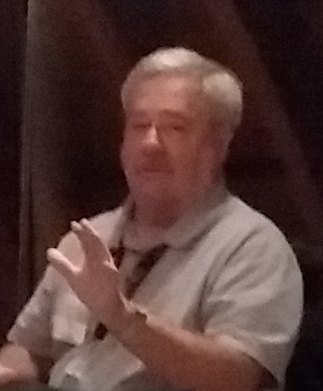
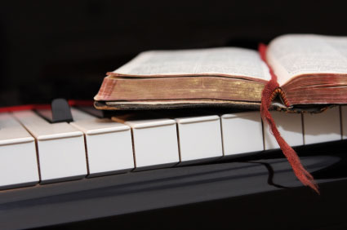
Because of the “goodness of God” that is taught only by Paul and found only in a King James 1611 Bible, I hope this video presentation Bible study will bring to you a new level of understanding.
Or maybe you will experience a ‘new beginning’ in your life based on what you have just learned from the Risen Christ through Paul in the KJB.
Prepared and presented by:
Mikel Paulson
2 Gretchen Ln, Bella Vista, AR 72715
509-876-1611
www.scatteredchristians.org
www.paulson1611rd.org
sousaman1611@cox.net
Remember, it is NOT the severity of God that will lead anyone to repentance today.
That is for tomorrow, during the time of great Tribulation
It is the ‘Goodness of God’ that leadeth ‘thee’ to repentance today, and it is a joyful repentance, too… …full of spiritual understanding!
The goodness of God is still in place ‘for’ and ‘to’ us during today’s Dispensation of the Grace of God

Slide 14
He which testifieth these things saith,
Surely I come quickly.
Amen.
Even so, come, Lord Jesus.
The grace of our Lord Jesus Christ
be with you all. Amen.

Slide 15
It is Finished

