Slide 1
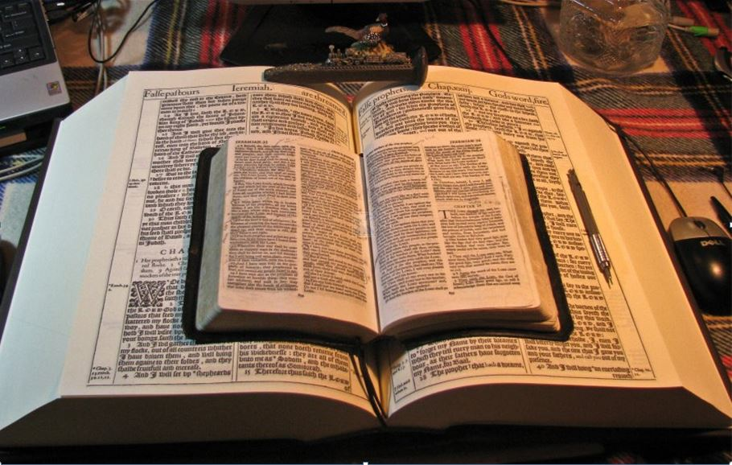
2021
…Praise thy name … for thy truth:
for Thou Hast Magnified Thy Word Above All Thy Name
‘Our Real Battle’
Part I
Introduction to “The Goodness of God” and to “Our Real Battle”
GOODNESS of GOD
Romans 2:4; 11:22; 5:1-21
Mikel Paulson
2 Gretchen Ln., Bella Vista, AR 72715
sousaman1611@cox.net
www.scatteredchristians.org
www.paulson1611rd.org
YouTube – “Retired Music Educator”
Rightly Dividing
the Word of Truth
by the Apostle Paul Only
Bible Studies from the Risen Saviour Jesus Christ
from a King James 1611 Bible
Teaching the ‘Greater Commission’ According to the Apostle Paul!
Emphasizing the ‘Goodness of God’ During Today’s “Dispensation of the Grace of God.”

Slide 2
Sermon Series Contents
Part I - Sermon Video Presentation
Romans 4:2; 11:22; 5:1-21
To Understand the “Goodness of God”
Introduction to the “Real Battle for a Sincere Christian”
GOODNESS of GOD
Part II - Sermon Video Presentation
Romans 6:1-14
To Understand Being “Dead Indeed Unto Sin”
Part III - Sermon Video Presentation
Romans 6:15-23
To Understand Being “Made Free from Sin”
Part IV - Sermon Video Presentation
Romans 7:1-14
To Understand Being “Dead to the Law”
Part V - Sermon Video Presentation Conclusion
Romans 7:1-14
To Understand “It is No More I That Do It”
“The Real Battle for a Sincere Christian”

Slide 3
Concerning this magnificent doctrine that we are about to study in detail right through to the marvelous conclusion,
this is one of the most exciting and more important doctrines that contributes to the joy and peace of a sincere Christian!
Along with learning all about the marvelous details of the goodness of God, you will now see why it is the goodness of God that would bring people to repentance! Despite what all modern pastors are preaching today, being ‘quickened’ through the goodness of God does not mean everyone must change their life by following the commandments and doctrines of men to a “touch not, taste not, do not, think not, be not, go not, hear not, handle not, in order to be blessed by God now and forever” type of a lifestyle.
GOODNESS of GOD
It DOES mean being instantly approved unto God and then growing in understanding into a mature Christian knowing ‘what it all means’ as well as ‘how to enjoy pleasing the living God’ with the added peace and assurance of no longer ‘being deceived’ by pastors, teachers, authors, musicians, scholars and even friends and family - even as well as no longer being deceived by Satan himself!
I guarantee, that in all the ‘good words and fair speeches’ from today’s modern any-and-all denominational pastors,
(and I say this with years of experience, observation and listening to others talk about their ‘former’ pastor)
you will never hear from them about Paul’s teachings on the goodness of God and ‘sin’ and ‘sinning,’
especially like you will read from a rightly divided King James 1611 Bible.
All preachers want to do today is to ‘scare’ you into believing that through their sermons on
‘godly living’ and ‘godly giving,’ that you will keep thinking that you are escaping from experiencing the severity of God.
Modern Christianity has changed the truth of God into a lie; it is teaching Jewish doctrine to Gentiles; it has created a deep spiritual blindness that has spread all over the world through all their local churches; it has created a form of godliness but denying the power thereof; it has caused people to choose not to endure sound doctrine by turning their itching ears away from the truth.
Today’s ecumenical ‘love-all’ Christianity has failed the world and the living God by preparing the world for the coming Antichrist, not for scriptural truth of the return of the real Risen Christ!
No wonder people today are NOT interested in the truth about living God; they are not even interested in a King James Bible. They have been taught by pastor’s good words and fair speaking to seek those visual miracles, signs and wonders that existed IN THE PAST and ONLY for Jews.

Slide 4
Romans 2:4
And thinkest thou this, O man, that judgest them which do such things,
and doest the same, that thou shalt escape the judgment of God?
Or despisest thou the riches of his goodness and forbearance and longsuffering;
not knowing that the
leadeth thee to repentance?
GOODNESS of GOD
Romans 11:22
Behold therefore the goodness and severity of God:
on them which fell, severity;
but toward thee, goodness,
if thou continue in his goodness:
otherwise thou also shalt be cut off.
II Thessalonians 2:6,7
And now ye know what withholdeth that he might be revealed in his time.
For the mystery of iniquity doth already work: only he who now letteth will let, until he be taken out of the way.

Slide 5
GOOD'NESS
The state of being good; the physical qualities which constitute value, excellence or perfection;
as the goodness of timber; the goodness of a soil.
1. The moral qualities which constitute Christian excellence; moral virtue; religion.
But the fruit of the Spirit is love, joy, peace, longsuffering, gentleness, goodness, faith, Meekness, temperance: against such there is no law.
Galatians 5:22,23
GOODNESS of GOD
BENEF'ICENCE, noun
The practice of doing good;
active goodness, kindness, or charity.
2. Kindness; benevolence; benignity of heart;
but more generally, acts of kindness;
charity; humanity exercised.
I shall remember his goodness to me with gratitude.
DISPOSI’TION, noun
Natural fitness or tendency.
BENIG'NITY noun
Goodness of disposition or heart; kindness of nature; graciousness.
1. Actual goodness; beneficence.
2. Salubrity; wholesome quality;
or that which tends to promote health.
BENEV'OLENCE, noun
1. The disposition to do good; good will; kindness; charitableness; the love, of mankind, accompanied with a desire
to promote their happiness.
2. An act of kindness; good done; charity given.
3. A species of contribution or tax illegally exacted by arbitrary
kings of England.
3. Kindness; benevolence of nature; mercy.
And the LORD passed by before him, and proclaimed,
The LORD, The LORD God, merciful and gracious, longsuffering,
and abundant in goodness and truth,
Exodus 34:6
SALU'BRITY, noun
Wholesomeness; healthfulness; favorableness to the
preservation of health;
as the salubrity of aid,
of a country or climate.
4. Kindness; favor shown; acts of benevolence, compassion or mercy.
And Jethro rejoiced for all the goodness which the LORD had done to Israel,
whom he had delivered out of the hand of the Egyptians.
Exodus 18:9
P.S. - Why do you suppose the words ‘goodness’ and ‘goodness of God’ are NEVER mentioned in the Gospels or in Hebrews through Jude?
As His children, Jews always must deal with the SEVERITY of God!
It is US GENTILES, as the body of Christ, that receive the grace & goodness of God!

Slide 6
Introduction to God’s Grace
Introduction to God’s Grace
Introduction to God’s Grace
Knowing Ephesians 3:2,3 that we live during the greatest dispensation of all time… the dispensation of the grace of God which was given to Paul directly by revelation from the Risen Christ to give to us Gentiles;
Knowing Romans 5:1,2 - Therefore being justified by faith, we have peace with God through our Lord Jesus Christ: By whom also we have access by faith into this grace wherein we stand, and rejoice in hope of the glory of God;
Knowing Romans 5:8-10 - But God commendeth his love toward us, in that, while we were yet sinners, Christ died for us. Much more then, being now justified by his blood, we shall be saved from wrath through him. For if, when we were enemies, we were reconciled to God by the death of his Son, much more, being reconciled, we shall be saved by his life.
Knowing Romans 5:12,13 Wherefore, as by one man sin entered into the world, and death by sin;
and so death passed upon all men,
for that all have sinned:
For until the law sin was in the world: but sin is not imputed
when there is no law…
GOODNESS of GOD
Knowing Romans 5:15
But not as the offence, so also is the free gift. For if through the offence of one many be dead, much more the grace of God, and the gift by grace, which is by one man, Jesus Christ, hath abounded unto many.
Knowing Romans 5:16-21
And not as it was by one that sinned, so is the gift: for the judgment was by one to condemnation,
but the free gift is of many offences unto justification.
For if by one man's offence death reigned by one;
much more they which receive abundance of grace and of the gift of righteousness shall reign in life by one, Jesus Christ.)
Therefore as by the offence of one judgment came upon all men to condemnation;
even so by the righteousness of one the free gift came upon all men unto justification of life.
For as by one man's disobedience many were made sinners, so by the obedience of one shall many be made righteous.
We can ‘know’
these things by:
Only By:
Moreover the law entered, that the offence might abound.
But where sin abounded, grace did much more abound:
His words only!
His Life - not ours!
His only apostle Paul!
That as sin hath reigned unto death,
His Righteousness - not ours!
Rightly Dividing to
His ‘risen’ words only!
even so might grace reign through righteousness unto eternal life by Jesus Christ our Lord.
His Death by Crucifixion
His Burial and Resurrection
King James 1611 Bible Only!
GRACE REIGNS TODAY
His Faith - not ours!

Slide 7
Introduction to the Real Battle
When you have the assurance and awareness that - You are Crucified with Christ; You are Dead with Christ; You are Buried With Christ; You are Risen With Christ; Christ Liveth in You; You are in Christ; You Liveth with Christ; You are Dead Indeed Unto Sin…
… that awareness will help you understand the difference and the true application of the words ‘to’ and ‘for’ concerning the King James 1611 Bible.
…that awareness will help you understand that we, as believers in the risen Christ, already stand approved unto God and you will see that marvelous truth as you rightly divided the word of truth!
…that awareness will help you know, not only what ‘rightly dividing the word of truth’ means,
but that you will exercise that awareness by reading the King James 1611 Bible correctly!
…that awareness will help you understand the goodness of God is to us today as Gentiles while the severity of God has always been to the Jews, and will be during their tribulation!
GOODNESS of GOD
…that awareness will help you understand that the KJ1611 is the ONLY
inspired and preserved words of God for your final authority today!
…that awareness will help you understand your enemy is truly a spiritual enemy.
…that awareness will help you know the difference between the Kingdom of God and the kingdom of heaven and what those two kingdoms represent.
…that awareness will help you understand the difference between the original church design in Acts 2 being falsely used today as compared to Paul’s ‘church’ goals in Ephesians 4:12-16 and Ephesians 5 with the difference between the local church and the body of Christ being that they are NOT one-in-the-same – one is alive and one is social only.
…that awareness will help you understand Gentiles being ‘quickened’ vs Israel needing to be ‘born again!’
…that awareness will help you see Satan getting less and less of advantage over you as you grow in realization and in understanding of the devices of Satan as he lifts himself up to be like the most High!
…that awareness will help you see and follow the true design for music and being aware that Satan has ‘taken over’ the power of music because of his desire to be worshipped like the most High and how the music in churches today supports and glorifies Satan while it does NOT please God, all according to Paul!
…that awareness will help you realize that our ‘battles’ are not to “just try to win the world to Jesus” with our mouth, or with man’s scholarship and wisdom, or our speaking and teaching skills, or the modern false claims of prayer power, or our ‘favorite’ church presentations and programs, or with the musical talents and performances in our church concerts and entertainment shows, or with our expecting to see and even creating our own miracles, signs and wonders, etc.!
You will then understand why Paul says it is our ‘reasonable service’ to present our bodies a living sacrifice, holy, acceptable unto God and that we should be not conformed to this world: but be ye transformed by the renewing of your mind, that ye may prove what is that good, and acceptable and perfect, will of God. For I say, through the grace given unto me, to every man that is among you, not to think of himself more highly than he ought to think; but to think soberly, according as God hath dealt to every man the measure of faith. Romans 12:1-3
The real battle that we need to learn to deal with is our toughest battle…
is with our own flesh.
More on that battle in Parts II-V.

Slide 8
End of Part I
(Introductions Completed)
Now let’s move on to Part II where we will begin this wonderful doctrinal study by answering this first question:
So, because of God’s wonderful grace in our lives…
What shall we say then? Shall we continue in sin, that grace may abound?
GOODNESS of GOD
Now the God of hope fill you
with all joy and peace in believing,
that ye may abound in hope,
through the power of the Holy Ghost.
Romans 15:13

Slide 9
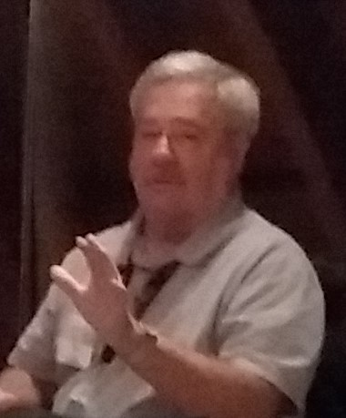
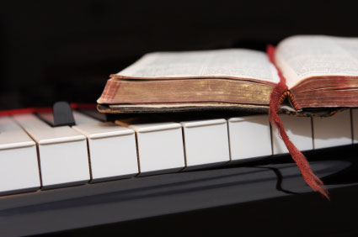
Because of the “goodness of God” that is taught only by Paul and found only in a King James 1611 Bible, I hope this video presentation Bible study will bring to you a new level of understanding.
Or maybe you will experience a ‘new beginning’ in your life based on what you have just learned from the Risen Christ through Paul in the KJB.
Prepared and presented by:
Mikel Paulson
2 Gretchen Ln, Bella Vista, AR 72715
509-876-1611
www.scatteredchristians.org
www.paulson1611rd.org
sousaman1611@cox.net
Remember, it is NOT the severity of God that will lead anyone to repentance today.
That is for tomorrow, during the time of great tribulation
It is the ‘Goodness of God’ that leadeth ‘thee’ to repentance today, and it is a joyful repentance, too… …full of spiritual understanding!
The goodness of God is still in place ‘for’ and ‘to’ us during today’s Dispensation of the Grace of God

Slide 10
He which testifieth these things saith,
Surely I come quickly.
Amen.
Even so, come, Lord Jesus.
The grace of our Lord Jesus Christ
be with you all. Amen.

Slide 11
It is Finished

