Slide 1
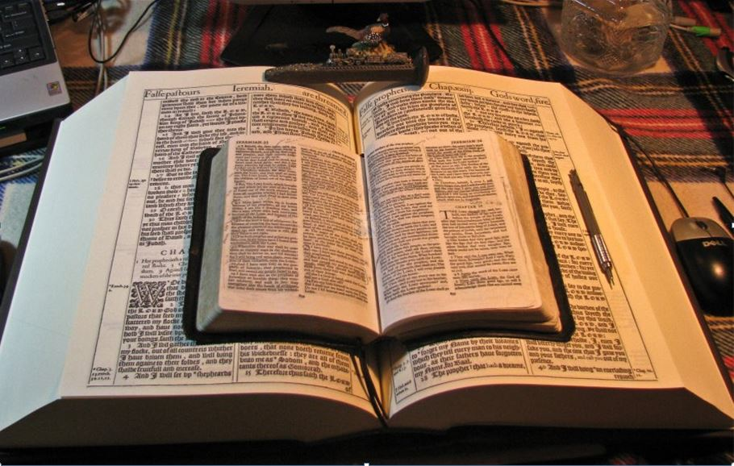
2021
…Praise thy name … for thy truth:
for Thou Hast Magnified Thy Word Above All Thy Name
‘Our Real Battle’
Part II
Understand Being “Dead to Sin”
GOODNESS of GOD
I am Crucified with Christ
Dead with Christ
Buried with Christ
Risen With Christ
Christ Liveth in Me
I Am In Christ
I Liveth With Christ
I am Dead Indeed Unto Sin
God Forbid
What Shall We Say Then?
Shall We Continue in Sin,
That Grace May Abound?
How shall we,
that are dead to sin,
live any longer therein?
Romans 6:1-14
Mikel Paulson
2 Gretchen Ln., Bella Vista, AR 72715
sousaman1611@cox.net
www.scatteredchristians.org
www.paulson1611rd.org
YouTube – “Retired Music Educator”
Rightly Dividing
the Word of Truth
by the Apostle Paul Only
Bible Studies from the Risen Saviour Jesus Christ
from a King James 1611 Bible
Teaching the ‘Greater Commission’ According to the Apostle Paul!
Emphasizing the ‘Goodness of God’ During Today’s “Dispensation of the Grace of God.”

Slide 2
‘The Real Battle’
Part I - Sermon Video Presentation
Romans 5
To Understand the “Goodness of God”
Introduction to the “Real Battle for a Sincere Christian”
GOODNESS of GOD
Part II - Sermon Video Presentation
Romans 6:1-14
To Understand Being “Dead Indeed Unto Sin”
Part III - Sermon Video Presentation
Romans 6:15-23
To Understand Being “Made Free from Sin”
Part IV - Sermon Video Presentation
Romans 7:1-14
To Understand Being “Dead to the Law”
Part V - Sermon Video Presentation Conclusion
Romans 7:1-14
To Understand “It is No More I That Do It”
“The Real Battle for a Sincere Christian”

Slide 3
Dead Indeed Unto Sin
Romans 6
:1-14
Romans 6
:15-23
What shall we say then? Shall we continue in sin, that grace may abound?
What then? shall we sin, because we are not under the law, but under grace?
God forbid. How shall we, that are dead to sin, live any longer therein?
Know ye not, that so many of us as were baptized into Jesus Christ
were baptized into his death?
Therefore we are buried with him by baptism into death: that like as Christ was raised up from the dead by the glory of the Father, even so we also should walk in newness of life.
God forbid. Know ye not, that to whom ye yield yourselves servants to obey,
his servants ye are to whom ye obey; whether of sin unto death,
or of obedience unto righteousness?
But God be thanked, that ye were the servants of sin,
but ye have obeyed from the heart that form of doctrine which was delivered you.
For if we have been planted together in the likeness of his death,
we shall be also in the
likeness of his resurrection:
GOODNESS of GOD
Being then made free from sin,
ye became the servants of righteousness.
I speak after the manner of men
because of the infirmity of your flesh:
For if we have been planted together in the likeness of his death,
we shall be also in the likeness of his resurrection:
Knowing this, that our old man is crucified with him,
that the body of sin might be destroyed,
that henceforth we should not serve sin.
For he that is dead is freed from sin.
Now if we be dead with Christ, we believe that we shall also live with him:
Knowing that Christ being raised from the dead dieth no more;
death hath no more dominion over him.
For in that he died, he died unto sin once:
but in that he liveth, he liveth unto God.
Likewise reckon ye also yourselves to be dead indeed unto sin,
but alive unto God through Jesus Christ our Lord.
Let not sin therefore reign in your mortal body,
that ye should obey it in the lusts thereof.
Neither yield ye your members as instruments of unrighteousness unto sin:
but yield yourselves unto God, as those that are alive from the dead,
and your members as instruments of righteousness unto God.
For sin shall not have dominion over you:
for ye are not under the law,
but under grace.
for as ye have yielded your members servants to uncleanness
and to iniquity unto iniquity;
even so now yield your members servants to righteousness unto holiness.
For when ye were the servants of sin, ye were free from righteousness.
What fruit had ye then in those things whereof ye are now ashamed?
for the end of those things is death.
But now being made free from sin,
and become servants to God,
ye have your fruit unto holiness,
and the end everlasting life.
For the wages of sin is death;
but the gift of God is eternal life through Jesus Christ our Lord.
Pray for understanding in this matter of a great doctrine,
as it is found only in a King James 1611 Bible!
For this cause we also, since the day we heard it, do not cease to pray for you, and to desire that ye might be filled with the knowledge of his will
in all wisdom and spiritual understanding; Colossians 1:9
Consider what I say; and the Lord give thee understanding in all things. II Timothy 2:7
If any man think himself to be a prophet, or spiritual, let him acknowledge that the things that I write unto you are the commandments of the Lord. I Corinthians 14:37

Slide 4
Dead Indeed Unto Sin
Romans 6
:1-14
What shall we say then? Shall we continue in sin, that grace may abound?
God forbid. How shall we, that are dead to sin, live any longer therein?
Know ye not, that so many of us as were baptized into Jesus Christ
were baptized into his death?
Therefore we are buried with him by baptism into death: that like as Christ was raised up from the dead by the glory of the Father, even so we also should walk in newness of life.
For if we have been planted together in the likeness of his death,
we shall be also in the
likeness of his resurrection:
GOODNESS of GOD
For if we have been planted together in the likeness of his death,
we shall be also in the likeness of his resurrection:
Knowing this, that our old man is crucified with him,
that the body of sin might be destroyed,
that henceforth we should not serve sin.
For he that is dead is freed from sin.
Now if we be dead with Christ, we believe that we shall also live with him:
Knowing that Christ being raised from the dead dieth no more;
death hath no more dominion over him.
For in that he died, he died unto sin once:
but in that he liveth, he liveth unto God.
Likewise reckon ye also yourselves to be dead indeed unto sin,
but alive unto God through Jesus Christ our Lord.
Let not sin therefore reign in your mortal body,
that ye should obey it in the lusts thereof.
Neither yield ye your members as instruments of unrighteousness unto sin:
but yield yourselves unto God, as those that are alive from the dead,
and your members as instruments of righteousness unto God.
For sin shall not have dominion over you:
for ye are not under the law,
but under grace.

Slide 5
Dead Indeed Unto Sin
I am crucified with Christ: nevertheless I live; yet not I, but Christ liveth in me: and the life which I now live
in the flesh I live by the faith of the Son of God, who loved me, and gave himself for me.
Galatians 2:20
I am Crucified with Christ
Knowing this, that our old man is crucified with him, that the body of sin might be destroyed,
that henceforth we should not serve sin.
Romans 6:6
I am Dead with Christ
For ye are dead, and your life is hid with Christ in God.
Colossians 3:3
And if Christ be in you, the body is dead because of sin; but the Spirit is life because of righteousness
Romans 8:10
GOODNESS of GOD
Therefore we are buried with him by baptism into death: that like as Christ was raised up from the dead
by the glory of the Father, even so we also should walk in newness of life.
Romans 6:4
I am Buried With Christ
Buried with him in baptism, wherein also ye are risen with him through the faith of the operation of God,
who hath raised him from the dead.
Colossians 2:12
Buried with him in baptism, wherein also ye are risen with him through the faith of the operation of God,
who hath raised him from the dead.
Colossians 2:12
I am Risen With Christ
If ye then be risen with Christ, seek those things which are above, where Christ sitteth on the right hand of God.
Colossians 3:1
I am crucified with Christ: nevertheless I live; yet not I, but Christ liveth in me: and the life which I now live in the flesh I live by the faith of the Son of God, who loved me, and gave himself for me.
Galatians 2:20
Christ Liveth In Me
For though he was crucified through weakness, yet he liveth by the power of God. For we also are weak in him, but we shall live with him by the power of God toward you.
II Corinthians 13:4
I Am In Christ
There is therefore now no condemnation to them which are in Christ Jesus, who walk not after the flesh,
but after the Spirit.
Romans 8:1
Yea, and all that will live godly in Christ Jesus shall suffer persecution.
II Timothy 3:12
I Liveth With Christ
Now if we be dead with Christ, we believe that we shall also live with him:
Romans 6:8
I am Dead Indeed Unto Sin
Likewise reckon ye also yourselves to be dead indeed unto sin, but alive unto God through Jesus Christ our Lord.
Romans 6:11
God forbid. How shall we, that are dead to sin, live any longer therein?
Romans 6:2

Slide 6
Dead Indeed Unto Sin
Newness of Life
Romans 6:4
Therefore we are buried with him by baptism into death: that like as Christ was raised up from the dead by the glory of the Father, even so we also should walk in newness of life.
Review/Conclusion – for a sincere and truly ‘saved by faith’ Christian
Quicken
Romans 8:11
But if the Spirit of him that raised up Jesus from the dead dwell in you, he that raised up Christ from the dead shall also quicken your mortal bodies by his Spirit that dwelleth in you.
We are dead to sin (‘sin’ is used here as a noun, not the verbal ‘sinning’).
We were baptized unto Christ’s death.
We were buried with Christ.
We were raised up from the dead.
Dead Unto Sin
Romans 6:11
Likewise reckon ye also yourselves to be dead indeed unto sin, but alive unto God through Jesus Christ our Lord.
GOODNESS of GOD
Ephesians 2:1
And you hath he quickened, who were dead in
trespasses and sins;
Dead to the Law
Romans 7:4a
Wherefore, my brethren, ye also are become dead to the law by the body of Christ…
We were quickened (made alive) by and with the Risen Christ (‘born again’ doesn’t even work)
Ephesians 2:5
Even when we were dead in sins, hath quickened us
together with Christ,
(by grace ye are saved;)
We should walk in the newness of life.
We were planted together… in the likeness of his death.
We were planted together… in the likeness of his resurrection.
Romans 7:6
But now we are delivered from the law, that being dead wherein we were held; that we should serve in newness of spirit, and not in the oldness of the letter.
Our old man was crucified with Christ.
Colossians 2:13
And you, being dead in your sins
and the uncircumcision of your flesh, hath he quickened together with him, having forgiven you all trespasses;
Our body of sin was destroyed, so we cannot serve sin.
We were freed from sin when we became dead to sin.
Because we became dead with Christ, we now live with Christ.
Galatians 2:21
I do not frustrate the grace of God: for if righteousness come by the law, then Christ is dead in vain.
We are now always dead unto sin - (indeed)
For this cause I Paul, the prisoner of Jesus Christ for you Gentiles, If ye have heard of the dispensation of the grace of God which is given me to you-ward:
We are now always dead to the law
Now our ‘sinning’ becomes ‘bad works’ because there is no law to label as sin.
The works of gold, silver, precious stones, wood, hay and/or stubble done in our body as a Christian still need to be judged as good or bad based on Paul’s teachings and his manner of life, but we ourselves have already been through our own judgment – which Christ paid the wages of sin of death for us who believe!
Sin shall not have dominion over us anymore because we are no longer under the law (severity of God), but under grace (goodness of God)!
This is all about why this dispensation is called ‘the dispensation of the grace of God.’ (Do a word study on the word ‘grace’ – it’s a great study!)
For we must all appear before the judgment seat of Christ; that every one may receive the things done in his body, according to that he hath done, whether it be good or bad. II Corinthians 5:10
In the day when God shall judge the secrets of men by Jesus Christ according to my gospel. Romans 2:16

Slide 7
How Can All of This Be?
Dead Indeed Unto Sin
How Can All of This Be?
First
Paul preached that we are in a spiritual kingdom called the kingdom of God, NOT the physical kingdom we see and experience today, which is called the kingdom of heaven. This is the visible, earthly kingdom of buildings, temples, signs, wonders, etc. that ‘was’ and ‘will be’ but is NOT important today!
For the kingdom of God is not meat and drink; but righteousness, and peace, and joy in the Holy Ghost. Romans 14:17
And Paul dwelt two whole years in his own hired house, and received all that came in unto him, Preaching the kingdom of God,
and teaching those things which concern the Lord Jesus Christ, with all confidence, no man forbidding him. Acts 28:30,31
GOODNESS of GOD
Second
This is made possible by a ‘spiritual operation’ and is described in Colossians 2:11-15 which enables Christ to give us full spiritual victory today.
In whom also ye are circumcised with the circumcision made without hands,
in putting off the body of the sins of the flesh by the circumcision of Christ:
And for the record, this is not referring to a water baptism, or as Paul called it, “John’s baptism” and the “baptism of John.” It was a water baptism that was needed during the days of the gospels and was to Jews only! Paul teaches a spiritual baptism to the Gentiles today, not a physical water baptism!
Buried with him in baptism,
wherein also ye are risen with him
through the faith of the operation of God,
who hath raised him from the dead.
And you, being dead in your sins and the uncircumcision of your flesh,
hath he quickened together with him,
having forgiven you all trespasses;
Blotting out the handwriting of ordinances that was against us, which was contrary to us,
and took it out of the way, nailing it to his cross;
And having spoiled principalities and powers,
he made a shew of them openly, triumphing over them in it.
I will make a video sermon presentation about the above operation, often called ‘spiritual circumcision’ and will also look closer at the Judgment Seat of Christ where our good and bad works are judged (but not listed as sins). Two sermon video presentations on the three kingdoms are already available on Satan’s Kingdom of This World, Kingdom of Heaven and the Kingdom of God.

Slide 8
Dead Indeed Unto Sin
End of Part II
Be sure to follow up with Part III, where we see the answer the next ‘obvious’ question:
What then? shall we sin, because we are not under the law, but under grace?
GOODNESS of GOD
Now the God of hope fill you
with all joy and peace in believing,
that ye may abound in hope,
through the power of the Holy Ghost.
Romans 15:13

Slide 9
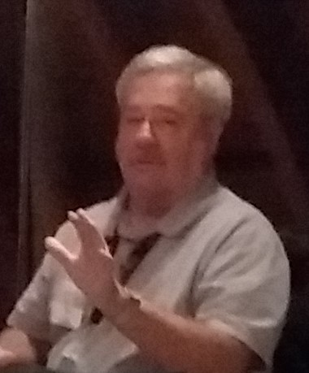
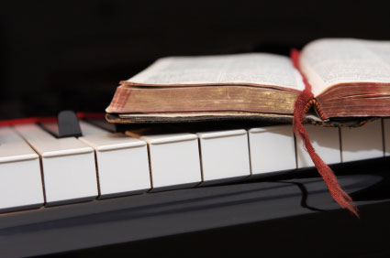
Because of the “goodness of God” that is taught only by Paul and found only in a King James 1611 Bible, I hope this video presentation Bible study will bring to you a new level of understanding.
Or maybe you will experience a ‘new beginning’ in your life based on what you have just learned from the Risen Christ through Paul in the KJB.
Prepared and presented by:
Mikel Paulson
2 Gretchen Ln, Bella Vista, AR 72715
509-876-1611
www.scatteredchristians.org
www.paulson1611rd.org
sousaman1611@cox.net
Remember, it is NOT the severity of God that will lead anyone to repentance today.
That is for tomorrow, during the time of great Tribulation
It is the ‘Goodness of God’ that leadeth ‘thee’ to repentance today, and it is a joyful repentance, too… …full of spiritual understanding!
The goodness of God is still in place ‘for’ and ‘to’ us during today’s Dispensation of the Grace of God

Slide 10
He which testifieth these things saith,
Surely I come quickly.
Amen.
Even so, come, Lord Jesus.
The grace of our Lord Jesus Christ
be with you all. Amen.

Slide 11
It is Finished

Slide 13
Being Crucified with Christ
GOODNESS of GOD

