Slide 1
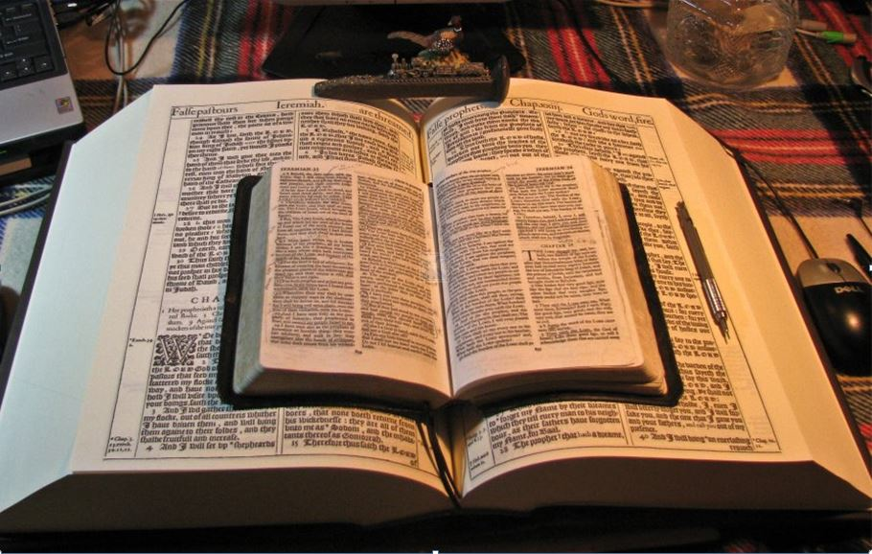
2021
…Praise thy name … for thy truth:
for Thou Hast Magnified Thy Word Above All Thy Name
‘Our Real Battle’
Part III
Understand Being “Made Free from Sin”
GOODNESS of GOD
…shall we sin, because we are not under the law, but under grace?
The Second Question:
Know ye not,
that to whom ye yield
yourselves servants to obey,
his servants ye are to whom ye obey;
What Then?
God Forbid
Romans 6:15-23
…whether of sin unto death, or
of obedience unto righteousness?
Mikel Paulson
2 Gretchen Ln., Bella Vista, AR 72715
sousaman1611@cox.net
www.scatteredchristians.org
www.paulson1611rd.org
YouTube – “Retired Music Educator”
Rightly Dividing
the Word of Truth
by the Apostle Paul Only
Bible Studies from the Risen Saviour Jesus Christ
from a King James 1611 Bible
Teaching the ‘Greater Commission’ According to the Apostle Paul!
Emphasizing the ‘Goodness of God’ During Today’s “Dispensation of the Grace of God.”

Slide 2
‘The Real War’
Part I - Sermon Video Presentation
Romans 5
To Understand the “Goodness of God”
Introduction to the “Real Battle for a Sincere Christian”
GOODNESS of GOD
Part II - Sermon Video Presentation
Romans 6:1-14
To Understand Being “Dead Indeed Unto Sin”
Part III - Sermon Video Presentation
Romans 6:15-23
To Understand Being “Made Free from Sin”
Part IV - Sermon Video Presentation
Romans 7:1-14
To Understand Being “Dead to the Law”
Part V - Sermon Video Presentation Conclusion
Romans 7:1-14
To Understand “It is No More I That Do It”
“The Real Battle for a Sincere Christian”

Slide 3
Made Free from Sin
Part II - Romans 6
:1-14
Part III - Romans 6
:15-23
What shall we say then? Shall we continue in sin, that grace may abound?
What then? shall we sin, because we are not under the law, but under grace?
God forbid. How shall we, that are dead to sin, live any longer therein?
Know ye not, that so many of us as were baptized into Jesus Christ
were baptized into his death?
Therefore we are buried with him by baptism into death: that like as Christ was raised up from the dead by the glory of the Father, even so we also should walk in newness of life.
God forbid. Know ye not, that to whom ye yield yourselves servants to obey,
his servants ye are to whom ye obey; whether of sin unto death,
or of obedience unto righteousness?
But God be thanked, that ye were the servants of sin,
but ye have obeyed from the heart that form of doctrine which was delivered you.
For if we have been planted together in the likeness of his death,
we shall be also in the
likeness of his resurrection:
GOODNESS of GOD
Being then made free from sin,
ye became the servants of righteousness.
I speak after the manner of men
because of the infirmity of your flesh:
For if we have been planted together in the likeness of his death,
we shall be also in the likeness of his resurrection:
Knowing this, that our old man is crucified with him,
that the body of sin might be destroyed,
that henceforth we should not serve sin.
For he that is dead is freed from sin.
Now if we be dead with Christ, we believe that we shall also live with him:
Knowing that Christ being raised from the dead dieth no more;
death hath no more dominion over him.
For in that he died, he died unto sin once:
but in that he liveth, he liveth unto God.
Likewise reckon ye also yourselves to be dead indeed unto sin,
but alive unto God through Jesus Christ our Lord.
Let not sin therefore reign in your mortal body,
that ye should obey it in the lusts thereof.
Neither yield ye your members as instruments of unrighteousness unto sin:
but yield yourselves unto God, as those that are alive from the dead,
and your members as instruments of righteousness unto God.
For sin shall not have dominion over you:
for ye are not under the law,
but under grace.
for as ye have yielded your members servants to uncleanness
and to iniquity unto iniquity;
even so now yield your members servants to righteousness unto holiness.
For when ye were the servants of sin, ye were free from righteousness.
What fruit had ye then in those things whereof ye are now ashamed?
for the end of those things is death.
But now being made free from sin,
and become servants to God,
ye have your fruit unto holiness,
and the end everlasting life.
For the wages of sin is death;
but the gift of God is eternal life through Jesus Christ our Lord.

Slide 4
Made Free from Sin
Part III - Romans 6
:15-23
What then? shall we sin, because we are not under the law, but under grace?
God forbid. Know ye not, that to whom ye yield yourselves servants to obey,
his servants ye are to whom ye obey; whether of sin unto death,
or of obedience unto righteousness?
But God be thanked, that ye were the servants of sin,
but ye have obeyed from the heart that form of doctrine which was delivered you.
GOODNESS of GOD
Being then made free from sin,
ye became the servants of righteousness.
I speak after the manner of men
because of the infirmity of your flesh:
for as ye have yielded your members servants to uncleanness
and to iniquity unto iniquity;
even so now yield your members servants to righteousness unto holiness.
For when ye were the servants of sin, ye were free from righteousness.
What fruit had ye then in those things whereof ye are now ashamed?
for the end of those things is death.
But now being made free from sin,
and become servants to God,
ye have your fruit unto holiness,
and the end everlasting life.
For the wages of sin is death;
but the gift of God is eternal life through Jesus Christ our Lord.
As Paul did for us, pray for your own understanding in this matter of a great doctrine as it is found only in a King James 1611 Bible!
For this cause we also, since the day we heard it, do not cease to pray for you, and to desire that ye might be filled with the knowledge of his will
in all wisdom and spiritual understanding; Colossians 1:9
Consider what I say; and the Lord give thee understanding in all things. II Timothy 2:7
If any man think himself to be a prophet, or spiritual, let him acknowledge that the things that I write unto you are the commandments of the Lord. I Corinthians 14:37

Slide 5
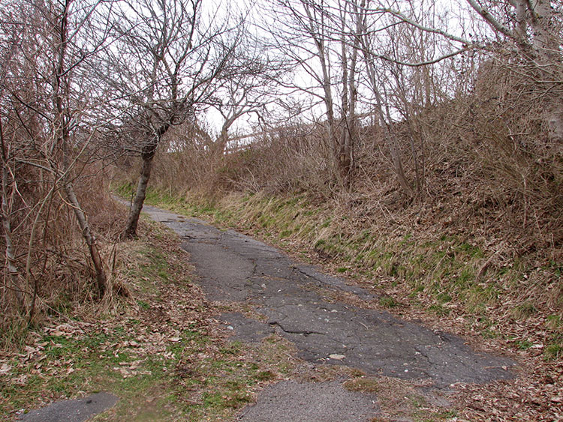
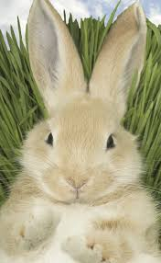
Made Free from Sin
Our second question:
What then? shall we sin, because we are not under the law, but under grace?
Check my sermons on what Paul ‘assumes’ we already know… and then make sure you ‘know’ what you need to know!
Responses
#1:
God forbid.
Wherein in time past ye walked according to the course of this world, according to the prince of the power of the air, the spirit that now worketh in the children of disobedience: Among whom also we all had our conversation in times past in the lusts of our flesh, fulfilling the desires of the flesh and of the mind; and were by nature the children of wrath, even as others. Ephesians 1:2,3
#2:
Know ye not, that to whom ye yield yourselves servants to obey,
his servants ye are to whom ye obey;
whether of sin unto death, or of obedience unto righteousness?
Modern Bibles say ‘slave’.
But now in Christ Jesus ye who sometimes were far off are made nigh by the blood of Christ. Eph 2:13
GOODNESS of GOD
Unto me, who am less than the least of all saints, is this grace given, that I should preach among the Gentiles the unsearchable riches of Christ;
Ephesians 3:8,
Explanation:
But God be thanked, that ye were the servants of sin,
but ye have obeyed from the heart
that form of doctrine which was delivered you.
Wherefore remember, that ye being in time past Gentiles in the flesh, who are called Uncircumcision by that which is called the Circumcision in the flesh made by hands; That at that time ye were without Christ, being aliens from the commonwealth of Israel, and strangers from the covenants of promise, having no hope, and without God in the world: Ephesians 2:11,12
‘Conclusional’
Answer:
Being then made free from sin,
ye became the servants of righteousness.
Furthermore then we beseech you, brethren, and exhort you by the Lord Jesus, that as ye have received of us how ye ought to walk and to please God, so ye would abound more and more. I Thessalonians 4:1
Bunny Trails
That if thou shalt confess with thy mouth the Lord Jesus, and shalt believe in thine heart that God hath raised him from the dead, thou shalt be saved. For with the heart man believeth unto righteousness; and with the mouth confession is made unto salvation. For the scripture saith, Whosoever believeth on him shall not be ashamed. For there is no difference between the Jew and the Greek: for the same Lord over all is rich unto all that call upon him.
For the law of the Spirit of life in Christ Jesus hath made me free from the law of sin and death. Romans 8:2
- Because that, when they knew God, they glorified him not as God, neither were thankful; but became vain in their imaginations, and their foolish heart was darkened. Romans 1:21
- And let the peace of God rule in your hearts, to the which also ye are called in one body; and be ye thankful. Colossians 3:15
Stand fast therefore in the liberty wherewith Christ hath made us free, and be not entangled again with the yoke of bondage. Galatians 5:1
For whosoever shall call upon the name of the Lord shall be saved. Romans 10:9-13

Slide 6
Reading the daily ‘life’ of Paul in the Book of Acts, you see just how much Paul and us are alike… From man to man, he knows exactly how we feel because he is just another ‘rotten’ person as we ‘were.’
Rom 7:18 For I know that in me (that is, in my flesh,) dwelleth no good thing…
Made Free from Sin
Yield - to give way to pressure or influence; submit to urging, persuasion; to give up; to cease resistance or contention; to submit.
I speak after the manner of men
because of the infirmity of your flesh:
for as ye have yielded your members servants to uncleanness
and to iniquity unto iniquity;
even so now yield your members servants to righteousness unto holiness.
If forced, we would be slaves.
I also believe that is one reason why people don’t like Paul. They must think they are better than him - thus better than us. They don’t respect Paul, nor do they respect us because they see us not ‘being’ as holy as they think they are, yet they see us full of joy and with great assurance and comfort, among other things!
Unto whom should we submit?
? A deceived and deceiving pastor’s guilt trips by their good words and fair speeches from Hebrews 13:7,17 and any/all Old Testament/Gospel claims while always rejecting Paul, thus constantly preparing his people global religion and the coming of the Antichrist?
GOODNESS of GOD
It is called envy and it is often very damaging, destructive and deadly.
For when ye were the servants of sin, ye were free from righteousness.
What fruit had ye then in those things whereof ye are now ashamed?
for the end of those things is death.
? Your church statement of faith and/or denominational objectives? Based on which church? Acts 2 or Eph 4:12-16?
It is sad, though, as they really have no idea what Paul’s manner of life consists of compared to the rules of the Gospel nor do they know how we are already approved unto God!
But now being made free from sin,
and become servants to God,
ye have your fruit unto holiness,
and the end everlasting life.
So then they that are in the flesh cannot please God.
Romans 8:8
!! How about submitting to your own rightly divided easily understood inspired, perfect and preserved Scriptures and keeping it just between you and the Lord! II Tim 2:15,16; 4:2
My manner of life from my youth, which was at the first among mine own nation at Jerusalem, know all the Jews; Which knew me from the beginning, if they would testify, that after the most straitest sect of our religion I lived a Pharisee. I verily thought with myself, that I ought to do many things contrary to the name of Jesus of Nazareth. Which thing I also did in Jerusalem: and many of the saints did I shut up in prison, having received authority from the chief priests; and when they were put to death, I gave my voice against them. And I punished them oft in every synagogue, and compelled them to blaspheme; and being exceedingly mad against them, I persecuted them even unto strange cities. Acts 26:9; 8:3
For the wages of sin is death;
but the gift of God is eternal life
through Jesus Christ our Lord.
!! Looking to ‘follow’ the teachings of the RISEN Saviour as taught to us by Paul through the King James Bible?
According to the grace of God which is given unto me, as a wise masterbuilder, I have laid the foundation, and another buildeth thereon. But let every man take heed how he buildeth thereupon. For other foundation can no man lay than that is laid, which is Jesus Christ. Now if any man build upon this foundation gold, silver, precious stones, wood, hay, stubble; Every man's work shall be made manifest: for the day shall declare it, because it shall be revealed by fire; and the fire shall try every man's work of what sort it is. If any man's work abide which he hath built thereupon, he shall receive a reward. If any man's work shall be burned, he shall suffer loss: but he himself shall be saved; yet so as by fire. I Corinthians 3:10-15
As for Saul, he made havock of the church, entering into every house, and haling men and women committed them to prison.

Slide 7
Made Free from Sin
For the wages of sin is death; but the gift of God is eternal life through Jesus Christ our Lord.
However, if you still don’t know…
Is That Cool or What!
AND don’t understand…
Why…
How eternal life really is a free gift…
That it is not
just ‘by’ Him…
That it’s NOT Jesus’ doctrine to the Jews from the Gospels for today (only believing that He is the Son of God), but that it IS Paul’s doctrine from the ‘Risen’ Christ to us Gentiles today - from the heart…
Rom 6:1, What shall we say then? Shall we continue in sin, that grace may abound?
Rom 6:2, God forbid. How shall we, that are dead to sin, live any longer therein?
Rom 6:3, Know ye not, that so many of us as were baptized into Jesus Christ were baptized into his death?
Rom 6:4, Therefore we are buried with him by baptism into death:
that like as Christ was raised up from the dead by the glory of the Father, even so we also should walk in newness of life.
Rom 6:5, For if we have been planted together in the likeness of his death, we shall be also in the likeness of his resurrection:
Rom 6:6, Knowing this, that our old man is crucified with him, that the body of sin might be destroyed, that henceforth we should not serve sin.
Rom 6:7, For he that is dead is freed from sin.
Rom 6:8, Now if we be dead with Christ, we believe that we shall also live with him:
Rom 6:9, Knowing that Christ being raised from the dead dieth no more; death hath no more dominion over him.
Rom 6:10, For in that he died, he died unto sin once: but in that he liveth, he liveth unto God.
Rom 6:11, Likewise reckon ye also yourselves to be dead indeed unto sin, but alive unto God through Jesus Christ our Lord.
Rom 6:12, Let not sin therefore reign in your mortal body, that ye should obey it in the lusts thereof.
Rom 6:13, Neither yield ye your members as instruments of unrighteousness unto sin:
but yield yourselves unto God, as those that are alive from the dead, and your members as instruments of righteousness unto God.
Rom 6:14, For sin shall not have dominion over you: for ye are not under the law, but under grace.
Rom 6:15, What then? shall we sin, because we are not under the law, but under grace? God forbid.
Rom 6:16, Know ye not, that to whom ye yield yourselves servants to obey, his servants ye are to whom ye obey; whether of sin unto death, or of obedience unto righteousness?
Rom 6:17, But God be thanked, that ye were the servants of sin, but ye have obeyed from the heart that form of doctrine which was delivered you.
Rom 6:18, Being then made free from sin, ye became the servants of righteousness.
Rom 6:19, I speak after the manner of men because of the infirmity of your flesh: for as ye have yielded your members servants to uncleanness and to iniquity unto iniquity;
even so now yield your members servants to righteousness unto holiness.
Rom 6:20, For when ye were the servants of sin, ye were free from righteousness.
Rom 6:21, What fruit had ye then in those things whereof ye are now ashamed? for the end of those things is death.
Rom 6:22, But now being made free from sin, and become servants to God, ye have your fruit unto holiness, and the end everlasting life.
Rom 6:23, For the wages of sin is death; but the gift of God is eternal life through Jesus Christ our Lord.
… He does something
‘TO’ us!
…then I suggest you stop now and read Romans 6 again – without my bunny trails – and read it all to yourself (or even out loud) slowly, over and over, until it clicks for you. Believe me, you ‘will know’ when it clicks…
…you won’t be able to sit still.

Slide 8
Made Free from Sin
End of Part III
Be sure you have seen both Part I and II – those will help you in understanding the ‘Goodness of God’…
…and what it means to be ‘dead indeed unto sin’ and being ‘made free from sin.’
GOODNESS of GOD
…despisest thou the riches of his goodness and forbearance and longsuffering; not knowing that the goodness of God leadeth thee to repentance?
Behold therefore the goodness and severity of God: on them which fell, severity;
but toward thee, goodness, if thou continue in his goodness:
otherwise thou also shalt be cut off.
Romans 6:1-14 - First Question:
What shall we say then? Shall we continue in sin, that grace may abound?
God forbid
We are dead unto sin but alive unto God through Jesus Christ our Lord !
Romans 6:15-28 - Second Question:
What then? shall we sin, because we are not under the law, but under grace?
God forbid
But now being made free from sin, and become servants to God…
Have you noticed? He doesn’t ask us
to ‘change or else’! (severity of God)…
Now the God of hope fill you
with all joy and peace in believing,
that ye may abound in hope,
through the power of the Holy Ghost.
Romans 15:13
HE CHANGES US! (Goodness of God)
Also, on YouTube or in my website, watch my short video sermon presentation on today being the “Best Dispensation” and all the specific changes Christ makes in us!
Therefore if any man be in Christ, he is a new creature: old things are passed away; behold, all things are become new.
Yes! There’s even more, so go on to IV!

Slide 9
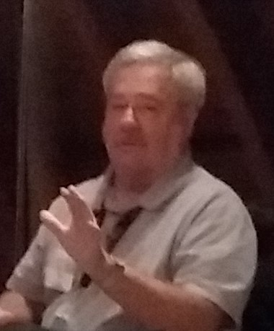
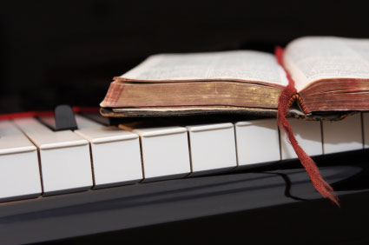
Because of the “goodness of God” that is taught only by Paul and found only in a King James 1611 Bible, I hope this video presentation Bible study will bring to you a new level of understanding.
Or maybe you will experience a ‘new beginning’ in your life based on what you have just learned from the Risen Christ through Paul in the KJB.
Prepared and presented by:
Mikel Paulson
2 Gretchen Ln, Bella Vista, AR 72715
509-876-1611
www.scatteredchristians.org
www.paulson1611rd.org
sousaman1611@cox.net
Remember, it is NOT the severity of God that will lead anyone to repentance today.
That is for tomorrow, during the time of great Tribulation
It is the ‘Goodness of God’ that leadeth ‘thee’ to repentance today, and it is a joyful repentance, too… …full of spiritual understanding!
The goodness of God is still in place ‘for’ and ‘to’ us during today’s Dispensation of the Grace of God

Slide 10
He which testifieth these things saith,
Surely I come quickly.
Amen.
Even so, come, Lord Jesus.
The grace of our Lord Jesus Christ
be with you all. Amen.

Slide 11
It is Finished

