Slide 1
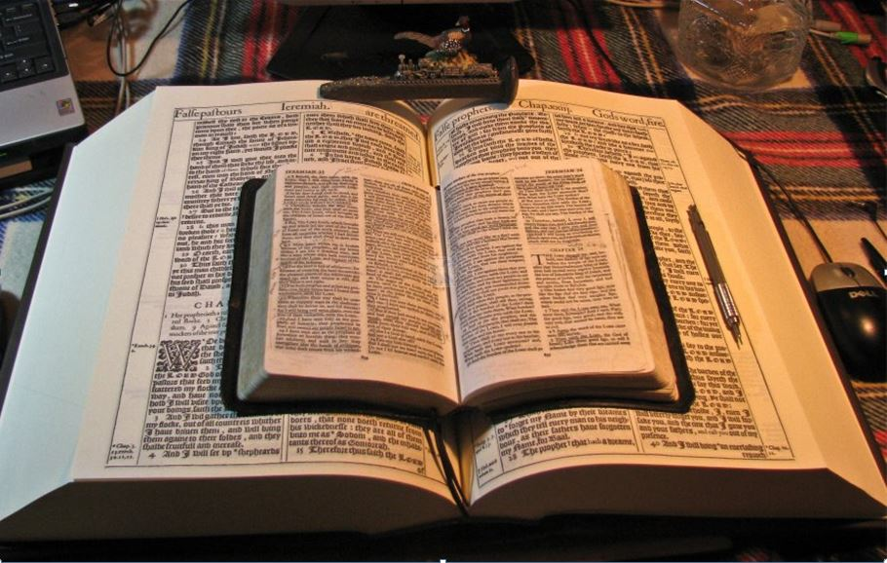
2021
…Praise thy name …for thy truth:
for Thou Hast Magnified Thy Word Above All Thy Name
‘Our Real Battle’
Part IV
Understand Being “Dead to the Law”
GOODNESS of GOD
God Forbid
What Shall We Say Then?
But sin,
taking occasion by the commandment, wrought in me all manner of concupiscence.
Is the law sin?
Nay, I had not known sin,
but by the law: for I had not known lust, except the law had said, Thou shalt not covet.
Romans 7:1-13
Mikel Paulson
2 Gretchen Ln., Bella Vista, AR 72715
sousaman1611@cox.net
www.scatteredchristians.org
www.paulson1611rd.org
YouTube – “Retired Music Educator”
For without the law sin was dead.
Rightly Dividing
the Word of Truth
by the Apostle Paul Only
Bible Studies from the Risen Saviour Jesus Christ
from a King James 1611 Bible
Teaching the ‘Greater Commission’ According to the Apostle Paul!
Emphasizing the ‘Goodness of God’ During Today’s “Dispensation of the Grace of God.”

Slide 2
‘The Real Battle’
Part I - Sermon Video Presentation
Romans 5
To Understand the “Goodness of God”
Introduction to the “Real Battle for a Sincere Christian”
GOODNESS of GOD
Part II - Sermon Video Presentation
Romans 6:1-14
To Understand Being “Dead to Sin”
Part III - Sermon Video Presentation
Romans 6:15-23
To Understand Being “Made Free from Sin”
Part IV - Sermon Video Presentation
Romans 7:1-13
To Understand Being “Dead to the Law”
Part V - Sermon Video Presentation Conclusion
Romans 7:14-25
To Understand “It is No More I That Do It”
“The Real Battle for a Sincere Christian”

Slide 3
For this cause we also, since the day we heard it, do not cease to pray for you, and to desire that ye might be filled with the knowledge of his will in all wisdom and spiritual understanding; Colossians 1:9
Dead to the Law
Jews – Gospel teachings from before Jesus was glorified! (John 7:37)
Romans 7:1-3
Gentiles today – following Jewish OT gospel law from before Jesus was glorified supposedly wanting to win the world to Jesus, etc.
I am thinking that NOW chapter 7 will make even more sense to you…
(If you have studied the Goodness of God and Romans 6 in I, II, III, that is!)
Consider what I say; and the Lord give thee understanding in all things. II Tim 2:7
From here on and into IV and V, if you just read slowly and carefully,
your understanding might be pleasantly noticeable and peacefully exciting!
(…) giving heed to Jewish fables, and commandments of men, that turn from the truth. Titus 1:14
If any man think himself to be a prophet, or spiritual, let him acknowledge that the things that I write unto you are the commandments of the Lord. I Cor 14:37
GOODNESS of GOD
Christian American ‘citizens’ - I exhort therefore, that, first of all, supplications, prayers, intercessions, and giving of thanks, be made for all men; For kings, and for all that are in authority; that we may lead a quiet and peaceable life in all godliness and honesty. I Tim 2:1,2
Having a form of godliness, but denying the power thereof: from such turn away. For of this sort are they which creep into houses, and lead captive silly women laden with sins, led away with divers lusts, Ever learning, and never able to come to the knowledge of the truth. II Tim 3:5-7
Question: v. 1
Know ye not, brethren, (for I speak to them that know the law,)
how that the law hath dominion over a man as long as he liveth?
Nobody likes that thought so ‘loving pastors’ talk about the love of God, no doctrine, nondenoms etc.
Workers and Bosses - Let as many servants as are under the yoke count their own masters worthy of all honour, that the name of God and his doctrine be not blasphemed. And they that have believing masters, let them not despise them, because they are brethren; but rather do them service, because they are faithful and beloved, partakers of the benefit. These things teach and exhort. I Tim 6:1,2
His response comes in an illustration simply explaining the law
Remember,
today is about the goodness of God with all its
doctrinal details.
This is NOT about divorce being dastardly wrong, as today’s confused pastors preach.
v. 2 - For the woman which hath an husband is bound
by the law to her husband so long as he liveth;
For there are many unruly and vain talkers and deceivers, specially they of the circumcision: Whose mouths must be stopped, who subvert whole houses, teaching things which they ought not, for filthy lucre's sake. One of themselves, even a prophet of their own, said, The Cretians are alway liars, evil beasts, slow bellies. This witness is true. Wherefore rebuke them sharply, that they may be sound in the faith; Not giving heed to Jewish fables, and commandments of men, that turn from the truth. Titus 1:10-14
but if the husband be dead,
she is loosed from the law of her husband.
There are exceptions for divorce in God’s eyes…
While this IS the law and design of marriage, we also are not in the days of the severity of God.
v. 3 - So then if, while her husband liveth,
she be married to another man,
she shall be called an adulteress:
But even a ‘wrong’ divorce doesn’t bring on the severity
of God!
but if her husband be dead, she is free from that law;
so that she is no adulteress, though she be married to another man.
Those that can’t let go and won’t let you, either! Stand fast therefore in the liberty wherewith Christ hath made us free, and be not entangled again with the yoke of bondage. Galatians 5:1
It will still burn!
But evil men and seducers shall wax worse and worse, deceiving,
and being deceived. II Timothy 3:13
All globally ecumenicalized self-proclaimed denom and non-denom Western / Eastern born-again spiritualist religious groups.

Slide 4
II Cor 5:17 - Therefore if any man be in Christ, he is a new creature: old things are passed away; behold, all things are become new.
Dead to the Law
Note: Paul never calls us sinners!
Eph 2:1-3 And you hath he quickened, who were dead in trespasses and sins;
Wherein in time past ye walked according to the course of this world, according to the prince of the power of the air, the spirit that now worketh in the children of disobedience:
Among whom also we all had our conversation in times past in the lusts of our flesh, fulfilling the desires of the flesh and of the mind; and were by nature the children of wrath, even as others.
Romans 7:4-6
v. 4 - Wherefore, my brethren,
ye also are become dead to the law by the body of Christ;
that ye should be married to another, even to him who is raised from the dead,
that we should bring forth fruit unto God.
Simply put, ‘lost’ foks are:
‘without Christ!’
‘without God!’
‘aliens from Israel!’
‘strangers from the covenants of promise’
‘without hope’
See, we ARE His bride!
It is all about Him, not us!
GOODNESS of GOD
But they are not:
‘bad-deed-doing’ people
‘sinners’
‘people sinning’
‘in their lost status because of their evil works, sins, etc.
Eph 2:11,12 Wherefore remember, that ye being in time past Gentiles in the flesh, who are called Uncircumcision by that which is called the Circumcision in the flesh made by hands;
That at that time ye were without Christ, being aliens from the commonwealth of Israel, and strangers from the covenants of promise, having no hope, and without God in the world:
He explains it again!
LOST
v. 5 - For when we were in the flesh,
the motions of sins, which were by the law,
did work in our members to bring forth fruit unto death.
LAW CAME
LAW SHOWED ME SIN
Hell is full of good people…
they just were simply without Christ!
they were dead in their trespasses and sins!
v. 6 - But now we are delivered from the law,
that being dead wherein we were held;
that we should serve in newness of spirit,
and not in the oldness of the letter.
Romans 8:1-4 There is therefore now no condemnation to them which are in Christ Jesus, who walk not after the flesh, but after the Spirit.
For the law of the Spirit of life in Christ Jesus hath made me free from the law of sin and death.
For what the law could not do, in that it was weak through the flesh, God sending his own Son in the likeness of sinful flesh, and for sin, condemned sin in the flesh: That the righteousness of the law might be fulfilled in us, who walk not after the flesh, but after the Spirit.
CHRIST DELIVERED ME FROM THE LAW
…because every good, nice, positive, religious, generous, giving, prayerful, honest, ‘godly’ act still could not please God – THEY WERE ‘IN THE FLESH,’ NOT IN THE SPIRIT! (Romans 8:28)
Romans 8:5-8 For they that are after the flesh do mind the things of the flesh; but they that are after the Spirit the things of the Spirit. For to be carnally minded is death; but to be spiritually minded is life and peace. Because the carnal mind is enmity against God: for it is not subject to the law of God, neither indeed can be. So then they that are in the flesh cannot please God.
I AM DEAD TO
THE LAW
Romans 8:9, But ye are not in the flesh, but in the Spirit, if so be that the Spirit of God dwell in you. Now if any man have not the Spirit of Christ, he is none of his.
I AM RISEN TO SERVE IN NEWNESS OF SPIRIT
P.S.
Not ‘fall short’ – NIV -
For all have sinned, and come short of the glory of God;

Slide 5
Romans 3:9-31
Dead to the Law
What then? are we better than they? No, in no wise: for we have before proved both Jews and Gentiles, that they are all under sin;
As it is written, There is none righteous, no, not one:
There is none that understandeth, there is none that seeketh after God.
They are all gone out of the way, they are together become unprofitable; there is none that doeth good, no, not one.
Their throat is an open sepulchre; with their tongues they have used deceit; the poison of asps is under their lips:
Whose mouth is full of cursing and bitterness:
Romans 2:4, Or despisest thou the riches of his goodness and forbearance and longsuffering;
not knowing that the goodness of God leadeth thee to repentance?
II Timothy 2:24-26, And the servant of the Lord must not strive; but be gentle unto all men, apt to teach, patient, In meekness instructing those that oppose themselves; if God peradventure will give them repentance to the acknowledging of the truth;
GOODNESS of GOD
Rom 22:22, Behold therefore the goodness and severity of God:
on them which fell, severity;
but toward thee, goodness,
if thou continue in his goodness: otherwise thou also shalt be cut off.
Their feet are swift to shed blood:
Destruction and misery are in their ways:
And the way of peace have they not known:
There is no fear of God before their eyes.
Now we know that what things soever the law saith, it saith to them who are under the law:
that every mouth may be stopped, and all the world may become guilty before God.
And that they may recover themselves out of the snare of the devil, who are taken captive by him at his will.
Therefore by the deeds of the law there shall no flesh be justified in his sight: for by the law is the knowledge of sin.
But now the righteousness of God without the law is manifested, being witnessed by the law and the prophets;
Even the righteousness of God which is by faith of Jesus Christ unto all and upon all them that believe: for there is no difference:
For all have sinned, and come short of the glory of God;
Being justified freely by his grace through the redemption that is in Christ Jesus:
Whom God hath set forth to be a propitiation through faith in his blood,
to declare his righteousness for the remission of sins that are past, through the forbearance of God;
To declare, I say, at this time his righteousness: that he might be just, and the justifier of him which believeth in Jesus.
Where is boasting then? It is excluded. By what law? of works? Nay: but by the law of faith.
Therefore we conclude that a man is justified by faith without the deeds of the law.
Is he the God of the Jews only? is he not also of the Gentiles? Yes, of the Gentiles also:
Seeing it is one God, which shall justify the circumcision by faith, and uncircumcision through faith.
Do we then make void the law through faith? God forbid: yea, we establish the law.

Slide 6
Dead to the Law
Romans 7:7-13
COVET - To desire or wish for, with eagerness; to desire earnestly to obtain or possess; in a good sense. To desire inordinately; to desire that which it is unlawful to obtain or possess; in a bad sense. To have an earnest desire.
One More Time:
Conclusion/Explanation…
v. 7 - What shall we say then? Is the law sin? God forbid.
…by the words of the risen Christ given to Paul and then us
through our KJ1611 Bible!
Nay, I had not known sin, but by the law: for I had not known lust,
except the law had said, Thou shalt not covet.
CONCUPISCENCE - Lust; unlawful or irregular desire of sexual pleasure. In a more general sense, the coveting of carnal things, or an irregular appetite for worldly good; inclination for unlawful enjoyments.
GOODNESS of GOD
v. 8 - But sin, taking occasion by the commandment,
wrought in me all manner of concupiscence.
For without the law sin was dead.
So then,
maybe now people would be more willing to be:
Hopefully, people would then realize, that because of ‘sin,’ not just because of their ‘sinning,’ that they are truly:
‘without Christ,’
‘without God,’
‘aliens from Israel,’
‘strangers from the covenants of promise,’
‘without hope.’
v. 9 - For I was alive without the law once:
but when the commandment came, sin revived, and I died.
‘with Christ’,
with the ‘living God,’
‘joint-heirs with Israel’
and not ‘strangers from the covenants of promise’
(in fact, have more promises)
and would have assurances of ‘eternal hope’!
v. 10 - And the commandment, which was ordained to life, I found to be unto death.
v. 11 - For sin, taking occasion by the commandment,
deceived me, and by it slew me.
v. 12 - Wherefore the law is holy,
and the commandment holy, and just, and good.
Let’s end IV with a question and a final answer…
v. 13 - Was then that which is good made death unto me?
God forbid.
But sin, that it might appear sin, working death in me by that which is good;
that sin by the commandment might become exceeding sinful.

Slide 7
Dead to the Law
End of Part IV
Be sure to follow up with Part V where I sum up these five video presentations by trying to explain
what the ‘Real Battle’ for a sincere Christian is, all the while also trying to help folks to get a solid grasp, joy and peace that passeth all understanding concerning any and all the foundational doctrine from the Book of Romans!
GOODNESS of GOD
…the ‘latter times’ that are beginning to ‘wrap up’ their final stages with their seducing spirits and doctrines of devils before the ‘last days’ become the official doctrine to follow while the hearing of the words of the Lord enters its famine status.
especially on…
Now the God of hope fill you
with all joy and peace in believing,
that ye may abound in hope,
through the power of the Holy Ghost.
Romans 15:13
…‘sin’ vs ‘sinning.’
…the doctrinal lies found in all religion and religions!
…the watered-down ignored if not even completely rejected great doctrines directly from the risen Christ to the Gentiles today by virtually all pastors today!
…the devil continuing his plans with his final seducing wiles as he believes he will soon be ‘like the most high’ because he has deceived today’s pastors and congregations all over the world and within all religions into hearing and following his lying words and playing along with his false worship music.
1. The ‘lost’ will continue to be lost, in spite of what their wonderful and well-loved ‘born again’ water-baptizing pastors teach, as they continue to try to falsely win the world to the anti-Christ (Rev 6) with their humanistic designed false love and prosperity doctrines.
…the changing of the truth into a lie that has brought complete spiritual destruction to the world scene, as it is now in final stages of becoming completely global.
2. Because of their good words and fair speeches that deceive the hearts of the simple, pastors will continue to keep their lost congregations falsely thinking they are Christians;
3. The conceited modern Christians who ‘proudly claim to be saved’ but in truth are still lost ‘good’ people will continue to believe the severity of God as they are taught to despise the goodness of God from Paul in a King James Bible as they think they should follow the apostles doctrine and hear they are still ‘sinners’ based on their unconfessed sins;
4. The ‘proudly lost’ will continue to have pleasure with each other in their unrighteousness believing they will escape the judgment of God as they see no ‘truth’ in the preaching of the false ‘savior’ they hear from religious people.
And now, finally, to Part V –
“The Real Battle for a Sincere Christian”

Slide 8
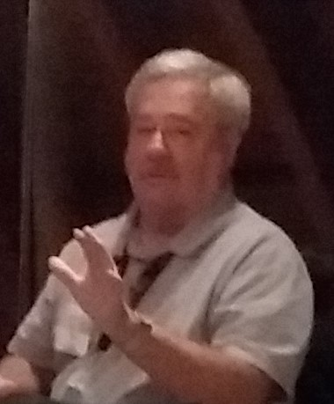
Because of the “goodness of God” that is taught only by Paul and found only in a King James 1611 Bible, I hope this video presentation Bible study will bring to you a new level of understanding.
Or maybe you will experience a ‘new beginning’ in your life based on what you have just learned from the Risen Christ through Paul in the KJB.
Prepared and presented by:
Mikel Paulson
2 Gretchen Ln, Bella Vista, AR 72715
509-876-1611
www.scatteredchristians.org
www.paulson1611rd.org
sousaman1611@cox.net
Remember, it is NOT the severity of God that will lead anyone to repentance today.
That is for tomorrow, during the time of great Tribulation
It is the ‘Goodness of God’ that leadeth ‘thee’ to repentance today, and it is a joyful repentance, too… …full of spiritual understanding!
The goodness of God is still in place ‘for’ and ‘to’ us during today’s Dispensation of the Grace of God

Slide 9
He which testifieth these things saith,
Surely I come quickly.
Amen.
Even so, come, Lord Jesus.
The grace of our Lord Jesus Christ
be with you all. Amen.

Slide 10
It is Finished

