Slide 1
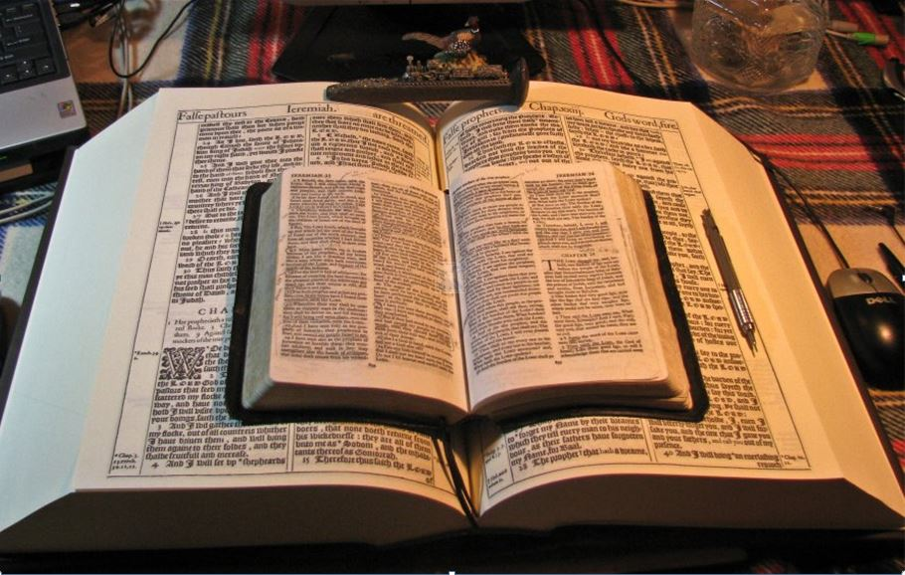
2021
…Praise thy name … for thy truth:
for Thou Hast Magnified Thy Word Above All Thy Name
‘Our Real Battle’
Part V - Conclusion
Understanding “It Is No More I That Do It”
GOODNESS of GOD
O wretched man that I am!
Who shall deliver me from the body of this death?
Romans 7:15-25
Mikel Paulson
2 Gretchen Ln., Bella Vista, AR 72715
sousaman1611@cox.net
www.scatteredchristians.org
www.paulson1611rd.org
YouTube – “Retired Music Educator”
Rightly Dividing
the Word of Truth
by the Apostle Paul Only
Bible Studies from the Risen Saviour Jesus Christ
from a King James 1611 Bible
Teaching the ‘Greater Commission’ According to the Apostle Paul!
Emphasizing the ‘Goodness of God’ During Today’s “Dispensation of the Grace of God.”

Slide 2
‘The Real Battle’
Part I - Sermon Video Presentation
Romans 5
To Understand the “Goodness of God”
Introduction to the “Real War for a Sincere Christian”
GOODNESS of GOD
Part II - Sermon Video Presentation
Romans 6:1-14
To Understand Being “Dead to Sin”
Part III - Sermon Video Presentation
Romans 6:15-23
To Understand Being “Made Free from Sin”
Part IV - Sermon Video Presentation
Romans 7:1-13
To Understand Being “Dead to the Law”
Part V - Sermon Video Presentation Conclusion
Romans 7:14-25
To Understand “It is No More I That Do It”
“The Real Battle for a Sincere Christian”

Slide 3
Now I beseech you, brethren, by the name of our Lord Jesus Christ, that ye all speak the same thing, and that there be no divisions among you; but that ye be perfectly joined together in the same mind and in the same judgment. I Cor 1:10
It is No More I That Do It
But I see another law in my members, warring against the law of my mind, and bringing me into captivity to the law of sin which is in my members. Romans 7:23
24,25a
O wretched man that I am!
who shall deliver me from the body of this death?
For the law of the Spirit of life in Christ Jesus hath made me free from the law of sin and death. Rom 8:2
For who hath known the mind of the Lord, that he may instruct him? But we have the mind of Christ. I Cor 2:16
For what the law could not do, in that it was weak through the flesh, God sending his own Son in the likeness of sinful flesh, and for sin, condemned sin in the flesh: Rom 8:3
I thank God through Jesus Christ our Lord.
That ye may with one mind and one mouth glorify God, even the Father of our Lord Jesus Christ. Rom 15:6
GOODNESS of GOD
Why was it so important to Paul to please God in his life?
Only let your conversation be as it becometh the gospel of Christ: that whether I come and see you, or else be absent, I may hear of your affairs, that ye stand fast in one spirit, with one mind striving together for the faith of the gospel; Phi 1:27
25b
So then…
I beseech you therefore, brethren, by the mercies of God, that ye present your bodies a living sacrifice, holy, acceptable unto God, which is your reasonable service.
with the mind I myself serve the law of God;
but with the flesh the law of sin.
And be not conformed to this world: but be ye transformed by the renewing of your mind, that ye may prove what is that good, and acceptable, and perfect, will of God. Rom 12:1,2
That ye be not soon shaken in mind, or be troubled, neither by spirit, nor by word, nor by letter as from us, as that the day of Christ is at hand. II Thess 2:2
There ya have it.
The ‘real’ war for a ‘sincere’ Christian!
For God hath not given us the spirit of fear; but of power, and of love, and of a sound mind. II Tim 1:7
According to the grace of God which is given unto me, as a wise masterbuilder, I have laid the foundation, and another buildeth thereon. But let every man take heed how he buildeth thereupon. I Corinthians 3:10
with the mind I myself serve the law of God;
Note: ‘Mind” is not mentioned in the OT and the only mention during the tribulation is I Pt 1:13, Heb 4:16, ‘when’ they beg for grace and receive it at the end when Christ shows up to ‘rescue’ them! Wherefore gird up the loins of your mind, be sober, and hope to the end for the grace that is to be brought unto you at the revelation of Jesus Christ;
Let us therefore come boldly unto the throne of grace, that we may obtain mercy, and find grace to help in time of need.
but with the flesh the law of sin.
Paul hated it! It is a constant war 24/7
all within yourself!
I have fought a good fight, I have finished my course, I have kept the faith:
Henceforth there is laid up for me a crown of righteousness, which the Lord, the righteous judge, shall give me at that day: and not to me only, but unto all them also that love his appearing. II Timothy 4:7,8
And also remember, they won’t have the KJB, either. Amos 8:11, Behold, the days come, saith the Lord GOD, that I will send a famine in the land, not a famine of bread, nor a thirst for water, but of hearing the words of the LORD:
O wretched man that I am!
who shall deliver me from the body of this death?

Slide 4
It is No More I That Do It
The Operation
Made Without Hands to Quicken You
I am interrupting this part V conclusion to show you
three important background doctrines
that show how all of this is totally made possible.
A Christians Judgment Seat
of Christ
Colossians 2:10-15
How can there be: an old man and a new man? Battle of the mind and flesh? Be hid in God? Be crucified with Christ? Be dead in Christ? Be a new creature knowing all things ‘are become new’? Be dead to sin?
Be dead to the law? How can Christ and Spirit
of God be in me and yet I am still alive doing
‘good and bad’ but learning to desire to do
more what is based on Paul’s manner of life?
Romans 14:10; I Cor 3:9-15; II Cor 5:10
This is a judgment for quickened people only. The judgment for the ‘lost’ is Revelation 20:11-15.
For us quickened, Christ has already paid the
judgment for our soul. This is the judgment
of our daily works based on whether we
followed Paul’s manner of life, giving God
His glory and fruit He designed for us to do.
GOODNESS of GOD
And ye are complete in him, which is the head of all principality and power: In whom also ye are circumcised with the circumcision made without hands, in putting off the body of the sins of the flesh by the circumcision of Christ:
For we must all appear before the judgment seat of Christ; that every one may receive the things done in his body, according to that he hath done, whether it be good or bad. II Cor 5:10
Rom 2:16, In the day when God shall judge the secrets of men by Jesus Christ according to my gospel.
Buried with him in baptism, wherein also ye are risen with him through the faith of the operation of God, who hath raised him from the dead.
According to the grace of God which is given unto me, as a wise masterbuilder, I have laid the foundation, and another buildeth thereon. But let every man take heed how he buildeth thereupon. For other foundation can no man lay than that is laid, which is Jesus Christ. Now if any man build upon this foundation gold, silver, precious stones, wood, hay, stubble; Every man's work shall be made manifest: for the day shall declare it, because it shall be revealed by fire; and the fire shall try every man's work of what sort it is.
Rom 6:22 … ye have your fruit unto holiness, and the end everlasting life.
And you, being dead in your sins and the uncircumcision of your flesh, hath he quickened together with him, having forgiven you all trespasses; Blotting out the handwriting of ordinances that was against us, which was contrary to us, and took it out of the way, nailing it to his cross; And having spoiled principalities and powers, he made a shew of them openly, triumphing over them in it.
Rom 7:4 … that we should bring forth fruit unto God.
Hebrews 4:12 For the word of God is quick, and powerful, and sharper than any twoedged sword, piercing even to the dividing asunder of soul and spirit, and of the joints and marrow, and is a discerner of the thoughts and intents of the heart.
If any
man's work abide which he hath built thereupon, he shall receive a reward. If any man's work shall be burned, he shall suffer loss: but he himself shall be saved; yet so as by fire. I Cor 3:11-15
Rightly Divide the Word of Truth
This is not a complicated ‘truth’ but it seems to be hated, rejected, ignored and completely misunderstood by just about everyone these days with eternal damnation results if rejected, etc. A sarcastic thank you is directed to the pastors, professors, publishers, bible committees, revisionists, etc. but especially to people who have NOT read the KJB!
Study to shew thyself approved unto God, a workman that needeth not to be ashamed, rightly dividing the word of truth. But shun profane and vain babblings: for they will increase unto more ungodliness. And their word will eat as doth a canker: of whom is Hymenaeus and Philetus; Who concerning the truth have erred, saying that the resurrection is past already; and overthrow the faith of some. II Timothy 2:15-18
It is simply knowing TO whom something is being directed to. Old Testament and Gospels and Acts 1-8 to the JEWS (History)! Romans to Philemon to the Gentiles (Present)! Hebrews to Jude to the tribulation people (mostly Jews). The Book of Revelation is past, present and future. Also, within Paul’s books, we must also be able to recognize what is written TO men, women, pastors, children, including knowing what was written before and after the arrival of the KJB (Corinthians).
PS – this is all simply obvious if you read from beginning to the end. The only reason we must emphasize it today is simply because people don’t read and the pastors, who are taken captive by the devil himself, have completely changed the truth of God into a lie, which, as it says in verse 18, have overthrown the faith of all their people today. GET BACK TO READING THE KJB, PEOPLE! Seriously, and t isn’t going to be available much longer, either! (Amos 8:11-13)

Slide 5
It is No More I That Do It
14 - For we know that the law is spiritual: but I am carnal, sold under sin.
So, we should now understand that purpose of the law and why we can see that the ‘law is spiritually designed and spiritually necessary. But we also should see why we shouldn’t park on the law and the severity of God to ‘win’ people to the Lord!
We also be able to now understand what ‘our flesh’ means – and that it is sinful in its design since man fell in the garden. “In the flesh” can mean two things – simply being alive and our inner sin nature. We died when the commandment came and introduced us to sin.
22 - For I delight in the law of God after the inward man:
Paul truly wanted to do the right thing for the Saviour that he met face to face as well as understanding what that Saviour did to him and for him. However, the battle rages as it did in Paul!
GOODNESS of GOD
Only to the sincerely quickened Christian is this battle so completely self-explanatory, thus so totally understandable!
No body, no thing, no how and no where can this be explained any better and any more truthful than in a King James 1611 Bible!
15-23
For that which I do I allow not: for what I would, that do I not; but what I hate, that do I.
If then I do that which I would not, I consent unto the law that it is good.
Now then it is no more I that do it, but sin that dwelleth in me.
For I know that in me (that is, in my flesh,) dwelleth no good thing:
for to will is present with me; but how to perform that which is good I find not.
For the good that I would I do not: but the evil which I would not, that I do.
Now if I do that I would not, it is no more I that do it, but sin that dwelleth in me.
I find then a law, that, when I would do good, evil is present with me.
For I delight in the law of God after the inward man:
But I see another law in my members, warring against the law of my mind,
and bringing me into captivity to the law of sin which is in my members.

Slide 6
It is No More I That Do It
That’s the real battle folks…
So, put your efforts on winning yourself to the real Christ, based on Paul as your masterbuilder, remembering that your works will be judged by the Risen Christ with Paul’s gospel to the Gentiles, not the apostle's doctrine to the Jews or by Peter’s Gospels to the Jews, or by James, Jude, John, etc.!
Sure, show & tell others about the Goodness of God through the Risen Saviour, Paul and the King James Bible – and it will be difficult.
24,25
O wretched man that I am! who shall deliver me from the body of this death?
I thank God through Jesus Christ our Lord.
So then with the mind I myself serve the law of God;
but with the flesh the law of sin.
But either through our own death or the rapture, the next big event is our own judgment seat of Christ!
GOODNESS of GOD
My final comments: I have noticed that during these modern Christianity days, pastors, educators, leaders, parents, etc. have done everything they could to convince their listeners that they are marvelously good people.
Today’s self-proclaimed Christian bases his ‘blessed life’ on God blessing him/her because they have ‘turned their lives over to Jesus’ and to ‘be like Christ,’ and now they think they walk that holy life here on earth, needing an occasional confession to make sure they are still clean enough for God’s physical blessings – so they can live a happy and prosperous ‘free’ life.
As a result, the severity of God approach does not only not work, it antagonizes the hearers to where it won’t be much longer and the ‘equal rights’ nonsense will become law and that will light the battle of good vs evil.
I am not sure why people think they are able to live that blessed life that earns physical blessings today when nobody in the past history ever could. Look at Adam and Eve, Abram, Moses, Samson and all the Jews during the OT / Gospels
Unfortunately, people do not ‘have a clue’ that the ‘goodness of God’ is what will bring people to Christ. To top that off, they have ‘no clue’ as to what the Goodness of God even consists of or what it even means.
But not today – suddenly, Gentiles are NOW somehow able to walk that clean walk, still with a few ‘bland’ general confessions will make them the great people they think they are? There are two verses that ‘label’ and ‘describe’ the people today who act like the ‘holy’ and ‘clean’ Christian they think they are!
If a person is willing to consider their eternal future, they may be willing to admit they are ‘lost’ and bound for Hell, etc. However, they really are not taught what that ‘lostness’ really consists of, thus they have no idea what Paul or even a King James Bible is talking about when it comes to being lost.
For I would not, brethren, that ye should be ignorant of this mystery,
lest ye should be wise in your own conceits; that blindness in part is happened to Israel, until the fulness of the Gentiles be come in. Romans 11:25
Hopefully this series has shown you more of what a ‘lost’ person really is and how the Risen Saviour does a lot more than just put a pencil check by your name that says you are saved.
Lastly: Church-Going-Christians need to heed Paul as he told people on Mars’ Hill…
If you keep looking to Paul in a KJB, you will find all the wonderful truth about the real living saving God!
I perceive that in all things ye are too superstitious. For as I passed by, and beheld your devotions, I found an altar with this inscription, TO THE UNKNOWN GOD.
Whom therefore ye ignorantly worship, him declare I unto you. Acts 17:22b,23

Slide 7
It is No More I That Do It
End of Part V and end of I-V series.
Be sure to follow up with more on Romans where we will look at this statement in chapter 8:
There is therefore now no condemnation to them which are in Christ Jesus…
GOODNESS of GOD
The Goodness of God
Dead to Sin
Made Free from Sin
Now the God of hope fill you
with all joy and peace in believing,
that ye may abound in hope,
through the power of the Holy Ghost.
Romans 15:13
Dead to the Law
It is No More I That Do It
OUR REAL WAR:
The Law of Our Mind vs
The Law of Sin
Are you ‘In Christ Jesus’ or are you just a good person?
Do you blanketly BELIEVE and TRUST your pastor?
Are you wasting your time and energy on the wrong war?
Do you live daily by YOUR faith or the faith OF Jesus Christ?
Do you own, read or even understand the King James Bible?
Do you say you are you ‘born again,’ ‘saved,’ or quickened?
Are you following the ‘wrong’ doctrines?
If you were to die today, do you know if you would be with God?
Are you following ‘another’ Jesus?
Do you have that God-given peace that passeth all understanding?

Slide 8
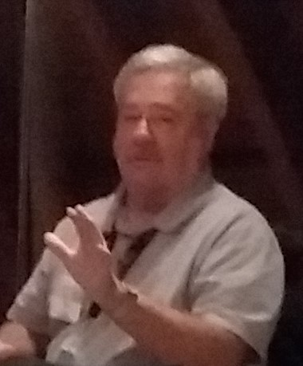
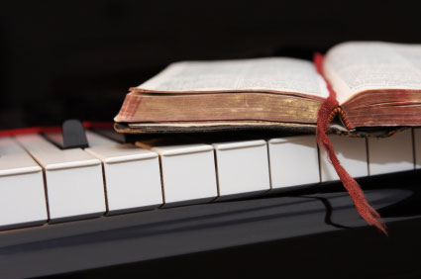
Because of the “goodness of God” that is taught only by Paul and found only in a King James 1611 Bible, I hope this video presentation Bible study will bring to you a new level of understanding.
Or maybe you will experience a ‘new beginning’ in your life based on what you have just learned from the Risen Christ through Paul in the KJB.
Prepared and presented by:
Mikel Paulson
2 Gretchen Ln, Bella Vista, AR 72715
509-876-1611
www.scatteredchristians.org
www.paulson1611rd.org
sousaman1611@cox.net
Remember, it is NOT the severity of God that will lead anyone to repentance today.
That is for tomorrow, during the time of great Tribulation
It is the ‘Goodness of God’ that leadeth ‘thee’ to repentance today, and it is a joyful repentance, too… …full of spiritual understanding!
The goodness of God is still in place ‘for’ and ‘to’ us during today’s Dispensation of the Grace of God

Slide 9
He which testifieth these things saith,
Surely I come quickly.
Amen.
Even so, come, Lord Jesus.
The grace of our Lord Jesus Christ
be with you all. Amen.

Slide 10
It is Finished

