Slide 1
Religion Today

Slide 2
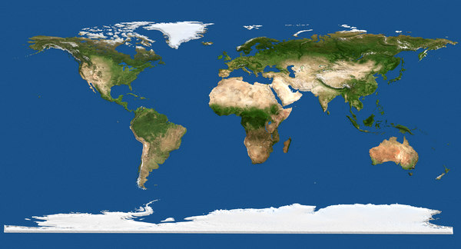
A World Without the Living God
Is a World With the ‘Imitation’ god!
For thou hast said in thine heart, I will ascend into heaven,
I will exalt my throne above the stars of God:
I will sit also upon the mount of the congregation, in the sides of the north:
I will ascend above the heights of the clouds;
I will be like the most High.
Yet thou shalt be brought down to hell, to the sides of the pit.
A Religion is Never Truth
Truth is Never a Religion

Slide 3
A WORLD Without the Living God
Has a Religion
The Holy Spirit has traveled from Antioch to Europe, to Africa, over to America, to Asia and back. The infamous and historically popular revivals of Europe, USA, China, etc. were smoke screens that hid the truth of a rightly divided KJB. The ‘truth’ was always replaced with a popular, less persecuting, guilt-causing, ‘hard’ preaching ‘Christianity.’ The miraculous Great Commission, with all its Jewish signs and wonders, replaced Paul’s Greater Commission containing the words and faith ‘of’ the risen Jesus Christ – all in preparation for the global arrival of the antichrist - ‘another Jesus - vs the return of the real Christ.
Note that a study of the music of Shem, Ham and Japheth reveals the global coming together as people unknowingly worship the antichrist with their fleshly desire and use of ‘all kinds of music’ (Daniel 3). Music has always preceded history. One can easily learn what has happened, is happening and will happen, all through a simple biblical study of music.
Note the increased and total ecumenical acceptance from ALL the Protestant denominations as they have returned to the Catholic mother ship while the world continues to move towards a global one-world religion.
Note the globally forced acceptance of the Islam religion, as portrayed by the ‘media,’ as a religion of love through the ‘needs’ of the Islamic refugees that is really nothing but part of a war started by Ishmael and will NEVER be stopped except by the return of the real Christ. This media directed cause for allowing these Israel-hating invaders hiding among the ‘refugees’ to come in to destroy the rest of the world is the proclamation of ‘religious freedom.’
Note the rejection of the US Constitution and thanklessness from all peoples today, as they ignore the fact that America has provided (food, inventions, rebuilding monies, debt forgiveness, clothes, civilized lifestyles, etc. and the global reaction of hate towards America being the most powerful nation.
Note the design, growth, acceptance and the media’s common-sense presentation of the mark of the beast / chip towards a global economy, a presentation that will convince ‘or require’ everyone ‘join in’ while giving the world governments 100% taxed-income control.
Note the global ‘love’ and tolerance of perverted lifestyles and the global ‘hate’ and intolerance towards Christian morals, manner of life, words of God, etc., especially from within America itself. The ’envy’ that is destroying America is like the ‘envy’ that brought on the crucifixion of Jesus.
The devil himself, portraying to be ‘another Jesus’ to the world, is simply trying to complete his desire
‘to be like the most high’ in all the world. Isaiah 14:14.

Slide 4
A NATION Without the Living God
Has a Religion
Even though America has been a provider of the King James Bible for years, its religious leaders replaced it with the ASV, NIV, etc. many years ago. Most of the dealings within the congregations were a financial payoff to the pastor to get the KJB out of their pews, thus they contributed and even caused this nation to fall into temptation, a snare and into many foolish and hurtful lusts. Money has become the major coveted item making this nation to err from the faith; the people as well as the nation have pierced themselves through with many sorrows. It is not God’s judgment we are seeing – it is the reapings from the work of the ‘clergy!’
America has become a nation full of pride, fullness of bread with an abundance of idleness. Instead of strengthening the hand of the poor and needy, we have become a welfare nation, actually making everyone weaker. America has become haughty and commits abominations with all the tolerance of the new evil lifestyles. America has taken on a religion – they have a god but it is NOT the Creator. America will soon usher in, if not even finance, the coming of the antichrist.
In this nation, as in all others now, children have become the oppressors, and women rule over the land more and more. Men have become as women and women as men. This nation is seeking to be replenished from the east.
In this nation, there is an increase of evil being called good and good being called evil; darkness is replacing light; bitter for sweet and sweet for bitter! People are becoming wise in their own sight. Vile people are electing vile leaders.
Because of this nation changing the truth of God into a lie and are now worshipping themselves as ‘the creature,’ God has given this nation up unto vile affections and given it over to a reprobate mind.
As a nation, America is increasing their choosing to go against Israel; however, it isn’t the physical blessings that America is losing by making this decision. It is the promise of Abraham’s imputed righteousness that people in this nation will miss.
This nation despises and rejects the riches of God’s goodness and forbearance and longsuffering; not knowing that the goodness of God would lead the citizens of America to repentance. The face that Gentile people should be seeking is the face (the mouth) of the risen Saviour – not the earthly Jesus.
The ‘Christianity’ in the churches of America today has been a false Christianity for many years. It is nothing but an empty ‘game-playing’ social group being run by gainsayers and evil men and seducers that are waxing worse and worse, deceiving and being deceived as their profane and vain babblings lead the people of this nation into an increase unto more ungodliness… all the while proclaiming that there is Christian revival going on in America – but alas, it is a false revival.
The affairs of this life and of this nation are the affairs of which we are not to be entangled. Yes, we must endure hardness, but these are not our wars. However, remember that this hardness is NOT for us to endure ‘to the end’ – it is just what happens when one chooses to try to live godly according to Paul.

Slide 5
A CHURCH Without the Living God
Has a Religion
The local church today teaches the Great Commission is supposed to be ‘confirmed’ by these signs: casting out devils; speaking with new tongues; taking up serpents, drinking any deadly thing and not be hurt; laying hands on the sick and they shall recover. That teaching was revived by in 1892 by William Carey, the so-called Father of Modern Missions. His book drove the truth away from God’s command to the Gentiles through Paul and his writings, to the gospels with the 12 apostles. The Gospels were written TO the Jews. Paul is the only apostle TO us as the Gentile nation today. Today’s Great Commission, if taught to be applied ‘to’ us today, is a false teaching today that was started by Baptist Missions yet the Baptists preach against signs, wonders, tongues, etc. Go figure!
Today’s emphasis in our local churches is from the Gospels, Acts, Hebrews, James, I II Peter, I II III John and Jude. However, those ‘teachings’ conflict with Paul’s books of Acts 9 through Philemon. Of course we must still read and learn Genesis to Revelation, but only Paul’s books are written TO us as Gentiles today. The preaching should be the words of the Risen Christ to the Gentiles, not the earthly doctrinal teachings of Jesus that was to be given to the Jews only.
When today’s pastors, authors, etc. do not teach and preach a rightly divided 1611 KJB, they are preaching profane and vain babblings which will increase unto more ungodliness and will overthrow people’s faith. They are men of corrupt minds, reprobate concerning the faith as they continue to resist the truth. They are proud, knowing nothing. They dote about questions and strifes of words, whereof cometh envy, strife, railings, evil surmisings. Yet, they blame others for causing division, when in God’s eyes, it is them who are causing the strifes of words, etc. They are men of corrupt minds and are destitute of the truth. They falsely teach that gain is godliness, thus the big mega churches and programs.
Because of the modern false gospel that pastors teach, Scripture calls them deceitful workers. While they are labeled as ministers of righteousness, the righteousness that they teach is their own, not God’s own righteousness that He imputes to His believers. Concerning the truth, they have erred! In their own deceitfulness, they cause others to also be deceitful as well as greatly educated to deceive others. These are evil men and seducers that shall wax worse and worse.
Today’s local church design and purpose is falsely based on Acts 2:41-47 instead of Paul’s Ephesians 4:12-16. No wonder the local churches have become a social gospel as they try to have favour with all the people. They do the apostle’s water baptism instead of the spiritual baptism that Paul teaches; they teach the apostles doctrine instead of Paul’s doctrine; they preach fear and guilt by preaching the severity of God instead of the riches of understanding, a peace which passeth all understanding, etc. through the goodness of God, which promises to lead people to repentance today.
We are not only not to be ashamed of the testimony of our Lord, but we are also not to be ashamed of the testimony of Paul. The risen Saviour tells the pastors today to bring the people into remembrance of Paul’s ways which be in Christ – and are to be taught every where in every church.
While our works will be judged by Jesus Christ, He will be using His teachings to us Gentiles through Paul, the manner of life which we are to strive to follow. We are to be stablished by Paul’s gospel, and the preaching of Jesus Christ, ACCORDING to the revelation of the mystery – which is exactly what ‘only Paul’ teaches.
Simply stated, today’s modern Christianity that is taught in all denominations today is a perverted gospel of Christ, of which Paul warns about in Gal 1:6-12 and II Cor 11:1-4.

Slide 6
A FAMILY Without the Living God
Has a Religion
The kids will easily see a) the false religion of their parents; b) a lying shyster of a ‘nice guy’ pastoral extortioner with his empty pastoral promises, threats, and signs with no results other than watching his parents spending lots of money from guilt producing sermons; c) prayers with no answers; d) their obedience not followed with blessings; e)their rebellion not followed by God’s chastisement. They will not see the results of the signs, wonders and miracles that denominations claim through their false Great Commission emphasis.
The kids will long for a) the joyful yet expensive feeding of their growing flesh and their newly acquired desires; b) friends and family members who are wise to their parent’s false religion; c) the days when they can escape from the domination, the ‘cruelty’, the unfun and unpleasant life of a false threatening scaring and guilt producing religion that their ‘mean’ and ‘unloving’ parents exhibit with their threats and teachings of the severity of God...
…OR the kids will get tired of all the lovey-dovey butterfly sweet sugary huggy Christians that produce nothing but other love-dovey butterfly Christians that show little if anything of the truth in their lives – just a wishy-washy false and fake and emptiness they call love.
The spouses will eventually leave each other, if not in an official divorce, at least in relationship. The kids will not see ‘true love’ within the household so their future household will never develop that love of truth and grace that the risen Saviour offers through Paul. They will, in fact, reject marriage and will want nothing to do with ‘any’ God – be it the Risen Saviour or not.
With the wife having become the ‘leader’ of the home because she was taught that she is the Holy Spirit of the family and that the man no longer follows the strong male role God would have him follow, the boys will become effeminate as the weaker male and now possibly even reverse their entire physical and sexual structure as well as their behavior around to the female side. The girls then, will become the strong, sports oriented, educated leader of her future family, and her marriage will eventually fail “because her dad and her coaches taught her to be strong and aggressive – even IF she were to ever desire to live the religious marriage design.
In order for the parents to ‘keep’ their child happy at home, they will have to give-in to their wants, whinings and wishes. Essentially, the children become the oppressors of their home and school – and will eventually turn into great members of the ’entitled beggars’ society who now demand their ideology through riot and destruction as they will still easily follow any and all anti-Christianity groups and organizations – including Communism, Marxism, Socialism, etc..
The wives a) will not adorn themselves in modest apparel or behavior; b) will participate in or even cause riotous behavior; c) will have no shamefacedness and sobriety; d) will wax wanton against the risen Christ and e) will thus cast off their first faith (if they ever even had one to cast off); f) they will be easily turned aside after Satan; g) they will be easily led away with divers lusts because they will be silly women laden with sins.
The number one love for the family will be for all members to work so they can make enough money to have the lusts they want. With money as their true god, they will fall into temptation and a snare, and into many foolish and hurtful lusts which will drown them in destruction and perdition. They will covet money so much that they will err from the faith thus piercing themselves through with many sorrows; and once all that damage starts taking place, ‘sure as shootin’, they will blame God for ‘not being there their difficult times’ and for ‘not loving them.’ Eventually they will either 1) no longer believe in any God; or 2) seek a denomination, cult OR an Eastern religion that will promise to bless / care for them physically and financially.
They miss out on the simple goodness of God that would lead the entire family to repentance and a growth full of understanding, nurturing through their knowledge of the RISEN SAVIOUR!
A family with a religion instead of the living God does not have a home; they just have an empty place for everyone to sleep and store their earthly riches!

Slide 7
A PERSON Without the Living God
Has a Religion
One of the greatest deceptions being taught from modern bible versions is when the KJB says ‘be followers,’ the modern bibles and pastors teach others to be ‘imitators’ of God, Paul, Jesus, the body of Christ, of their pastor’s walk and faith. An imitator is NOT a follower but is a fake – a fraud – a phony. Being an imitator of God is to be ‘like’ God, ‘like’ Jesus, ‘like’ Paul, ‘like’ the body of Christ, ‘like’ his faith - except that makes them really a liar, a fake, an antigod, an antichrist!
Religion Makes Imitations
Imitation Scriptures
Imitation Spirit
Imitation Churches
Imitation Pastors
Imitation Signs
Imitation Savio’r
Imitation Salvation
Resemble the Real Thing
In Sight – but easier
In Sound – but easier
In Success – financially only
Devilish
Gospel Water Baptisms
Appearance
Professional
Pleasing
Phony
Portray Casual
Signs were ‘to’ the Jews during the days of the Gospels, NOT ‘to’ the Gentiles today during the ‘dispensation of the grace of God
Was Formed in Eternity
But not as Jesus’ brother or God manifest in the flesh’
Resembles the Truth
Appears to be Righteous
Appears to be Real
Appears to Appeal
Disgusting
Ungodly
Unclean
Unhealthy
Unreal
Apostles OT Doctrine
Apostles OT Fellowship
Receive Praise from
the Religious
Unsaved
Ungodly
Unbelieving
Breaking of Bread
Attitude
Causes Deception
Creates Division
Contradicts Doctrine
Circulates Doubt
Removes the Shed Blood
Replaces it with Water
Replaces it with Works
Replaces it with
wishful thinking
Dynamic
Supernatural in:
Strength
Signs
Secrets
Imitation Prayer
Signs were for confirming the ‘Great Commission’ during the days of the Gospels and apostles
Is Feminine
Images always show long hair, soft lips, etc.
Portrayed as either soft, married or as sodomite, ‘gay’, or whatever you want him to be for you – your pal, buddy, etc.
Fear of God’s Severity
False Signs, Miracles
and Wonders
Appetites
Wealth
Women
Weak
Flesh
Rewards Sinner with Good Deeds with a…
Plan instead of a Man
Pride instead of a Master
Payment instead of Mercy
Robs Reliability of the Truth from the Readers
Of their Beliefs
Of their Behavior
Of their Battles
The signs that God did in the PAST are now the signs that the Devil does in the PRESENT as he performs them for the deceptions of the FUTURE
Directing
Against God’s: Word, Words, Ways & Wisdom
Speak New Tongues
Doctrinal
Profane and vain babblings increase in ungodliness
Unity Demanded
Removes the Realities of the Faith of Christ
…by putting the emphasis on the faith of the people in themselves instead of the faith OF Jesus Christ
Sold / Give Away
All Possessions
Abilities
None to Perceive
the Truth!
None to Preach
the Truth!
None to Practice
the Truth!
Numb the Weak
Seduce the Sheep
Lie to the Lost
Is Frail
In his Physique
In his Preaching
Results in Sorrow
Doubts in the Head
Deadness in the Heart
Damnation for the Soul
Depression for the Dying
Distressing
Disturbance in Soul
Distrust in Scriptures
Doubts about Salvation
Continued ‘Daily’ with One Accord in the Temple
The working of Satan is in all power and signs and lying wonders to deceive people into thinking ‘he’ is the real Jesus.
Those who are deceived will be part of the devil’s army when the real Jesus does come.
Gladness from
a False Unity
Is a Failure.
Unable to save
Unable to Secure
Unable to Strengthen
Do you have the Living God
or the Imitation?
Deceiving
In Final Judgment
Fake or Real Saviour
Seek Favour with
all the People

Slide 8
THE COMING OF SATAN – AS ANTICHRIST Revelation 6 | THE SECOND COMING OF JESUS CHRIST Revelation 19
War follows his arrival – a war among themselves! 6:4 | In righteousness he doth judge and make war! 19:11
His ministry ends up with the great day of God’s wrath! 19:15 | He is God’s wrath! 19:12-15
Comes with a bow! 6:2 | Comes with a sword! 19:15
Comes with no name! | Called Faithful and True! 19:11
Crown is given to him! 6:2 | Comes with many crowns! 19:12
Death and hell as they fight against themselves! 6:8 | Death and hell for those that fight against Him! 19:17-21
Comes to conquer! 6:2 | Has already overcome! His kingdoms are now! Jn 16:33; 5:45, Rev 11:15
Takes peace from the earth! 6:4 | Makes peace on the earth! 19:15
People make war amongst themselves! 6:8 | People make war against Him! 19:15
A sword is given to him! 6:4 | Comes with a sharp sword out of his mouth! 19:15
Measures out food… famine follows! 6:5-8 | Christ feeds those people to the birds! 19:17-18
Kills people for their testimony and the word of God! 6:9-11 | His people are killed for their testimony and His words! 6:9-11
Has a city who is a bride: Babylon! 17:1-18 | Has a city who is a bride! 21,22
An ‘angel of light’! II Corinthians 11:14 | The “light of the world”! John 8:12; 9:5
King over all the children of pride! Job 41:34 | King of Kings! 19:16
“Prince of this world!” John 14:30 | “Prince of Peace!” Isaiah 9:6
The “god of this world”! II Corinthians 4:4 | “My Lord and God”! John 20:28
He corrupted Scriptures by saying, “It is written…”! Luke 4:10 | He quoted Scriptures to Satan saying, “It is written…”! Luke 4:4,8
“Adversary – as a roaring lion”! I Peter 5:8 | “Lion of the Tribe of Judah”! 5:5
Author of all modern bibles! John 8:44 | Author of King James 1611 Bible I Corinthians 13:8-10

Slide 9
A World Without
the Living God
Will Worship the ‘Imitation’ god!
And he had power to give life unto the image of the beast, that the image of the beast should both speak, and cause that as many as would not worship the image of the beast should be killed. And he causeth all, both small and great, rich and poor, free and bond, to receive a mark in their right hand, or in their foreheads: And that no man might buy or sell, save he that had the mark, or the name of the beast, or the number of his name. Here is wisdom. Let him that hath understanding count the number of the beast: for it is the number of a man; and his number is Six hundred threescore and six.
A Religion is Never Truth
Truth is Never a Religion

Slide 10
A World With
the Living God
Is a World With the Risen Saviour
Even if it is just in ‘your’ own private world for now
, it won’t have to be for much longer!
For they themselves shew of us what manner of entering in we had unto you, and how ye turned to God from idols to serve the living and true God; And to wait for his Son from heaven, whom he raised from the dead, even Jesus, which delivered us from the wrath to come.
And he was clothed with a vesture dipped in blood:
and his name is called The Word of God.
And out of his mouth goeth a sharp sword,
that with it he should smite the nations:
and he shall rule them with a rod of iron:
and he treadeth the winepress of the
fierceness and wrath of Almighty God.
And he hath on his vesture and on his thigh a name written,
That ye be not soon shaken in mind, or be troubled, neither by spirit, nor by word, nor by letter as from us, as that the day of Christ is at hand. Let no man deceive you by any means: for that day shall not come, except there come a falling away first, and that man of sin be revealed, the son of perdition; Who opposeth and exalteth himself above all that is called God, or that is worshipped; so that he as God sitteth in the temple of God, shewing himself that he is God.
KING OF KINGS, AND LORD OF LORDS.

Slide 11
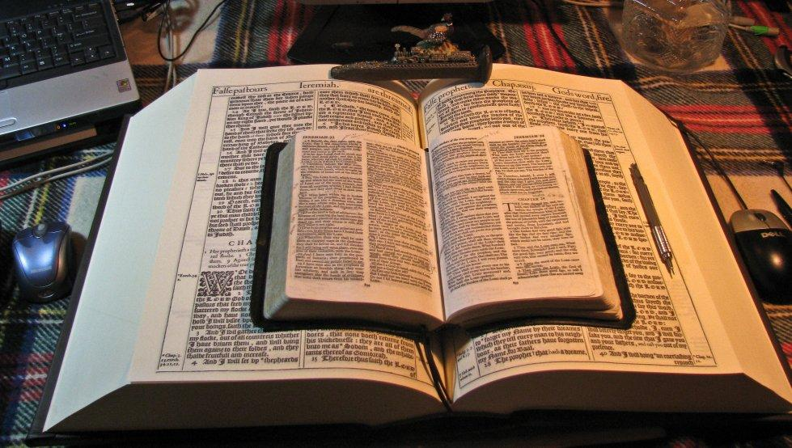
The wisdom of this world!
King James 1611 Bible
Ever learning, and never able to come to the knowledge
of the truth.
The Truth

Slide 13
Get one while you still can!
And I don’t mean from any ‘religious / Christian’ bookstore run by thieves and robbers
Behold, the days come, saith the Lord GOD,
that I will send a famine in the land,
not a famine of bread, nor a thirst for water,
but of hearing the words of the LORD.
And they shall wander from sea to sea,
and from the north even to the east,
they shall run to and fro
to seek the word of the LORD,
and shall not find it.
Amos 8:11-13
www.scatteredchristians.org

Slide 14
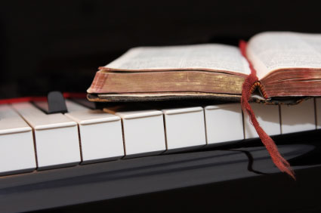
The End…
Prepared and presented by:
Mikel Paulson
2 Gretchen Ln
Bella Vista, AR 72715
509-876-1611
www.scatteredchristians.org
www.paulson1611rd.org
sousaman1611@cox.net
…but only of this presentation.
Hopefully, this also begins a new level or maybe even a ‘new beginning’ in your life based on what you have just learned from the Risen Christ… and also because of the “goodness of God” as taught by Paul, as found only in a King James Bible…
…knowing that the
goodness of God
leadeth thee to repentance
Romans 2:4b

Slide 15
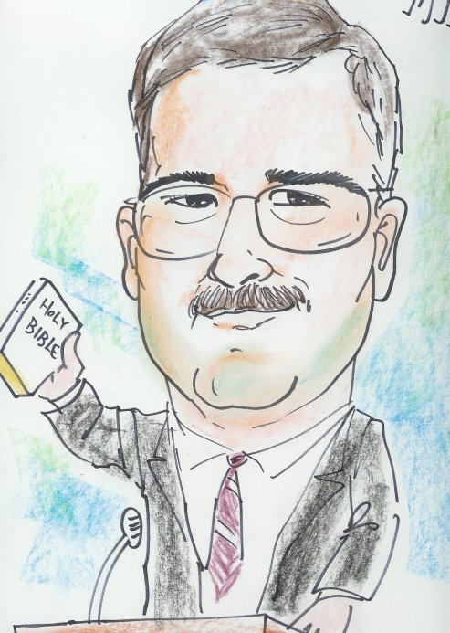
This is just a friendly reminder that this PowerPoint Presentation was designed by Mikel Paulson.
God breathed His pure words and then preserved them; Paul preached them and passed them to me in my KJB.
I just played with the PowerPoint to help make the ‘point’ with a powerful approach.
June 2016, updated October 2020 – www.scatteredchristians.org and www.paulson1611rd.org
This presentation is not copyrighted, of course, so if you can add more information, and there is a lot more that I am sure can be added to this, feel free to do so. My only expectation is that you use ONLY a King James 1611 Bible. Actually, that is not a huge concern of mine because if you tried to use any other modern bibles, you would find they wouldn’t work with this anyway; thus we see once again, the importance of a rightly divided 1611 KJB ONLY for truth.
If you do add more comments, scripture references, etc. for your own use – or to pass on to others,
please pass it on to me, as well. I would be glad to update yours to the website.
But watch thou in all things, endure afflictions,
do the work of an evangelist, make full proof of thy ministry.
One more thing: everything stated within this presentation is supported by KJB Scripture. If you want to know the scriptures used, then contact me, or look them up yourself. They exist!
- KJB ONLY -

Slide 16
The grace of our Lord Jesus Christ be with your spirit. Amen

