Slide 1
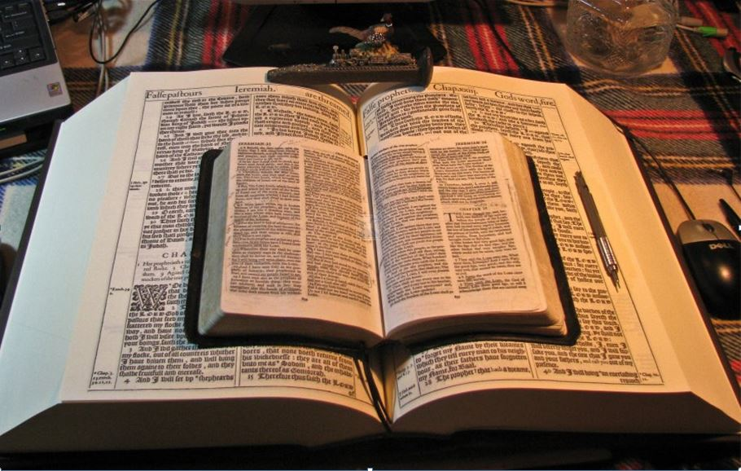
November 2021
…Praise thy name for… thy truth:
for Thou Hast Magnified Thy Word Above All Thy Name
November 2021
Holding fast the faithful word as he hath been taught,
that he may be able
by sound doctrine
both to exhort and
to convince the gainsayers.
Titus 1:9
Voice from Heaven
All scripture is given by inspiration of God,
and is profitable
for doctrine, for reproof,
for correction,
for instruction in righteousness…
Let it even be established,
that thy name may be magnified for ever.
I Chronicles 17:24
Study to shew thyself approved unto God,
a workman that needeth not to be ashamed, rightly dividing the word of truth.
II Timothy 2:15
…for thou hast magnified thy word
above all thy name.
Psalm 138:2b
…That the man of God may be perfect,
throughly furnished unto
all good works.
II Timothy 3:16,17
But when that which is perfect is come,
then that which is in part
shall be done away. I Corinthians 13:10
Mikel Paulson
2 Gretchen Ln., Bella Vista, AR 72715
sousaman1611@cox.net
www.scatteredchristians.org
www.paulson1611rd.org
YouTube – “Retired Music Educator”
Perfect - To finish or complete so as to leave nothing wanting Also see II Chronicles 8:16
Rightly Dividing
the Word of Truth
by the Apostle Paul Only
Bible Studies from the Risen Saviour Jesus Christ
from a King James 1611 Bible
Teaching the ‘Greater Commission’ According to the Apostle Paul!
Emphasizing the ‘Goodness of God’ During Today’s “Dispensation of the Grace of God.”
A PAUSE & STUDY
Bible Study.
A PAUSE & STUDY
Bible Study.

Slide 2
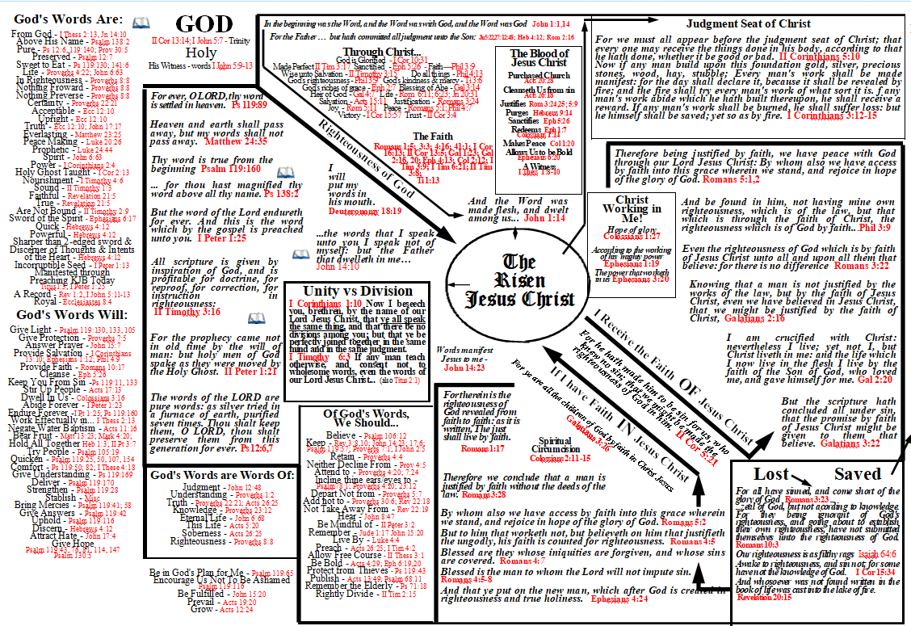
Romans 2:4b …not knowing that the goodness of God leadeth thee to repentance?

Slide 3
God's Words Are…
From God
I Thessalonians 2:13, Jn 14:10
Above His Name
Psalm 138:2
Pure
Psalms 12:6, 119:140; Proverbs 30:5
Preserved
Psalms 12:7
Sweet to Eat
Psalms 119:130; 141:6
Life
Proverbs 4:22; John 6:63
In Righteousness
Proverbs 8:8
Nothing Froward
Proverbs 8:8
Nothing Preverse
Proverbs 8:8
Certainty
Proverbs 22:21
Acceptable
Ecclesiastes 12:10
Upright
Ecclesiastes 12:10
Everlasting
Matthew 23:25
Peace Making
Luke 20:26; Philippians 4:8
Prophetic
Luke 24:44
Spirit
John 6:63
Power
I Corinthians 2:4
Holy Ghost Taught
I Corinthians 2:13
Nourishment
I Timothy 4:6
Sound
II Timothy 1:3
Faithful
Revelation 21:5
True
Revelation 21:5
Are Not Bound
II Timothy 2:9
Truth
Ecclesiastes 12:10; John 17:17
Sword of the Spirit
Ephesians 6:17
Quick
Hebrews 4:12
Powerful
Hebrews 4:12
Sharper than 2-edged Sword
Hebrews 4:12
Discerner of Thoughts
Hebrews 4:12
Discerner of the
Intents of the Heart
Hebrews 4:12
Incorruptible Seed
I Peter 1:13
Manifested Through
Preaching (KJB Today)
Titus 1:3
A Record
Revelation 1:2, I John 5:11-13
Royal
Ecclesiastes 8:4

Slide 4
Minister Grace
Ephesians 4:29
Give Light
Psalms 119:130, 133, 105
Give Protection
Proverbs 7:5
Answer Prayer
John 15:7
Provide Salvation
I Corinthians 13:10; Ephesians 1:12
Philippians 4:9
Provide Faith
Romans 10:17, Gal 2:16, 20; I Tim 4:6
Cleanse
Ephesians 5:26
Keep You From Sin
Psalms 119:11, 133’ Ephesians 2:1,5
Stir Up People
Acts 17:13
Dwell In Us
Colossians 3:16
Abide Forever
I Peter 1:23; Philippians 1:25
Endure Forever
I Peter 1:25; Psalms 119:160
Uphold
Psalms 119:116
God's Words Will…
Edify
Ephesians 4:29
Discern Thoughts and Intents
Hebrews 4:12
Attract Hate
John 17:4; Galatians 4:16
Give Hope
Psalms 119:43, 76, 81
114, 147; 130:5; Colossians 1:5
Work Effectually in
Them That Believe...
I Thessalonians 2:13
Negate Water Baptism
Acts 11:16
Encourage Us
Not To Be Ashamed
Romans 1:16; 10:11
Psalm 119:116; II Timothy 1:8
Be Fulfilled
John 15:20
Prevail
Acts 19:20
Grow
Acts 12:24
Make Known Unto Us
the Mystery
Ephesians 3:3
Bear Fruit
Matthew 13:23; Mark 4:20
Hold All Together
Hebrews 1:3; II Peter 3:7
Try People
Psalms 105:19
Quicken
Psalms 119:25, 50, 107, 154
Romans 8:11; Ephesians 2:1,5; Col 2:13
Comfort
Psalms 119:50; 82; I Thess 4:18; 5:11
Ephesians 6:22; Romans 15:4
Give Understanding
Psalms 119:169; II Tim 1:13
Deliver
Psalms 119:170
Strengthen
Psalms 119:28
Stablish
II Thessalonians 2:17
Bring Mercies
Psalms 119:41; 58
Give Answers
Psalms 119:42

Slide 5
Our Salvation In Relation To…
God
The Son
The Holy Spirit
Ourselves
Have Access to God’s Grace.
Ephesians 2:8, 18
Adopted into God's Family
Galatians 4:5; Ephesians 1:5
Get Heavenly Citizenship
Ephesians 2:19; II Cor 5:20
Become an Heir of God
Galatians 3:29; Romans 8:17 Ephesians 2:12-22
Have an Inheritance
Ephesians 1-3
Become a Servant of God
Romans 6:22
Are Reconciled to God
Romans 5:10; Ephesians 2:13
Have Peace with God
Philippians 4:7
Accepted in the Beloved
Ephesians 1:6
Baptized into Christ's Body
I Corinthians 12:13
Romans 6:4; Galatians 3:27
Buried with Christ
Colossians 2:10-12; Romans 6:4
Saved by Christ
Acts 16:31; Ephesians 2
Seated with Christ in
Heavenly Places
Ephesians 1:13,14; 2;6
Receive a Blessed Hope
Titus 2:13
Seals Us
Ephesians 1:13
Body becomes Temple
I Corinthians 6:19
We are Given
Spiritual Gifts
I Corinthians 12
Romans 12
II Thessalonians 2:1-6
We are Indwelt by...
Romans 8:11; II Timothy 1:14
I Corinthians 3:16
Accepted in the Beloved
Ephesians 1:6
We are Forgiven
Acts 26:18
We are Justified
Romans 5:1; 4:5
We are Quickened
Ephesians 2:1,5
We are Redeemed
Galatians 3:13; Titus 2:14
Victory over Sin
Romans 6:1,2,11,14
Become an Ambassador
II Corinthians 5:20
Become a New Creature
II Corinthians 5:17; Galatians 6:15
Sanctified
I Corinthians 6:11; Acts 26:18
‘Made’ Free
Romans 6:18, 22; 8:2
Galatians 5:1

Slide 6
The Word of God is Called:
word
Word of God
good word of God
word of thy lips
word of the Lord
word of his grace
word of the gospel
word of the kingdom
word of Jesus
word of the Lord Jesus
word of the LORD
word of Christ
word of his power
word of promise
word of faith
word of wisdom
word of knowledge
word of reconciliation
word of truth
word of life
word of the oath
word of exhortation
word of righteousness
word of they righteousness
word of prophecy
word of my patience
word of life
the truth of the gospel

Slide 7
Who / What / Where
is your final authority in your belief in all matters of faith
and practice? “Who says?”
The “Bottom Line Issue” is - WORDS!!
Ephesians 5:6 Let no man deceive you with vain words:
for because of these things cometh the wrath of God upon the children of disobedience.
Words?
Whose?
A Bible?
Many Bibles?
Which Bible?
Originals?
Is there really ‘one’ inspired and preserved so that I can read, study, hold in my own hand?
Which one?
Where is it?
Can you have just one?
OT Prophets?
12 Apostles
Paul ‘with’ or ‘ONLY’?
I Timothy 6:3-5 If any man teach otherwise, and consent not to wholesome words,
even the words of our Lord Jesus Christ, and to the doctrine which is according to godliness;
He is proud, knowing nothing, but doting about questions and strifes of words, whereof cometh envy, strife,
railings, evil surmisings, Perverse disputings of men of corrupt minds, and destitute of the truth,
supposing that gain is godliness: from such withdraw thyself.
I Corinthians 13:8-13; 14:1 Charity never faileth: but whether there be prophecies, they shall fail;
whether there be tongues, they shall cease; whether there be knowledge, it shall vanish away.
For we know in part, and we prophesy in part.
But when that which is perfect is come, then that which is in part shall be done away.
When I was a child, I spake as a child, I understood as a child, I thought as a child:
but when I became a man, I put away childish things.
People?
Who?
Pastor?
Church Denomination?
Musician/Music?
Author?
Professor?
You?
Feelings?
‘Spirit led”?
For now we see through a glass, darkly; but then face to face: now I know in part;
but then shall I know even as also I am known.
And now abideth faith, hope, charity, these three; but the greatest of these is charity.
Follow after charity, and desire spiritual gifts, but rather that ye may prophesy.
Behold, the days come, saith the Lord GOD, that I will send a famine in the land, not a famine of bread, nor a thirst for water,
but of hearing the words of the LORD:
And they shall wander from sea to sea, and from the north even to the east, they shall run to and fro to seek the word of the LORD,
and shall not find it.
Amos 8:11-13
See ‘Voice of the Stranger’ to learn about Satan’s words.

Slide 8
The Voice of the LORD:
The voice of the LORD is upon the waters:
The voice of the LORD is powerful;
The voice of the LORD is full of majesty.
The voice of the LORD breaketh the cedars;
The voice of the LORD divideth the flames of fire.
The voice of the LORD shaketh the wilderness;
The voice of the LORD maketh the hinds to calve,
and discovereth the forests:
from Psalm 29
By the word of the LORD were the heavens made; and all the host of them by the breath of his mouth
Psalm 33:6
For the LORD giveth wisdom: out of his mouth cometh knowledge and understanding.
Proverbs 2:6
Hearken unto me now therefore, O ye children, and attend to the words of my mouth.
Proverbs 7:24
All the words of my mouth are in righteousness;
there is nothing froward or perverse in them.
They are all plain to him that understandeth,
and right to them that find knowledge.
Proverbs 8:8,9
Diligently hearken to the voice of the Lord thy God
Exodus 15:6

Slide 9
The Authorized King James 1611 Holy Bible
For the word of God is quick, and powerful, and sharper than any two-edged sword,
piercing even to the dividing asunder of soul and spirit, and of the joints and marrow,
and is a discerner of the thoughts and intents of the heart.
Neither is there any creature that is not manifest in his sight:
but all things are naked and opened unto the eyes of him with whom we have to do. Hebrews 4:11,12
And I saw heaven opened,
and behold a white horse;
and he that sat upon him was called
Faithful and True,
and in righteousness he doth judge and make war.
His eyes were as a flame of fire,
and on his head were many crowns;
and he had a name written,
that no man knew, but he himself.
And he was clothed with
a vesture dipped in blood:
and his name is called The Word of God.
Revelation 19:11-13

Slide 10
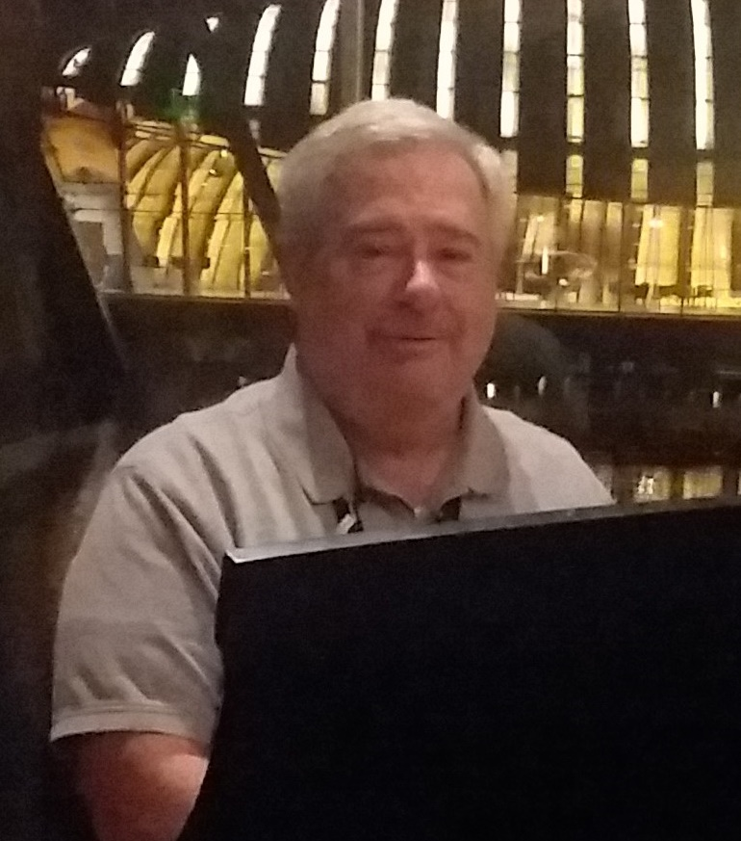
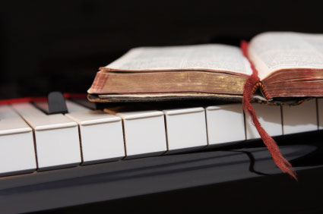
Because of the “goodness of God” that is taught only by Paul and found only in a King James 1611 Bible, I do sincerely hope this video presentation Bible study has brought you to a new level of Biblical / Scriptural awareness and understanding.
Prepared and presented by:
Mikel Paulson
2 Gretchen Ln, Bella Vista, AR 72715
509-876-1611
www.scatteredchristians.org
www.paulson1611rd.org
sousaman1611@cox.net
Or maybe you just need to receive that ‘new beginning’ with a soul saving ‘quickening’ in your life based on what you have just learned from the Risen Christ, through Paul, and as found only in the King James 1611 Bible.
Remember, it is NOT the ‘severity of God’ that will lead anyone to repentance today.
However, during the ‘time of the great tribulation,’ the severity of God returns and the goodness of God ends… and this time of tribulation does appear to be coming sooner than later!
It is the ‘Goodness of God’ that leadeth ‘thee’ to repentance today, and it is a joyful repentance with the riches of the full assurance of understanding and the peace of God that passeth all understanding!
The goodness of God is ‘still in place’ ‘for’ and ‘to’ us during today’s Dispensation of the Grace of God

Slide 11
Peace be to the brethren,
and love with faith,
from God the Father
and the Lord Jesus Christ.

Slide 12
Grace be with all them
that love our Lord Jesus Christ in sincerity.

Slide 13
Amen
Ephesians 6:23,24

