Slide 1
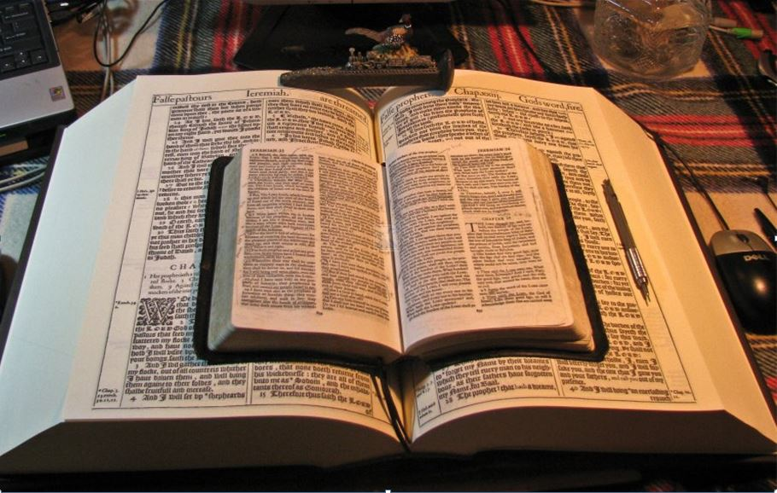
…Praise thy name for thy lovingkindness and for thy truth:
for Thou Hast Magnified Thy Word Above All Thy Name
II Thessalonians 2
Are we just CLOSER
or we are actually CLOSE?
…for that day shall not come, except there come a falling away first,
…only he who now letteth will let, until he be taken out of the way.
Mikel Paulson
2 Gretchen Ln., Bella Vista, AR 72715
sousaman1611@cox.net
www.scatteredchristians.org
www.paulson1611rd.org
YouTube – “Retired Music Educator”
Rightly Dividing
the Word of Truth
by the Apostle Paul Only
Bible Studies from the Risen Saviour Jesus Christ
from a King James 1611 Bible
Teaching the ‘Greater Commission’ According to the Apostle Paul!
Emphasizing the ‘Goodness of God’ During Today’s “Dispensation of the Grace of God.”

Slide 2
BESEECH, to entreat; to supplicate;
to implore;
to ask or pray with urgency;
II Thessalonians 2:1-12
Not ‘with’
Now we beseech you, brethren, by the coming of our Lord Jesus Christ, and by our gathering together unto him,
I Thess 4:13-18
That ye be not soon shaken in mind, or be troubled, neither by spirit, nor by word, nor by letter as from us,
as that the day of Christ is at hand.
Modern bibles, preachers, etc.
ENTREAT, to make an earnest petition or request.
Revelation 19:11
Let no man deceive you by any means: for that day shall not come,
except there come a falling away first,
and that man of sin be revealed, the son of perdition;
SUPPLICATE To entreat for; to seek by earnest prayer;
PERDI'TION, noun [Latin perditio, from perdo, to lose, to ruin.] 1. Entire loss or ruin; utter destruction; 2. The utter loss of the soul or of final happiness in a future state; eternal death.
Who opposeth and exalteth himself above all that is called God, or that is worshipped;
so that he as God sitteth in the temple of God, shewing himself that he is God.
Isaiah 14:12-16
Remember ye not, that, when I was yet with you, I told you these things?
I Thessalonians 4:13-18
And now ye know what withholdeth that he might be revealed in his time.
Revelation 6:1-5; I Peter 5:8
For the mystery of iniquity doth already work:
only he who now letteth will let, until he be taken out of the way.
Romans 5:9; 11:22; Ephesians 1:13
And then shall that Wicked be revealed,
Revelation 6:1-5; I Peter 5:8
whom the Lord shall consume with the spirit of his mouth, and shall destroy with the brightness of his coming:
Revelation 19:11-21
Even him, whose coming is after the working of Satan with all power and signs and lying wonders,
Revelation 16:13,14
And with all deceivableness of unrighteousness in them that perish;
Romans 1:28-2:4
because they received not the love of the truth, that they might be saved.
Romans 10:9-13, Ephesians 2:5
And for this cause God shall send them strong delusion, that they should believe a lie:
That they all might be damned who believed not the truth,
The truth today is NOT Mark 16:16-20
The Jews required ‘signs’ John 2:18 while the Gentiles are expected to use their brain… I Corinthians 1:22… thus the need for ONE Bible – in English, not a million modern versions!
Revelation 14:12
but had pleasure in unrighteousness.
Romans 1:28-32 to 2:1-5
Study
to shew thyself approved unto God, a workman that needeth not to be ashamed, rightly dividing the word of truth. II Tim 2:15
Do the study folks – and understand!

Slide 3
II Thessalonians 2:13-17
But...
…we are bound to give thanks alway to God for you, brethren beloved of the Lord,
because God hath from the beginning chosen you to salvation
through sanctification of the Spirit and belief of the truth:
Whereunto he called you by our gospel,
to the obtaining of the glory of our Lord Jesus Christ.
Therefore, brethren,
stand fast,
and hold the traditions which ye have been taught,
whether by word, or our epistle.
Now our Lord Jesus Christ himself,
and God, even our Father,
which hath loved us,
and hath given us everlasting consolation
and good hope through grace,
Comfort your hearts,
and stablish you in every good word and work.

Slide 4
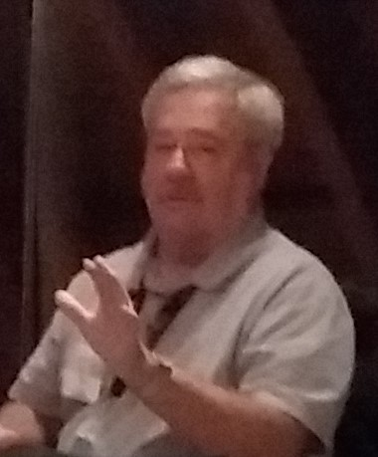
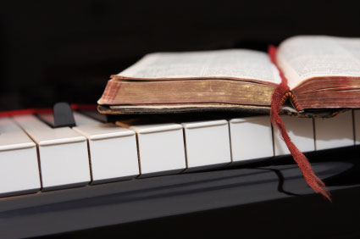
Because of the “goodness of God” that is taught only by Paul and found only in a King James 1611 Bible, I do sincerely hope this video presentation Bible study has brought you to a new level of Biblical and life understanding.
Or… maybe you need to experience a ‘new beginning’ in your life based on what you have just learned from the Risen Christ, through Paul, and found only in the King James 1611 Bible.
Prepared and presented by:
Mikel Paulson
2 Gretchen Ln, Bella Vista, AR 72715
509-876-1611
www.scatteredchristians.org
www.paulson1611rd.org
sousaman1611@cox.net
Remember, it is NOT the ‘severity of God’ that will lead anyone to repentance today.
However, during the time of the coming great tribulation, the severity of God returns… and it does appear to be coming sooner than later!
It is the ‘Goodness of God’ that leadeth ‘thee’ to repentance today, and it is a joyful repentance with the riches of the full assurance of understanding and the peace of God that passeth all understanding!
The goodness of God is ‘still in place’ ‘for’ and ‘to’ us during today’s Dispensation of the Grace of God

Slide 5
Peace be to the brethren,
and love with faith,
from God the Father
and the Lord Jesus Christ.

Slide 6
Grace be with all them
that love our Lord Jesus Christ in sincerity.

Slide 7
Amen
Ephesians 6:23,24

