Slide 2
The Christ That Paul Teaches
The Way of God More Perfectly – Acts 18:24-26
Shew I unto you a more excellent way! I Corinthians 2:31
But when it pleased God … who … called me by his grace, To reveal his Son in me, that I might preach him among the heathen… Galatians 1:15,16

Slide 3
First, Christ followed the Jews
Then Christ asked them to follow Him
(note: He did NOT ‘imitate’ the Jews!)
Moreover, brethren,
I would not that ye should be ignorant, how that all our fathers were under the cloud,
and all passed through the sea;
And did all drink the same spiritual drink:
for they drank of that spiritual Rock that followed them:
and that Rock was Christ.
I Corinthians 10:1,4
(note: He did NOT ask them to ‘imitate’ Him!)
Jesus said unto him,
If thou wilt be perfect,
go and sell that thou hast,
and give to the poor,
and thou shalt have treasure in heaven:
and come and follow me.
Matthew 19:21
Soon, we will follow Christ directly
(note: We will NEVER ‘imitate’ Christ!)
And the armies which were in heaven
followed him upon white horses,
clothed in fine linen,
white and clean.
Revelation 19:14
Today, we are to follow Paul as he follows the risen Christ’s teachings
(note: We are NOT told to ‘imitate’ Paul)
Be ye followers of me, even as I also am of Christ. I Corinthians 11:1
When Christ, who is our life, shall appear,
then shall ye also appear with him in glory. Col 3:4
Also read:
Romans 11:13,14; 15:15,16; I Corinthians 3:10; 4:16 Philippians 3:17; 4:9; I Thessalonians 1:5,6; 4:1,2 II Thessalonians 3:7-9; I Timothy 1:15,16 II Timothy 2:7; 4:16,17
To the end he may stablish your hearts unblameable in holiness before God, even our Father, at the coming of our Lord Jesus Christ with all his saints. 1 Thess 3:13

Slide 4
This is the Risen Christ That Paul Teaches in my King James 1611 Bible
This PowerPoint Bible Study shows what Paul speaks TO us about the Risen and Returning Jesus Christ
after Christ had spoken directly to Paul following Christ’s own death, burial AND resurrection!
For do I now persuade men, or God? or do I seek to please men?
for if I yet pleased men, I should not be the servant of Christ.
But I certify you, brethren, that the gospel which was preached of me is not after man.
For I neither received it of man, neither was I taught it,
but by the revelation of Jesus Christ.
Galatians 1:10-12
Now to him that is of power to stablish you according to my gospel,
and the preaching of Jesus Christ, according to the revelation of the mystery,
which was kept secret since the world began,
But now is made manifest, and by the scriptures of the prophets,
according to the commandment of the everlasting God,
made known to all nations for the obedience of faith:
Romans 16:25,26
Paul is the only Apostle with the GREATER Commission to the Gentiles – YOU and ME!
For so hath the Lord commanded us, saying, I have set thee to be a light of the Gentiles,
that thou shouldest be for salvation unto the ends of the earth.
Acts 13:47
Note: This particular PowerPoint is more about the Christ that Paul preaches; not so much about Paul himself.

Slide 5
This is the Risen Christ That Paul Teaches in my King James 1611 Bible
Galatians
1:1 - He was & is raised from the dead! He is the RISEN Saviour to the Gentiles, not earthly Jesus to the Jews!
Paul, an apostle, (not of men, neither by man, but by Jesus Christ, and God the Father, who raised him from the dead;)
John 7:39 - (But this spake he of the Spirit, which they that believe on him should receive:
for the Holy Ghost was not yet given; because that Jesus was not yet glorified.)
Hebrews 9:16,17 - For where a testament is, there must also of necessity be the death of the testator.
For a testament is of force after men are dead: otherwise it is of no strength at all while the testator liveth.
1:4 - He gave himself for our sins - did spiritually deliver and will physically deliver us from this present evil world!
Who gave himself for our sins, that he might deliver us from this present evil world,
according to the will of God and our Father:
1:10 - He is the one to please!
For do I now persuade men, or God? or do I seek to please men? for if I yet pleased men, I should not be the servant of Christ.
2:4; 5:1 – He is our liberty because he ‘makes’ us free!
And that because of false brethren unawares brought in, who came in privily to spy out our liberty which we have in Christ Jesus, that they might bring us into bondage:
Stand fast therefore in the liberty wherewith Christ hath made us free, and be not entangled again with the yoke of bondage.
2:20 - He is the one living in us now / the one who loved & loves me - who gave himself for me!
I am crucified with Christ: nevertheless I live; yet not I, but Christ liveth in me:
and the life which I now live in the flesh I live by the faith of the Son of God, who loved me, and gave himself for me.

Slide 6
This is the Risen Christ That Paul Teaches in my King James 1611 Bible
Galatians
3:1 - He was crucified!
O foolish Galatians, who hath bewitched you, that ye should not obey the truth,
before whose eyes Jesus Christ hath been evidently set forth, crucified among you?
Hebrews 9:16,17 - For where a testament is, there must also of necessity be the death of the testator. For a testament is of force after men are dead:
otherwise it is of no strength at all while the testator liveth.
4:5 - He redeemed us from under the law!
To redeem them that were under the law, that we might receive the adoption of sons.
5:6 – In Jesus Christ, faith worketh by love.
For in Jesus Christ neither circumcision availeth any thing, nor uncircumcision; but faith which worketh by love.
6:15 - In Christ Jesus availeth a new creature (II Cor 5:17)
For in Christ Jesus neither circumcision availeth any thing, nor uncircumcision, but a new creature.
Therefore if any man be in Christ, he is a new creature: old things are passed away; behold, all things are become new.
6:16 - Our peace is based on our walk in Him!
And as many as walk according to this rule, peace be on them, and mercy…
6:17 - We bear his marks on us and in our life!
From henceforth let no man trouble me: for I bear in my body the marks of the Lord Jesus.

Slide 7
This is the Risen Christ That Paul Teaches in my King James 1611 Bible
Ephesians
1:3 - He blesses us with all spiritual blessings!
Blessed be the God and Father of our Lord Jesus Christ, who hath blessed us
with all spiritual blessings in heavenly places in Christ:
1:5 - He made our adoption possible!
Having predestinated us unto the adoption of children by Jesus Christ to himself,
according to the good pleasure of his will,
1:6 - He made us accepted in the beloved! (Romans 11:28)
To the praise of the glory of his grace, wherein he hath made us accepted in the beloved.
As concerning the gospel, they are enemies for your sakes: but as touching the election, they are beloved for the fathers' sakes.
1:7 - He gives us redemption through his blood / forgives all our sins!
In whom we have redemption through his blood, the forgiveness of sins, according to the riches of his grace;
1:8 - He abounds his wisdom and prudence toward us!
Wherein he hath abounded toward us in all wisdom and prudence;
1:9 - He makes known to us the mystery of his will!
Having made known unto us the mystery of his will, according to his good pleasure which he hath purposed in himself:

Slide 8
This is the Risen Christ That Paul Teaches in my King James 1611 Bible
Ephesians
1:13,14 - He gives to us & seals the earnest of his inheritance for now...
In whom ye also trusted, after that ye heard the word of truth, the gospel of your salvation:
in whom also after that ye believed, ye were sealed with that holy Spirit of promise,
Which is the earnest of our inheritance until the redemption of the purchased possession, unto the praise of his glory.
1:17 - He gives us the spirit of wisdom reveals Himself!
That the God of our Lord Jesus Christ, the Father of glory,
may give unto you the spirit of wisdom and revelation in the knowledge of him:
1:18 - He enlightens our spiritual sight, shows us the hope of God's calling, He shows us riches of his inheritance!
The eyes of your understanding being enlightened; that ye may know what is the hope of his calling,
and what the riches of the glory of his inheritance in the saints,
1:19 - He shows us the exceeding greatness of his power!
And what is the exceeding greatness of his power to us-ward who believe, according to the working of his mighty power,
2:1,5 - He quickens from being dead in trespasses & sins!
And you hath he quickened, who were dead in trespasses and sins;
Even when we were dead in sins, hath quickened us together with Christ, (by grace ye are saved;)
2:6 - He raised us up together, and made it so we can sit together in heavenly places IN Him!
And hath raised us up together, and made us sit together in heavenly places in Christ Jesus:

Slide 9
This is the Risen Christ That Paul Teaches in my King James 1611 Bible
Ephesians
2:7 - He shews the exceeding riches of God's grace in his kindness toward us through Himself!
That in the ages to come he might shew the exceeding riches of his grace in his kindness toward us through Christ Jesus.
2:10 - He creates us to do good works!
For we are his workmanship, created in Christ Jesus unto good works,
which God hath before ordained that we should walk in them.
2:12 - He gives us hope now and gives us God!
That at that time ye were without Christ, being aliens from the commonwealth of Israel,
and strangers from the covenants of promise, having no hope, and without God in the world:
2:13 - He makes us nigh to God!
But now in Christ Jesus ye who sometimes were far off are made nigh by the blood of Christ.
2:14 - He brings us together with the Jews, God’s own chosen people!
For he is our peace, who hath made both one, and hath broken down the middle wall of partition between us;
2:15-17 - He abolished the enmity between us and God!
Having abolished in his flesh the enmity, even the law of commandments contained in ordinances; for to make in himself of twain one new man, so making peace; And that he might reconcile both unto God in one body by the cross,
having slain the enmity thereby: And came and preached peace to you which were afar off, and to them that were nigh.

Slide 10
This is the Risen Christ That Paul Teaches in my King James 1611 Bible
Ephesians
2:18 - He gives us access unto the Father
For through him we both have access by one Spirit unto the Father.
2:19 - He makes us fellow citizens with God’s household!
Now therefore ye are no more strangers and foreigners, but fellowcitizens with the saints, and of the household of God;
2:20 - He builds us up on a solid foundation!
And are built upon the foundation of the apostles and prophets, Jesus Christ himself being the chief corner stone;
3:9-12 - He gives us access to the heavenly wisdom of God in a bold & confident manner because of His faith!
And to make all men see what is the fellowship of the mystery, which from the beginning of the world hath been hid in God, who created all things by Jesus Christ: To the intent that now unto the principalities and powers in heavenly places
might be known by the church the manifold wisdom of God, According to the eternal purpose which he purposed
in Christ Jesus our Lord: In whom we have boldness and access with confidence by the faith of him.
3:16 - He strengthens us by his Spirit!
That he would grant you, according to the riches of his glory, to be strengthened with might by his Spirit in the inner man;
3:17-19 - He dwells in our hearts by faith - roots and grounds us in His love - makes us good ground!
That Christ may dwell in your hearts by faith; that ye, being rooted and grounded in love,
May be able to comprehend with all saints what is the breadth, and length, and depth, and height;
And to know the love of Christ, which passeth knowledge, that ye might be filled with all the fulness of God.

Slide 11
This is the Risen Christ That Paul Teaches in my King James 1611 Bible
Ephesians
3:20 - He is able to do exceeding abundantly above all that we ask or think, etc.!
Now unto him that is able to do exceeding abundantly above all that we ask or think,
according to the power that worketh in us,
4:11 - He gives some, apostles, prophets, evangelists, pastors & teachers, etc.!
And he gave some, apostles; and some, prophets; and some, evangelists; and some, pastors and teachers;
4:12 - He works on perfecting us and edifying us - as well as showing us the true work of the ministry today!
For the perfecting of the saints, for the work of the ministry, for the edifying of the body of Christ:
4:2021 - He takes away our opinions / replaces them with His mind through His words in the KJB today!
But ye have not so learned Christ;
If so be that ye have heard him, and have been taught by him, as the truth is in Jesus:
4:23, 24 - He is the new man we are to put on - created in righteousness and true holiness!
And be renewed in the spirit of your mind;
And that ye put on the new man, which after God is created in righteousness and true holiness.

Slide 12
This is the Risen Christ That Paul Teaches in my King James 1611 Bible
Ephesians
5:2 - He gave himself for us an offering and a sacrifice to God for a sweetsmelling savour!
And walk in love, as Christ also hath loved us,
and hath given himself for us an offering and a sacrifice to God for a sweetsmelling savour.
5:14 - He wakes us up from the dead - turns light on!
Wherefore he saith, Awake thou that sleepest, and arise from the dead,
and Christ shall give thee light.
6:10-18 - He is all of our armour!
Finally, my brethren, be strong in the Lord, and in the power of his might.
Put on the whole armour of God, that ye may be able to stand against the wiles of the devil.
For we wrestle not against flesh and blood, but against principalities, against powers,
against the rulers of the darkness of this world, against spiritual wickedness in high places.
Wherefore take unto you the whole armour of God,
that ye may be able to withstand in the evil day, and having done all, to stand.
Stand therefore, having your loins girt about with truth, and having on the breastplate of righteousness;
And your feet shod with the preparation of the gospel of peace;
Above all, taking the shield of faith, wherewith ye shall be able to quench all the fiery darts of the wicked.
And take the helmet of salvation, and the sword of the Spirit, which is the word of God:
Praying always with all prayer and supplication in the Spirit, and watching thereunto with all perseverance and supplication for all saints;

Slide 13
This is the Risen Christ That Paul Teaches in my King James 1611 Bible
Philippians
1:6 - He will perform the good work he began in us until He comes back - we can be sure of that!
Being confident of this very thing, that he which hath begun a good work in you will perform it
until the day of Jesus Christ:
2:6 - He is equal with God!
Who, being in the form of God, thought it not robbery to be equal with God:
2:7 - He made himself of no reputation!
But made himself of no reputation,
2:7-8 - He took upon him the form of a servant, was made in the likeness of men! (see Romans 6:5)
…and took upon him the form of a servant, and was made in the likeness of men:
And being found in fashion as a man…
For if we have been planted together in the likeness of his death, we shall be also in the likeness of his resurrection:
2:8 - He humbled himself and became obedient unto death, even the death of the cross!
…he humbled himself, and became obedient unto death, even the death of the cross.

Slide 14
This is the Risen Christ That Paul Teaches in my King James 1611 Bible
Philippians
2:9 - He was and is highly exalted by God!
Wherefore God also hath highly exalted him
2:9 - His name is above every name! (see Psalm 138:2)
and given him a name which is above every name:
for thou hast magnified thy word above all thy name.
2:10 - He will be bowed down to by everything/one!
That at the name of Jesus every knee should bow,
of things in heaven, and things in earth, and things under the earth;
2:11 - Everyone will confess to Him that He is Lord!
And that every tongue should confess that Jesus Christ is Lord,
to the glory of God the Father.
3:9 - We will be found in HIS righteousness!
And be found in him, not having mine own righteousness, which is of the law,
but that which is through the faith of Christ, the righteousness which is of God by faith:
Romans 2:16 – He will be the final judge – of our works as a Christian and the sins of the lost.
In the day when God shall judge the secrets of men by Jesus Christ according to my gospel.
Every man's work shall be made manifest: for the day shall declare it, because it shall be revealed by fire;
and the fire shall try every man's work of what sort it is.

Slide 15
This is the Risen Christ That Paul Teaches in my King James 1611 Bible
Colossians
1:11 - We are strengthened with all his might unto all patience and longsuffering with joyfulness!
Strengthened with all might, according to his glorious power, unto all patience and longsuffering with joyfulness;
1:12 – He made us meet to be partakers of the inheritance.
Giving thanks unto the Father, which hath made us meet to be partakers of the inheritance of the saints in light:
Eph 3:6 That the Gentiles should be fellowheirs, and of the same body, and partakers of his promise in Christ by the gospel:
1:13 - He delivered us from the power of darkness!
Who hath delivered us from the power of darkness,
1:13 - He translated us into His spiritual kingdom!
and hath translated us into the kingdom of his dear Son:
1:14 - He redeemed us through his blood - even the forgiveness of sins!
In whom we have redemption through his blood,
even the forgiveness of sins:
1:15-17 - His image is of the invisible God Himself!
Who is the image of the invisible God,
the firstborn of every creature:

Slide 16
This is the Risen Christ That Paul Teaches in my King James 1611 Bible
Colossians
1:16- By him, for him, were all things created!
For by him were all things created, that are in heaven, and that are in earth, visible and invisible,
whether they be thrones, or dominions, or principalities, or powers: all things were created by him, and for him:
1:17- He is before all things and by him all things consist!
And he is before all things, and by him all things consist.
1:18 - He is the head of the body, the church!
And he is the head of the body, the church:
1:18-19 - In him, all fulness dwells!
who is the beginning, the firstborn from the dead;
that in all things he might have the preeminence.
For it pleased the Father that in him should all fulness dwell;
1:20 - He made peace for us through the blood of his cross!
And, having made peace through the blood of his cross …

Slide 17
This is the Risen Christ That Paul Teaches in my King James 1611 Bible
Colossians
1:20,21 - He reconciled all things unto himself!
…by him to reconcile all things unto himself;
by him, I say, whether they be things in earth, or things in heaven.
And you, that were sometime alienated and enemies in your mind by wicked works,
yet now hath he reconciled
1:22 - He will eventually present us holy and unblameable and unreproveable in the sight of God!
In the body of his flesh through death, to present you holy and unblameable and unreproveable in his sight:
2:2,3 - In whom are all the treasures of wisdom and knowledge!
to the acknowledgement of the mystery of God, and of the Father, and of Christ;
In whom are hid all the treasures of wisdom and knowledge.
2:10 – We are complete in him!
And ye are complete in him, which is the head of all principality and power:
2:11 - He put off the body of sins of our flesh!
In whom also ye are circumcised with the circumcision made without hands,
in putting off the body of the sins of the flesh by the circumcision of Christ:
2:12 - We are buried with Him and have risen with him!
Buried with him in baptism, wherein also ye are risen with him
through the faith of the operation of God, who hath raised him from the dead.

Slide 18
This is the Risen Christ That Paul Teaches in my King James 1611 Bible
Colossians
2:13 - He quickened us together with him, having forgiven us all trespasses!
And you, being dead in your sins and the uncircumcision of your flesh,
hath he quickened together with him,
having forgiven you all trespasses;
2:13 – He blotted out the handwriting of ordinances against us
Blotting out the handwriting of ordinances that was against us, which was contrary to us,
and took it out of the way,
nailing it to his cross;
2:15 – He triumphed over the enemy for us
And having spoiled principalities and powers, he made a shew of them openly,
triumphing over them in it.
3:4 - He will have us appear with him in glory!
When Christ, who is our life, shall appear,
then shall ye also appear with him in glory.

Slide 19
This is the Risen Christ That Paul Teaches in my King James 1611 Bible
I Thessalonians
3:12 - He makes us increase and abound in love toward one another and toward all men!
And the Lord make you to increase and abound in love
one toward another,
and toward all men,
even as we do toward you:
3:13 - He stablishes our hearts unblameable in holiness before God at His coming!
To the end he may stablish your hearts unblameable in holiness before God,
even our Father,
at the coming of our Lord Jesus Christ with all his saints.

Slide 20
This is the Risen Christ That Paul Teaches in my King James 1611 Bible
II Thessalonians
1:5-10 - He will take care of all necessary vengeance!
Which is a manifest token of the righteous judgment of God,
that ye may be counted worthy of the kingdom of God, for which ye also suffer:
Seeing it is a righteous thing with God to recompense tribulation to them that trouble you;
And to you who are troubled rest with us, when the Lord Jesus shall be revealed from heaven with his mighty angels,
In flaming fire taking vengeance on them that know not God, and that obey not the gospel of our Lord Jesus Christ:
Who shall be punished with everlasting destruction from the presence of the Lord, and from the glory of his power;
When he shall come to be glorified in his saints, and to be admired in all them that believe
(because our testimony among you was believed) in that day.
2:16 - He gives everlasting consolation and good hope!
Now our Lord Jesus Christ himself, and God, even our Father,
which hath loved us, and hath given us everlasting consolation and good hope through grace,
Comfort your hearts,
and stablish you in every good word and work.
3:3 - He stablishes us and keeps us from evil!
But the Lord is faithful, who shall stablish you, and keep you from evil.

Slide 21
This is the Risen Christ That Paul Teaches in my King James 1611 Bible
I Timothy
1:14 - His grace is abundant with faith and love!
And the grace of our Lord was exceeding abundant with faith and love which is in Christ Jesus.
2:5,6 - He gave himself a ransom for all!
For there is one God, and one mediator between God and men, the man Christ Jesus;
Who gave himself a ransom for all, to be testified in due time.
6:14b-15 - He is the blessed and ONLY Potentate, the King of kings, and Lord of lords!
…the appearing of our Lord Jesus Christ: Which in his times he shall shew,
who is the blessed and only Potentate, the King of kings, and Lord of lords;
Rev 19:16 - And he hath on his vesture and on his thigh a name written,
KING OF KINGS, AND LORD OF LORDS.
6:16 - He hath immortality, dwelling in the light which no man can approach unto, seen, can see, etc.
Who only hath immortality, dwelling in the light which no man can approach unto;
whom no man hath seen, nor can see:
6:16 - He is to whom be honour and power everlasting!
…to whom be honour and power everlasting. Amen.

Slide 22
This is the Risen Christ That Paul Teaches in my King James 1611 Bible
II Timothy
1:10 - He abolished death!
But is now made manifest by the appearing of our Saviour Jesus Christ, who hath abolished death…
1:10 - He brought life and immortality to light!
and hath brought life and immortality to light through the gospel:
2:1 - He gives us strength through his grace!
Thou therefore, my son, be strong in the grace that is in Christ Jesus.
And he said unto me, My grace is sufficient for thee:
for my strength is made perfect in weakness.
Most gladly therefore will I rather glory in my infirmities,
that the power of Christ may rest upon me.
II Corinthians 12:9 -
2:8 - He was raised from the dead!
Remember that Jesus Christ of the seed of David was raised from the dead according to my gospel:

Slide 23
This is the Risen Christ That Paul Teaches in my King James 1611 Bible
Titus
1:1-3 - He manifests His word through preaching of Paul and today, through the KJB!
Paul, a servant of God, and an apostle of Jesus Christ, according to the faith of God's elect,
and the acknowledging of the truth which is after godliness;
In hope of eternal life, which God, that cannot lie, promised before the world began;
But hath in due times manifested his word through preaching,
which is committed unto me according to the commandment of God our Saviour;
The words of the LORD are pure words:
as silver tried in a furnace of earth, purified seven times.
Thou shalt keep them, O LORD, thou shalt preserve them
from this generation for ever.
Psalm 12:6,7
2:13 - He is our blessed hope!
Looking for that blessed hope, and the glorious appearing of the great God and our Saviour Jesus Christ;
2:14 - He is the One who gave himself for us, that he might redeem us from all iniquity, and purify unto himself a peculiar people, zealous of good works.
Who gave himself for us, that he might redeem us from all iniquity,
and purify unto himself a peculiar people,
zealous of good works.

Slide 24
This is the Risen Christ That Paul Teaches in my King James 1611 Bible
Titus
3:4-6 – Because of the kindness and love of God our Saviour, he shed on us abundantly
the washing and renewing of the Holy Ghost!
But after that the kindness and love of God our Saviour toward man appeared,
Not by works of righteousness which we have done,
but according to his mercy he saved us,
by the washing of regeneration, and renewing of the Holy Ghost;
Which he shed on us abundantly through Jesus Christ our Saviour;
3:7 - He justified us by his grace that we should be made heirs according to the hope of eternal life!
That being justified by his grace, we should be made heirs according to the hope of eternal life.

Slide 25
This is the Risen Christ That Paul Teaches in my King James 1611 Bible
Philemon
1:3 - He is from whom grace and peace has come!
Grace to you, and peace, from God our Father and the Lord Jesus Christ.
1:6 - He is from whom every good thing is in!
That the communication of thy faith may become effectual
by the acknowledging of every good thing which is in you in Christ Jesus.
1:8,9 - He can be our boldness as well as for love’s sake approach to people.
Wherefore, though I might be much bold in Christ to enjoin thee that which is convenient,
Yet for love's sake I rather beseech thee,
being such an one as Paul the aged,
and now also a prisoner of Jesus Christ.
1:25 - He gives our spirit His grace!
The grace of our Lord Jesus Christ be with your spirit. Amen.

Slide 26
Paul’s Warns Us About Another Jesus, Another Spirit, and Another Gospel!
For I am jealous over you with godly jealousy:
for I have espoused you to one husband, that I may present you as a chaste virgin to Christ.
But I fear, lest by any means, as the serpent beguiled Eve through his subtilty,
so your minds should be corrupted from the simplicity that is in Christ.
For if he that cometh preacheth another Jesus, whom we have not preached,
or if ye receive another spirit, which ye have not received,
or another gospel, which ye have not accepted,
ye might well bear with him.
II Corinthians 11:2-4
I marvel that ye are so soon removed from him that called you into the grace of Christ unto another gospel:
Which is not another; but there be some that trouble you, and would pervert the gospel of Christ.
But though we, or an angel from heaven, preach any other gospel unto you than that which we have preached unto you,
let him be accursed. As we said before, so say I now again,
If any man preach any other gospel unto you than that ye have received, let him be accursed.
Galatians 1:6-9
As Jesus warned the Jews; we should also learn from that warning!
For there shall arise false Christs, and false prophets,
and shall shew great signs and wonders;
insomuch that, if it were possible,
they shall deceive the very elect.
Matthew 24:24

Slide 27
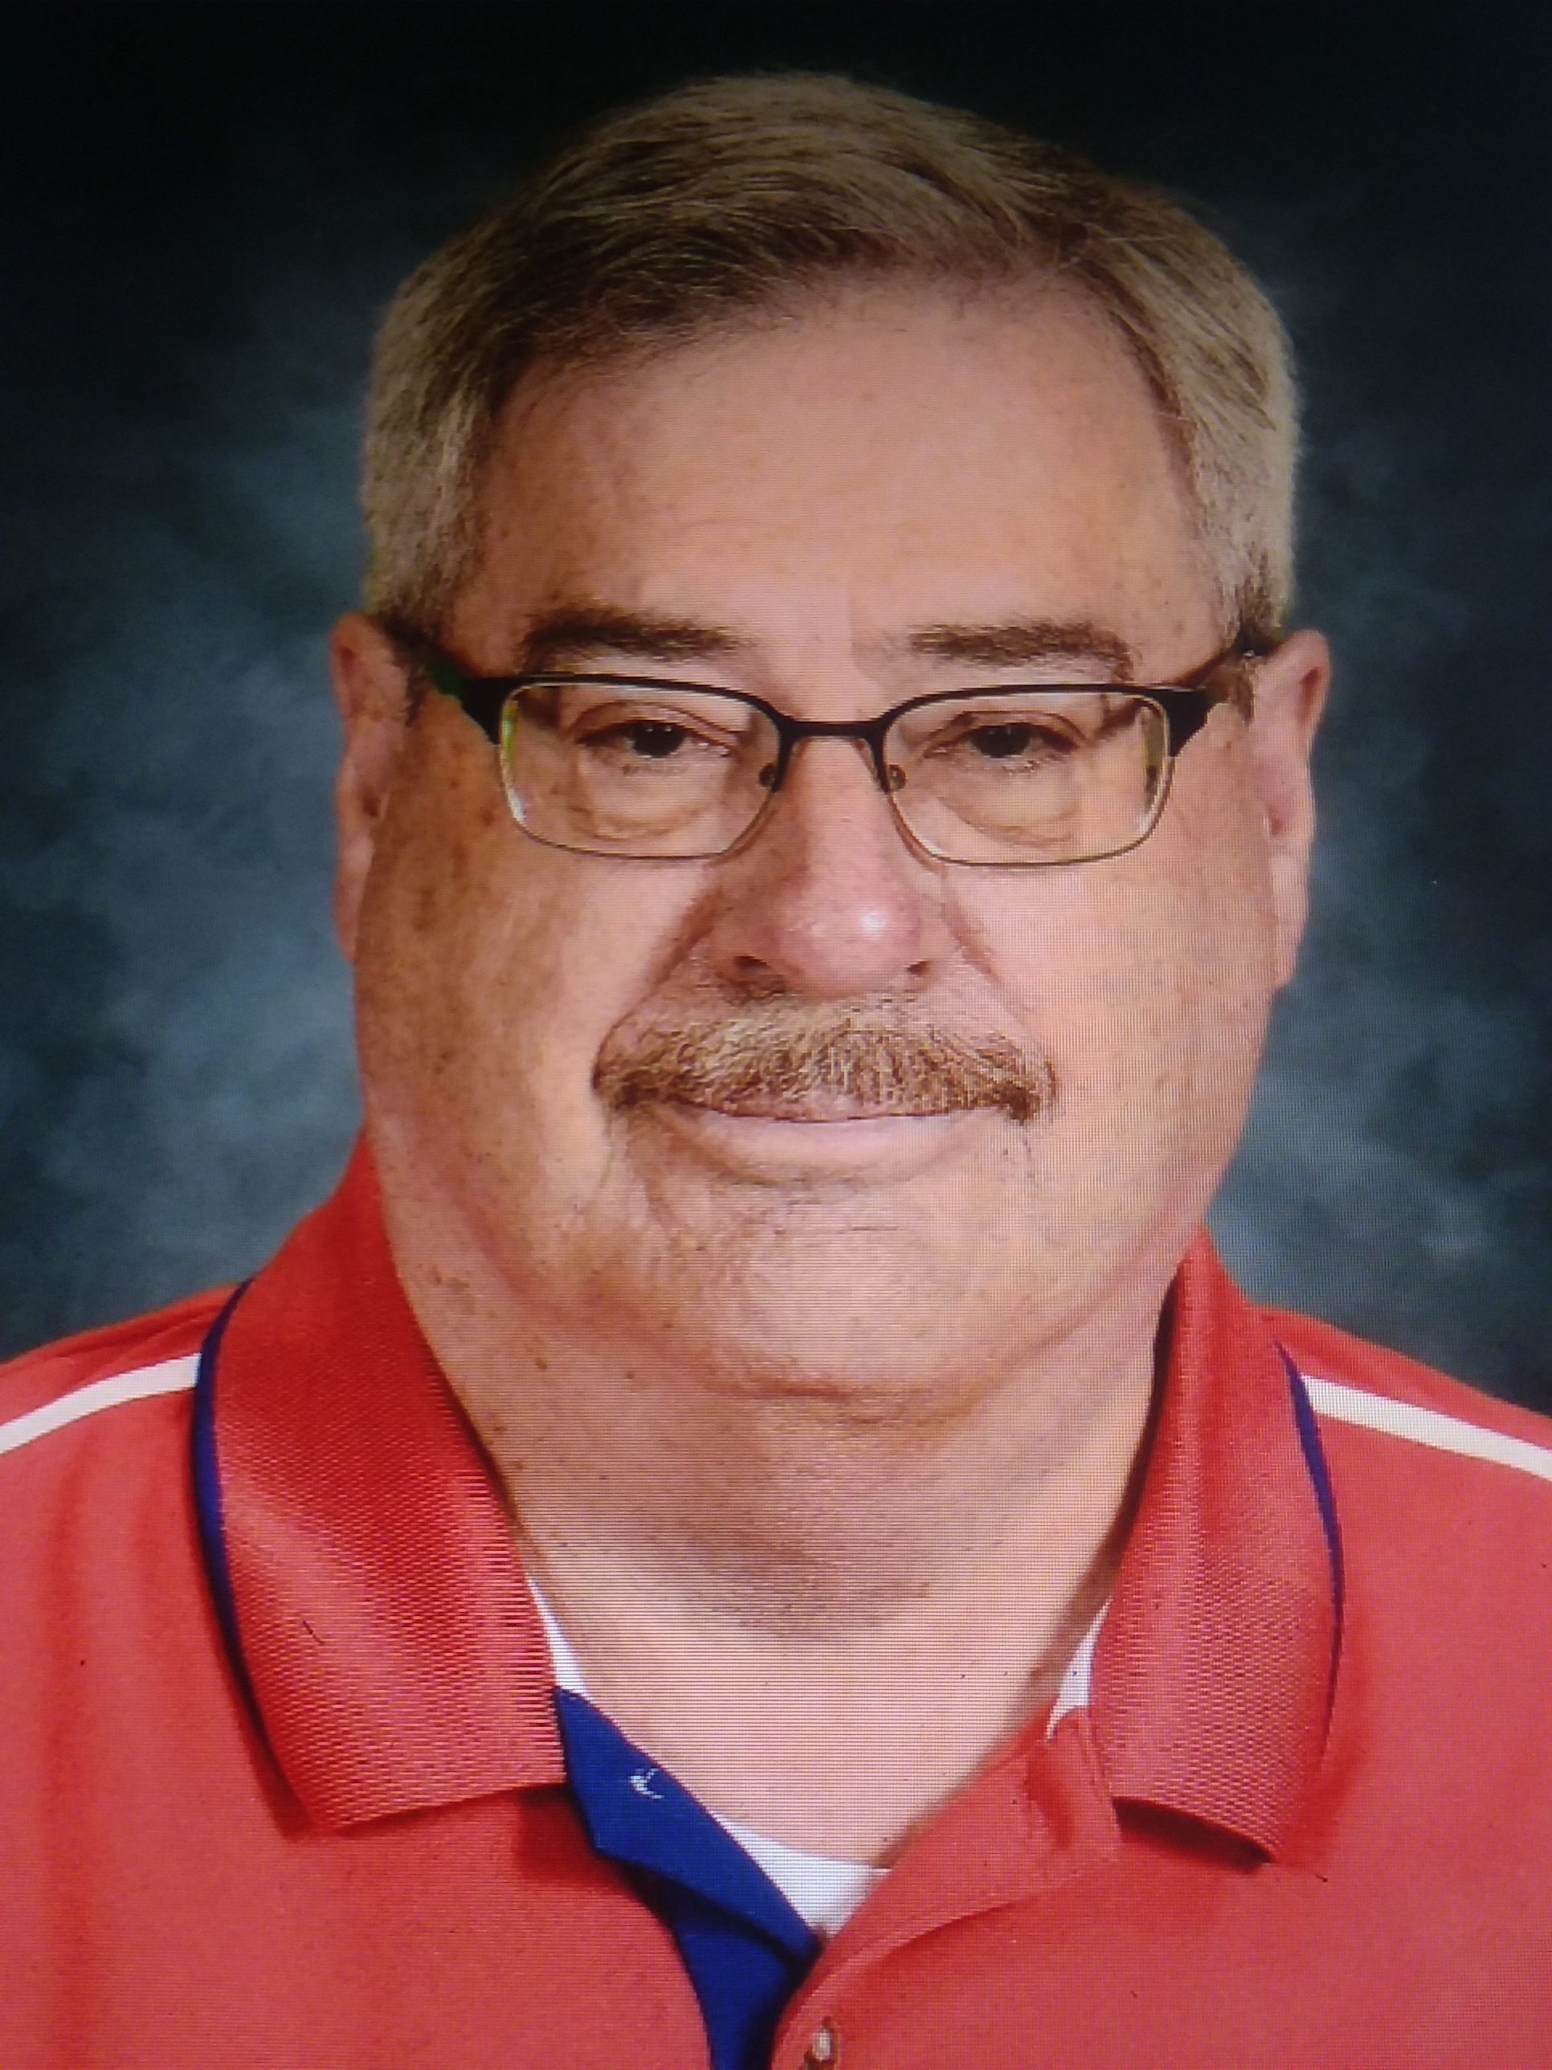
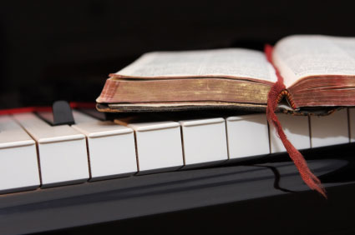
The End…
Paul’s Christ is my Christ!
Prepared and presented by:
Mikel Paulson
2 Gretchen Ln, Bella Vista, AR 72715
509-876-1611
www.scatteredchristians.org
www.paulson1611rd.org
sousaman1611@cox.net
…but only of this presentation.
Is he yours?
Hopefully, this also begins a new level or maybe even a ‘new beginning’ in your life based on what you have just learned from the Risen Christ… and especially because of the “goodness of God” as taught only by Paul and found only in a King James 1611 Bible…
…knowing that the goodness of God leadeth thee to repentance
Romans 2:4b
NOT the severity of God – Romans 11:22

Slide 28
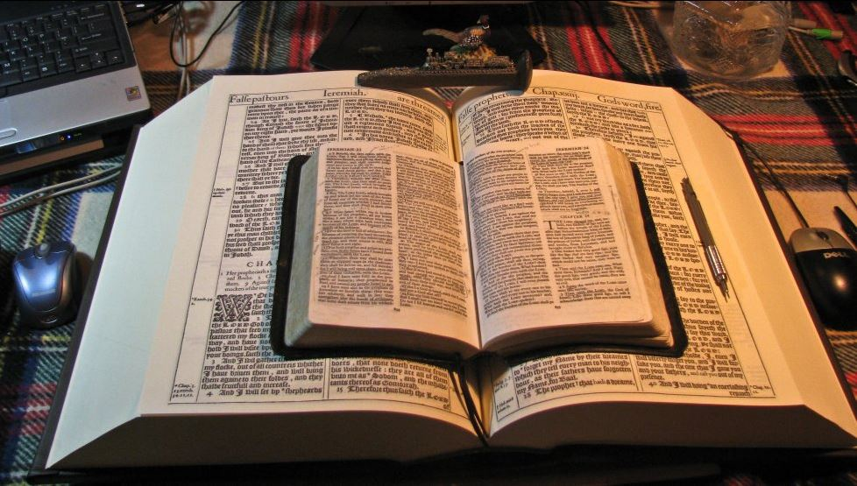

Slide 29
The grace of our Lord Jesus Christ be with you all. Amen

